Slide 1
Poster Template Instructions (delete this slide once you are done making your poster)
The purpose of this poster template is make it easy to display your conservation work. But this is just a template, and we encourage you to have fun with it! Feel free to:
Change the background & font colors;
Change the layout by moving or resizing the text boxes;
Rename the section headers or add additional sections to include information relevant to your work;
Add lots of pictures & graphics;
Add your organization’s logo;
Do whatever you think best conveys your work.
Other important recommendations:
Use san-serif font (e.g. Arial or Helvetica);
Use font size that is larger than 24 point;
Use short, concise sentences;
Use bullet points or very short paragraphs;
Make sure font type & size is consistent throughout the poster;
Make sure the background & font colors have high contrast so that text is legible;
Avoid using tables when pictures or graphics can be used instead;
Don’t forget to go into Format in the menu bar above and use the Align option to align text boxes and figures/tables to create a clean look to your poster.
To edit text in the template, simply highlight the current text and replace it with your own.
To add pictures or graphics, simply copy and paste into PowerPoint. Use Paste Special in the menu bar above to experiment with different pasting options that best display the image/graphic.
Make sure your figures look okay on your poster by viewing it at 100%. Scroll around to see if the images look good. If not, they won’t look good in final print.
Use the Group/Ungroup tool under the Format tab in the menu bar above to help keep images or text boxes together in a figure, as is done in the template figures.
The only aspects of the poster template that we ask you to keep the same are the poster size and the format of the logo section at the bottom.

Slide 2
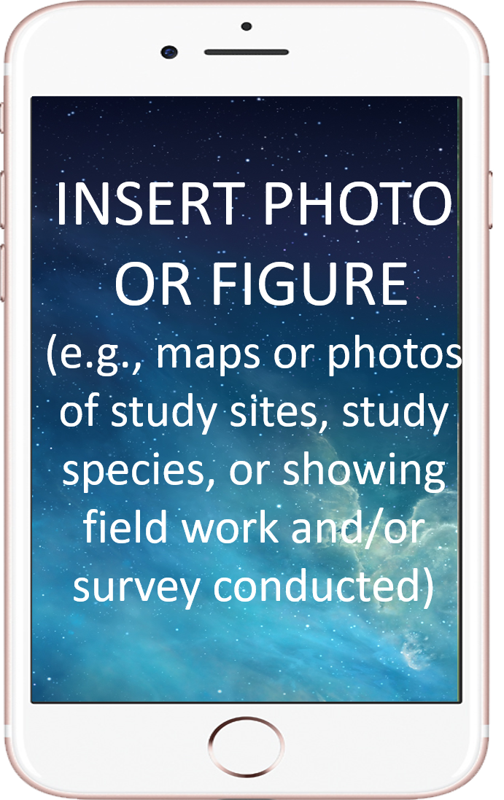
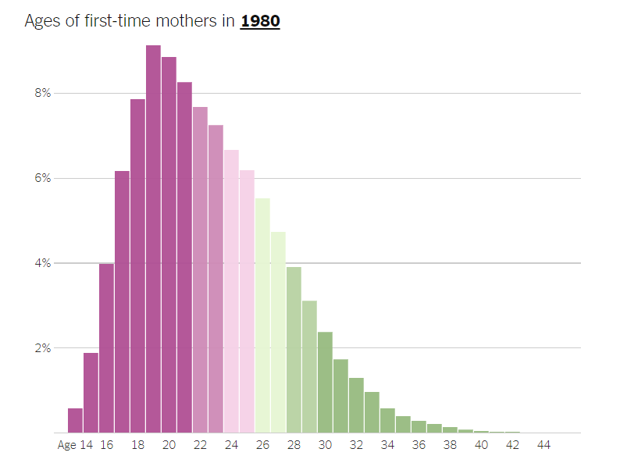
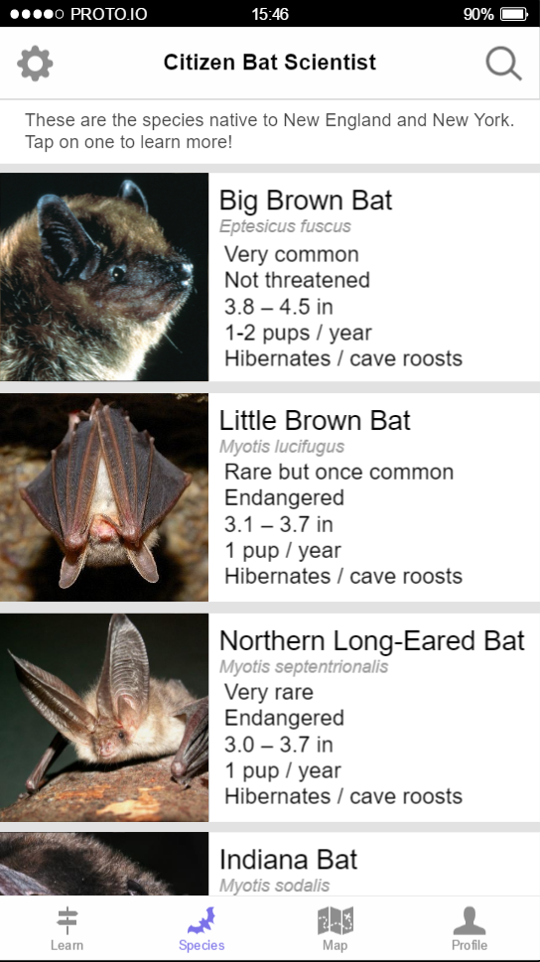
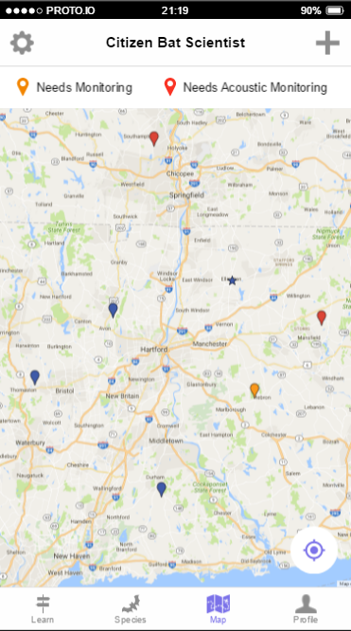
SHORT TITLE GOES HERE
CTP Participant Name¹ & CTP Participant Name²
¹CTP Participant Affiliation; ²CTP Participant Affiliation
Introduction & Objectives
Describe the overarching problem or issue your project is addressing. In other words, what is the broader issue that is motivating this project?
Make sure to provide essential background information on the issue that your work is addressing.
This section is vital for conveying to a layperson the importance of the project.
Clearly state how your project will address the focal question or issue, and list objectives/goals of the study:
Objective 1;
Objective 2;
Etc.
Fig. X. Include a brief description beneath each figure.
Methods
List the steps you took to complete the project.
Important things to include in this section are:
Location;
Time of year and duration of project;
Description of environment at sites or study organisms;
Techniques, procedures or tools used to carry out work.
If you had multiple parts to your project, you may want to consider separate Methods sections and rename the section headers.
(a)
(b)
Fig. X. Brief description of each figure. If there are multiple parts, label one (a), the other (b), etc. Refer to the figure in the section’s text. Number figures in the order they are referred to in text (e.g. Fig 1, Fig 2, etc.).
Results or Products
The results section should include several figures.
The more figures, the better. Use figures rather than tables.
Briefly describe major findings, results or products depicted in the figures.
Major finding 1;
Major finding 2;
Major finding 3;
Etc.
This is where you’ll show your really cool data!!
Fig. X. Don’t forget to include a brief description beneath each figure.
Conclusions or Next Steps
In this section the reader should take away the implications of the findings of the study. You should provide interpretation the findings.
You may also want to explore how the findings can inform management or conservation policy?
Or you could use this section to discuss future directions of work that builds off your project.
The more photos or graphics to catch your readers’ eye, the better!

