Slide 1
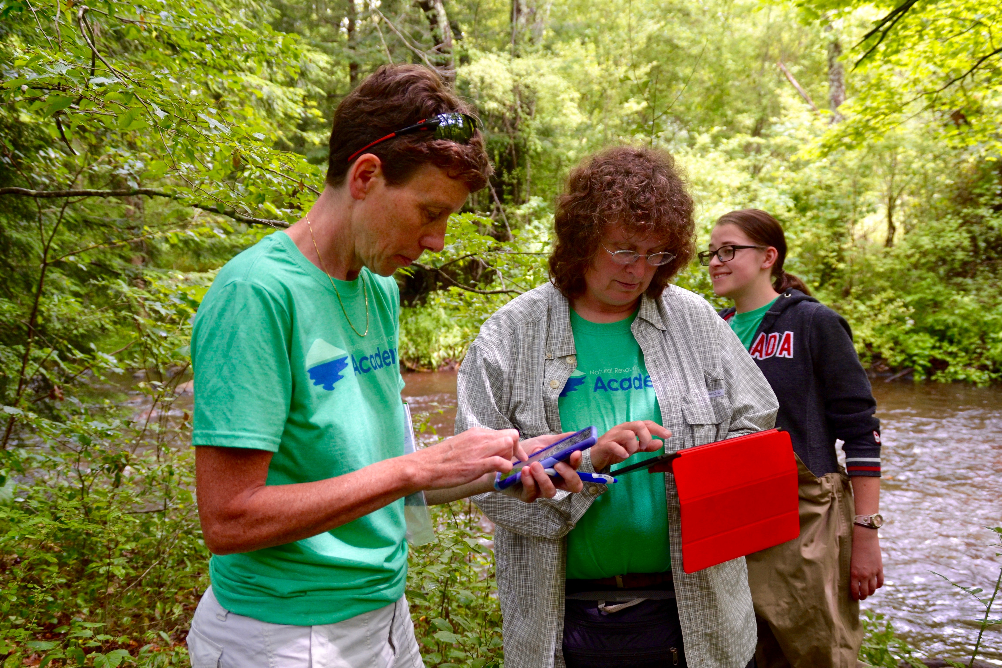
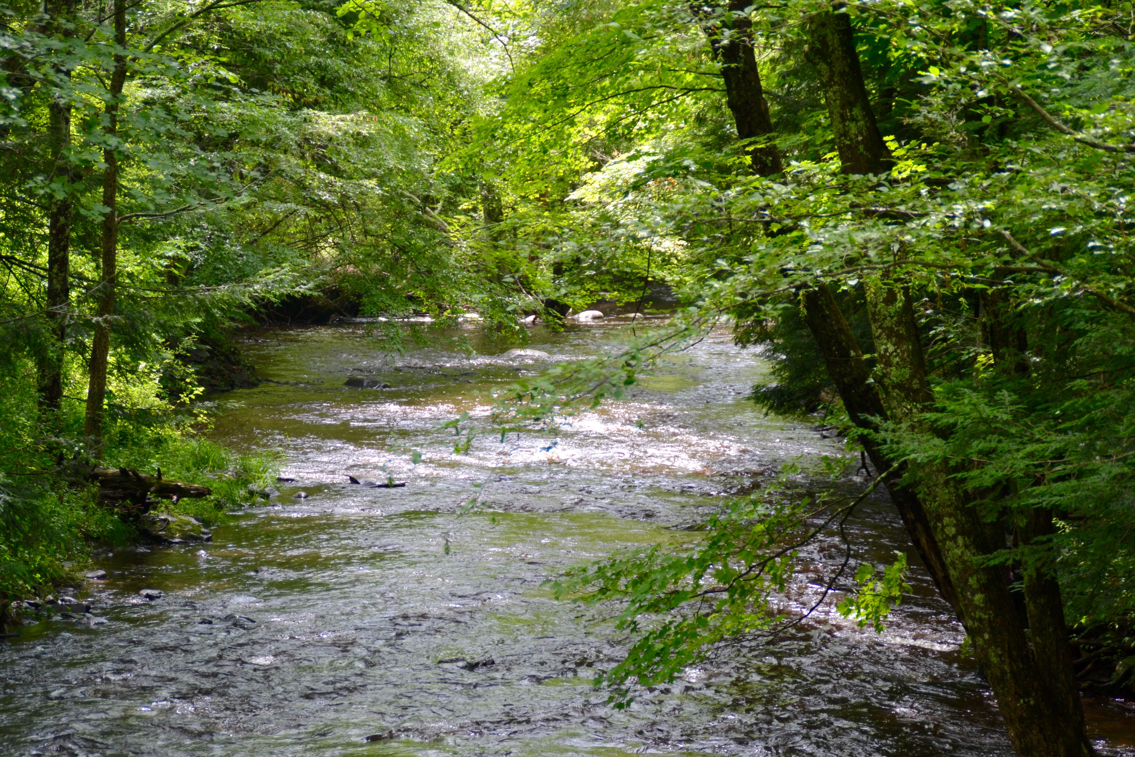
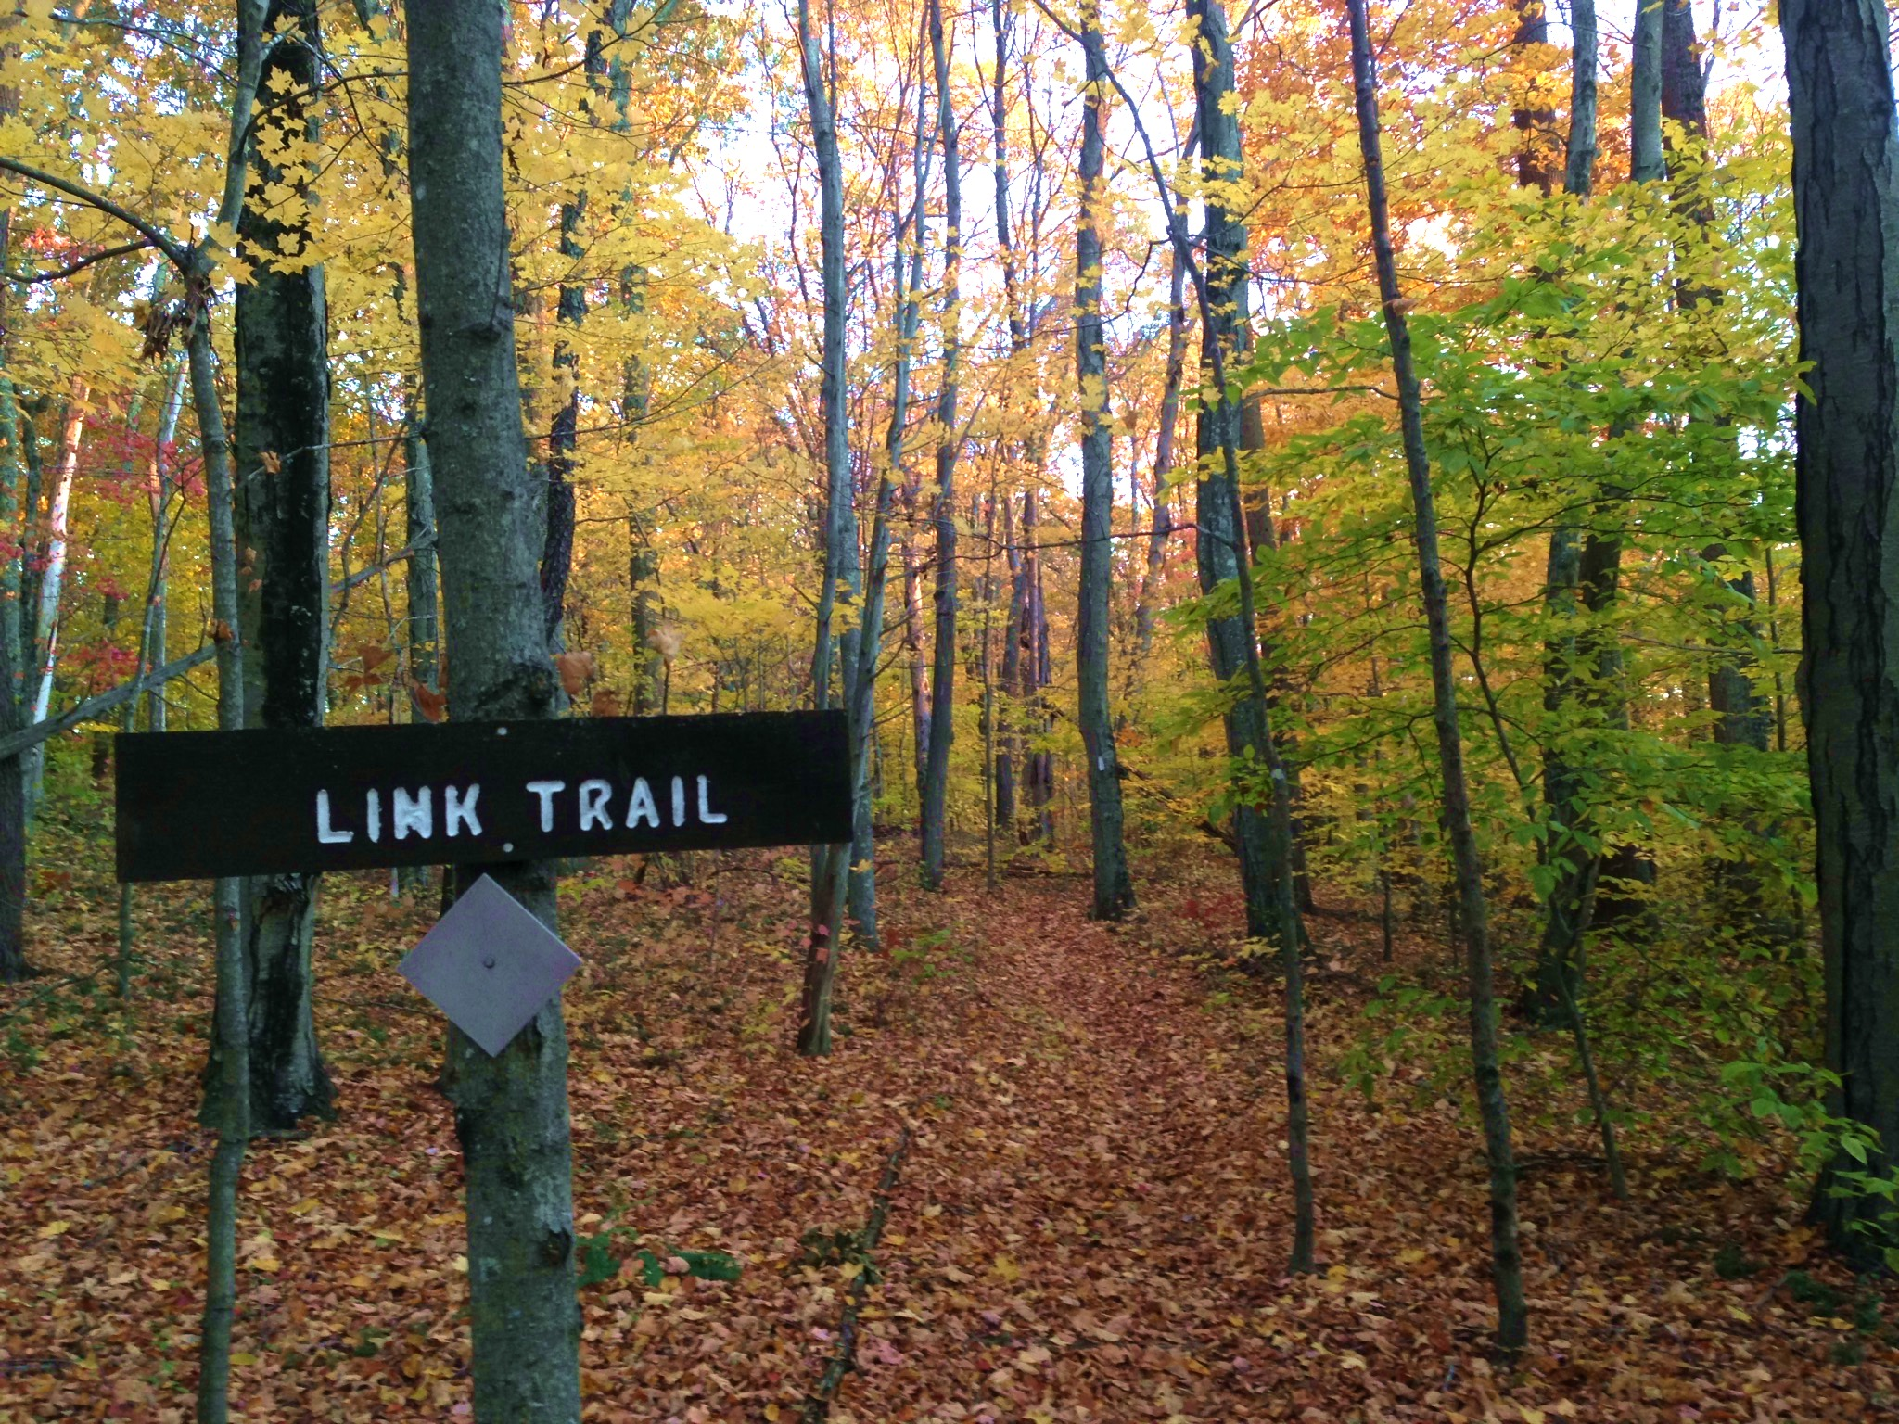
LAND & WATER
our field results
water
land
water & land

Slide 2
LAND & WATER
our field results
water
land
water & land

Slide 3
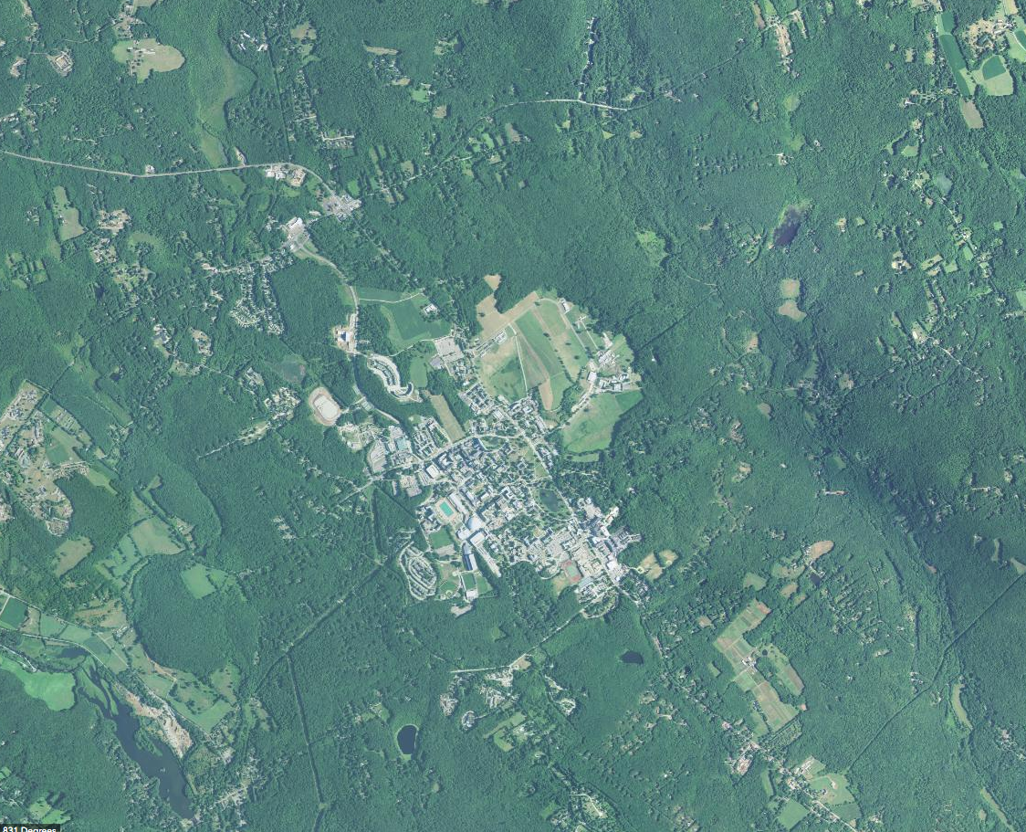
Fenton
Roberts
Eagleville

Slide 4
Watersheds all 3 on same map here

Slide 5
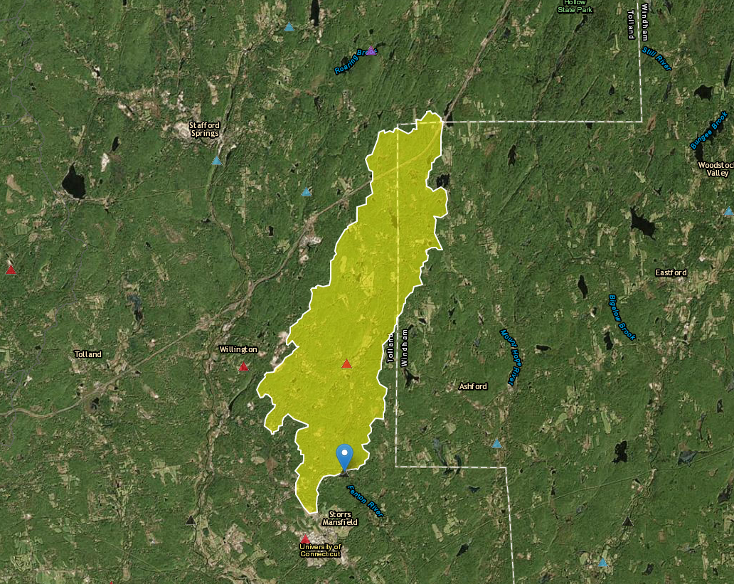
Fenton River
Fenton | Forest
drainage area | 19.2 mi²
% developed | 8%
% impervious cover | <1%
% wetlands | 1.7%
Forested Watershed
from USGS “StreamStats” tool

Slide 6
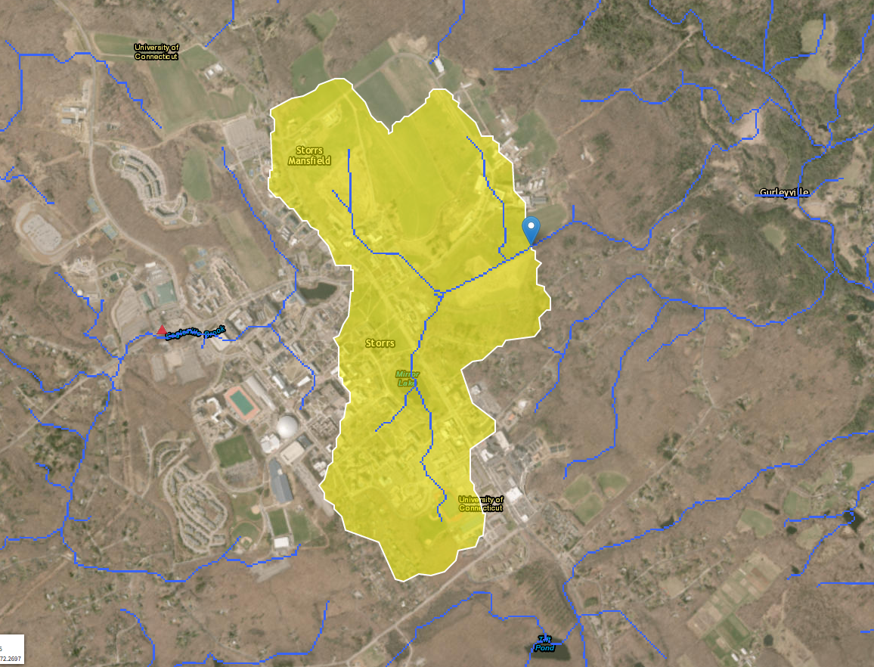
Roberts Brook
Roberts | Ag
drainage area | 0.7 mi²
% developed | 65%
% impervious cover | 22%
% wetlands | .2%
(Semi) Agricultural Watershed

Slide 7
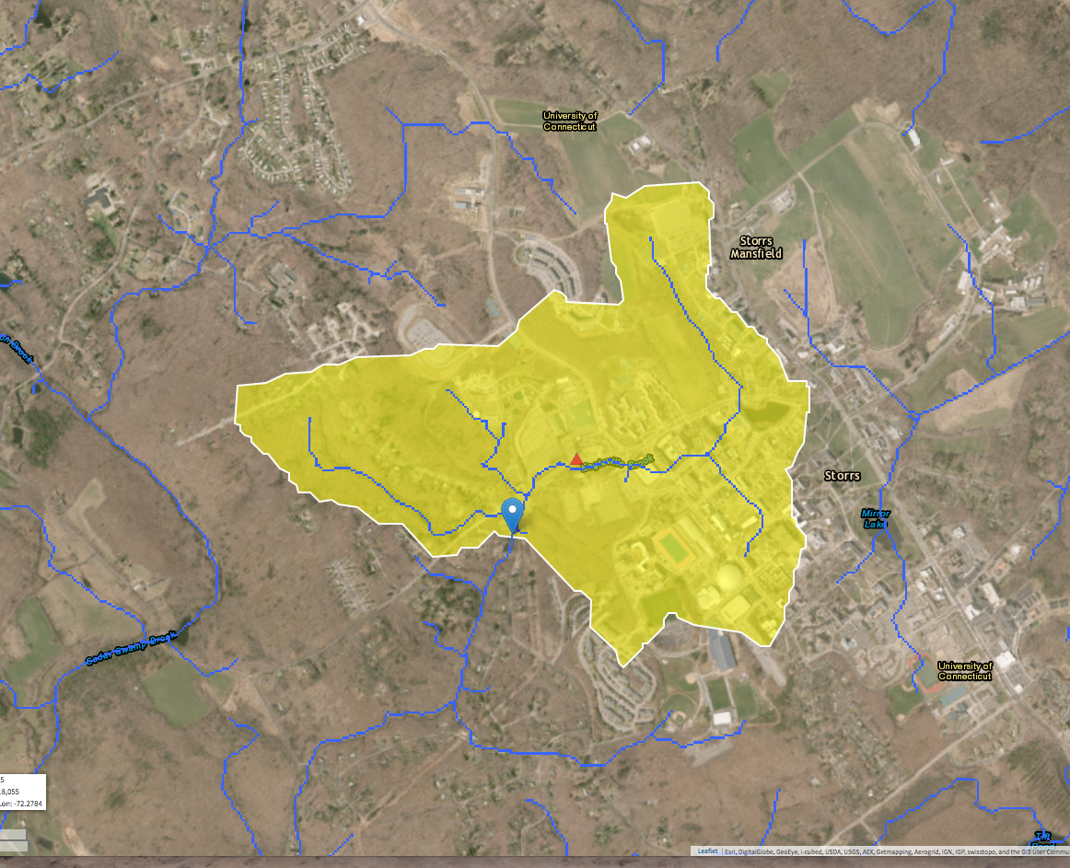
Eagleville Brook
Eagleville | Urban
drainage area | 0.8 mi²
% developed | 71%
% impervious cover | 32%
% wetlands | 1.2%
Urban Watershed

Slide 8
Fenton | Forest
% developed | 8%
% impervious cover | <1%
Roberts | Ag
% developed | 65%
% impervious cover | 22%
Eagleville | Urban
% developed | 71%
% impervious cover | 32%
TDS
conductivity
temperature
ammonia N
nitrate N
phosphate
pH
Macroinverts

Slide 9
LAND & WATER
our field results
water
land
water & land

Slide 10
Graphic: Water Cycle - Natural

Slide 11
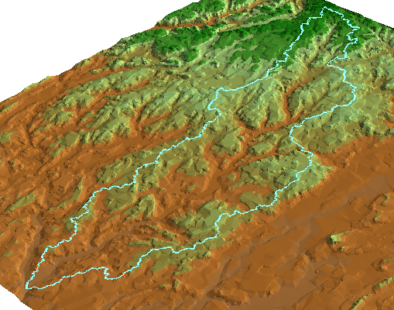
What is a Watershed?
A Watershed is an area of land that drains to a single outlet.
Notes:
Watersheds
To get a handle on this mobile and interconnected resource and its threats, it is helpful to look at watersheds. A watershed is simply the natural drainage basin on the land, with all the water in that area draining to a common outlet.
Watersheds provide a framework for looking at our resources, independent of state, county, or local political boundaries.

Slide 12
LAND & WATER
our field results
water
land
water & land

Slide 13
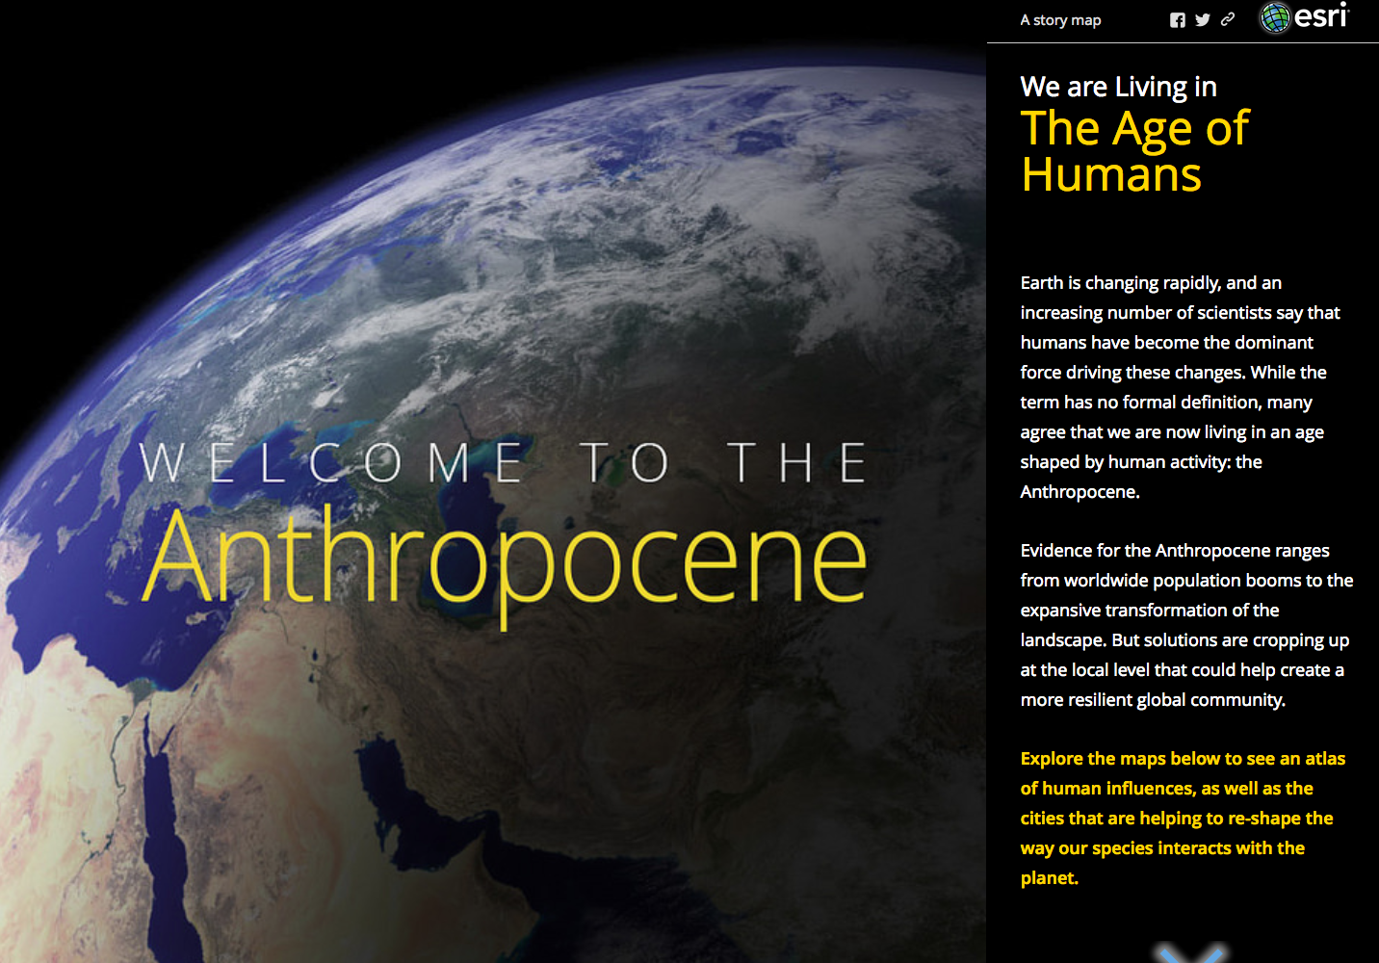

Slide 14
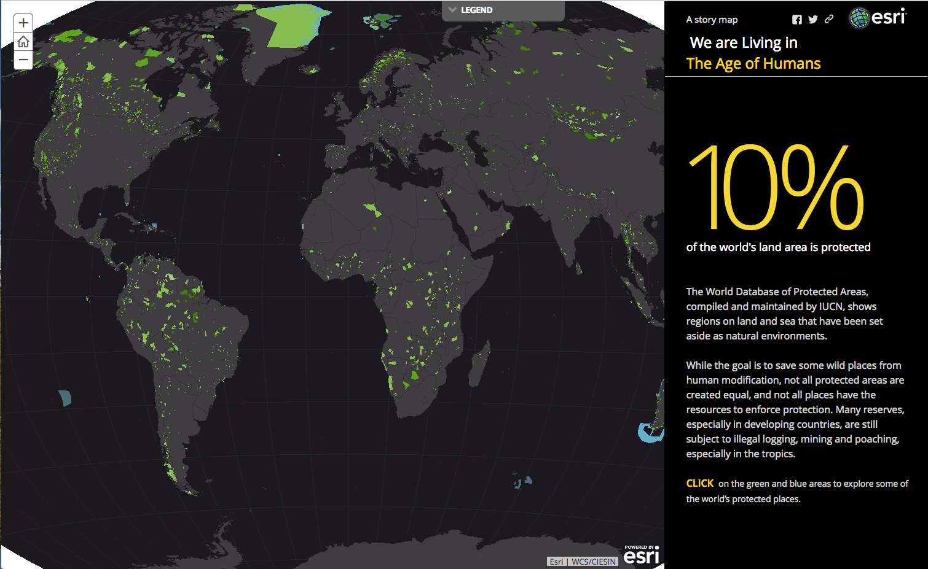
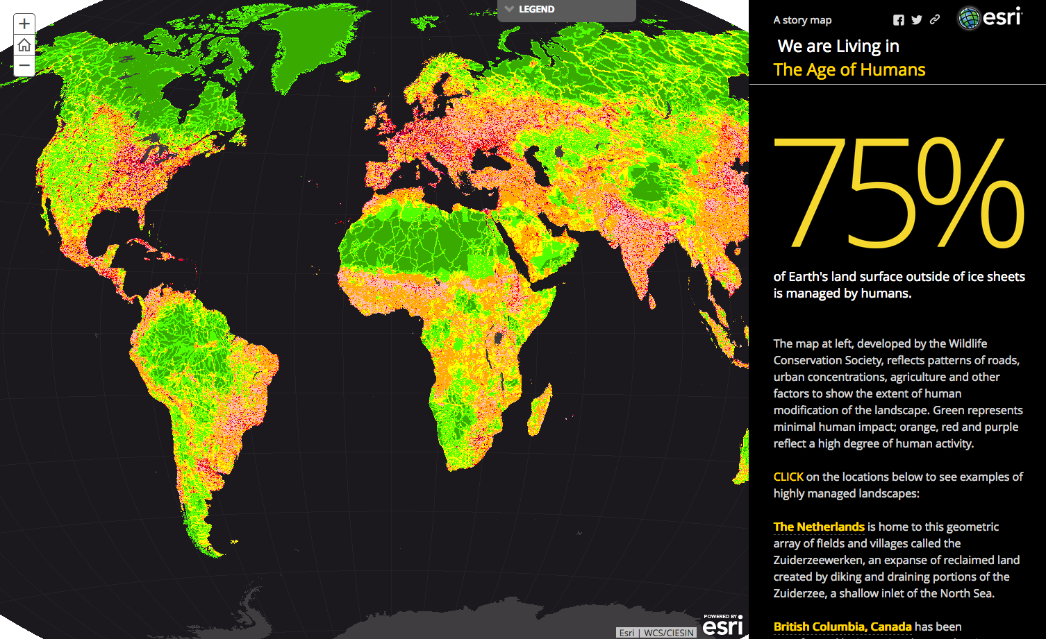
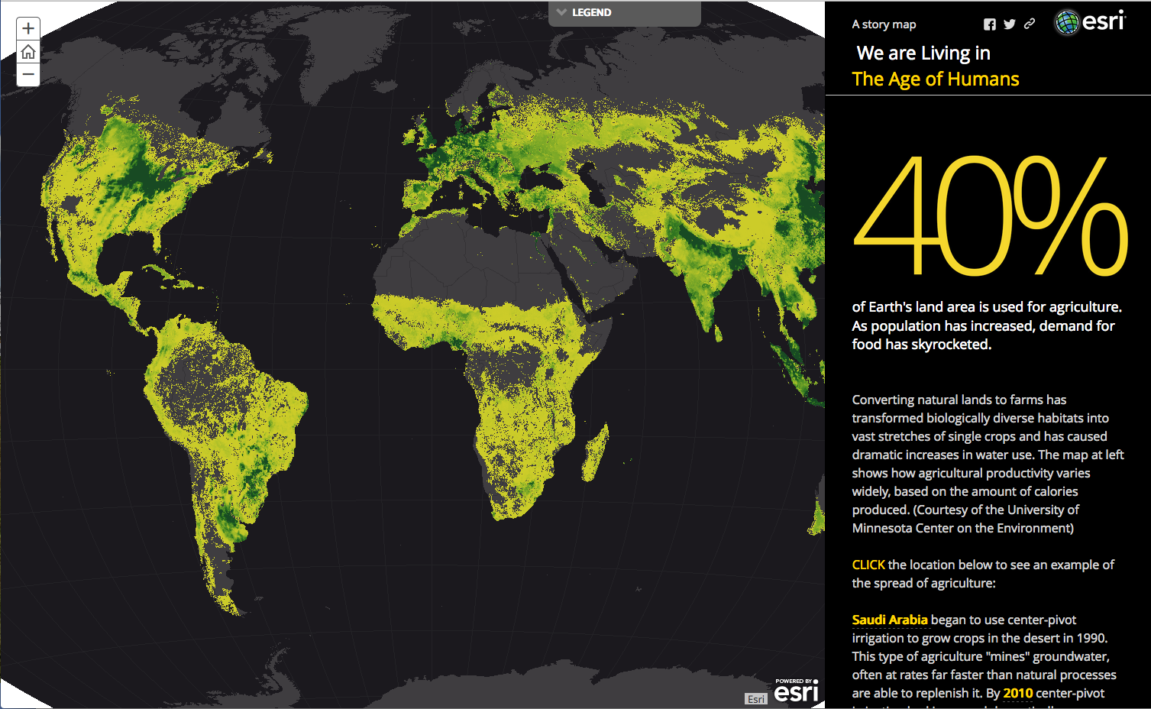
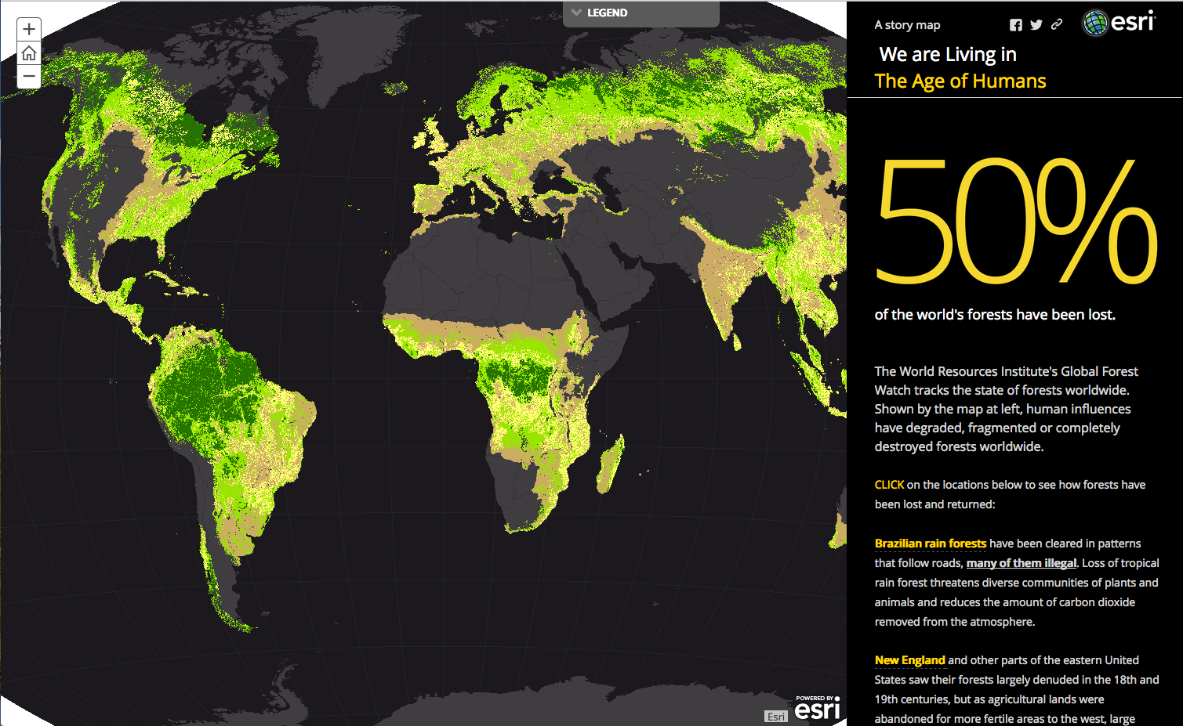

Slide 16
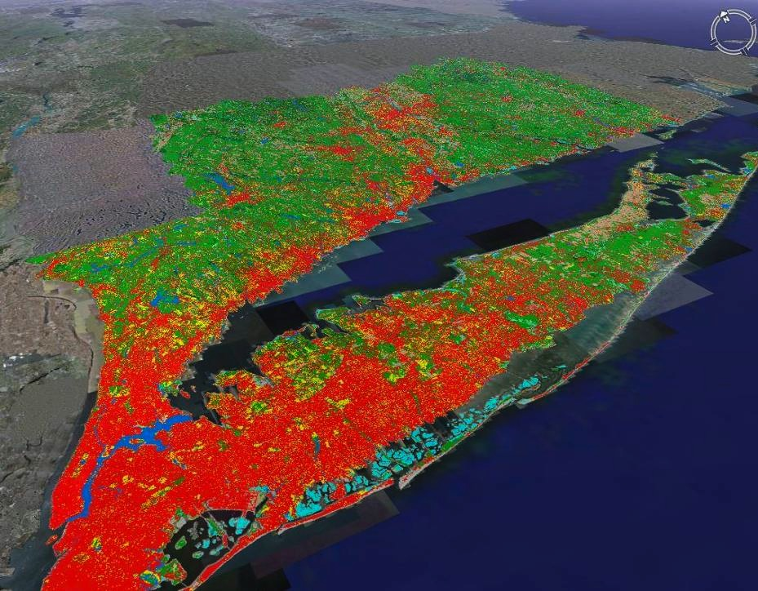
Connecticut’s Changing Landscape
30 years of change (1985-2015)
7 dates
30-meter land cover

Slide 17
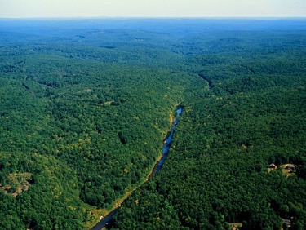

Land Cover vs Land Use
Land Cover: What is covering the land (forest, wetland, development)
Land Use: What is planned, practiced or permitted on a given area (commercial, residential, dedicated open space)

Slide 18
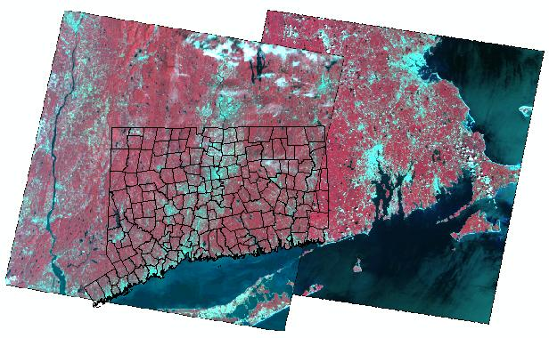
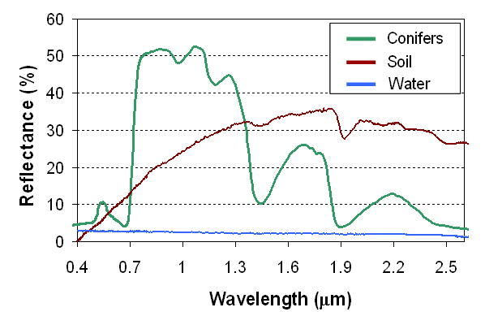
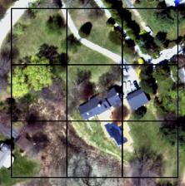
creating 30m land cover
Remote sensing uses sensors onboard satellites to capture images
Based on reflectance, satellite images are turned into land cover maps using computer algorithms and best professional judgement
The satellite captures information in 100 ft by 100 ft squares or pixels, appropriate for town, regional or state level interpretations but not fine enough for site-level studies

Slide 19
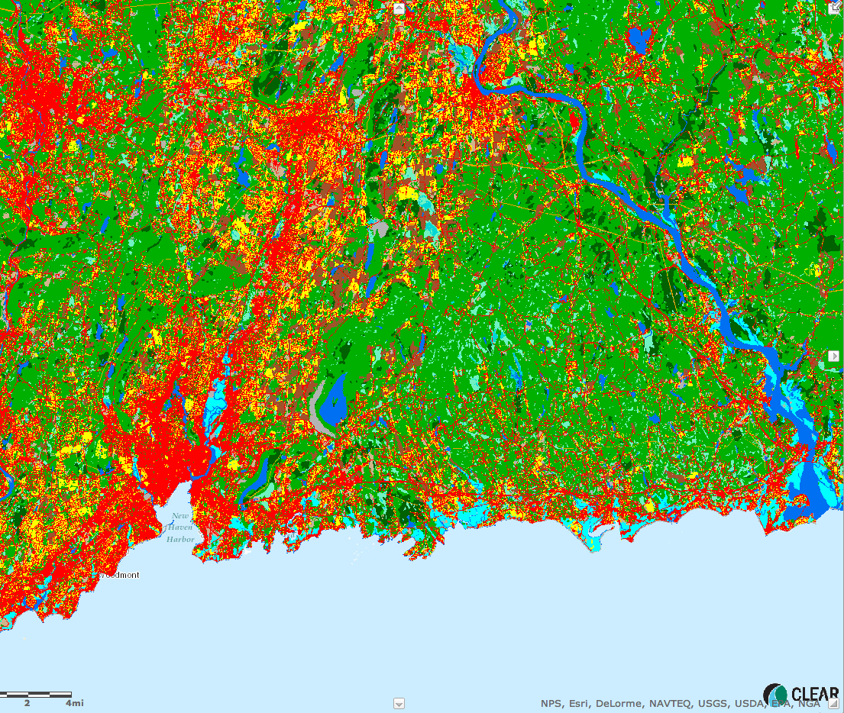
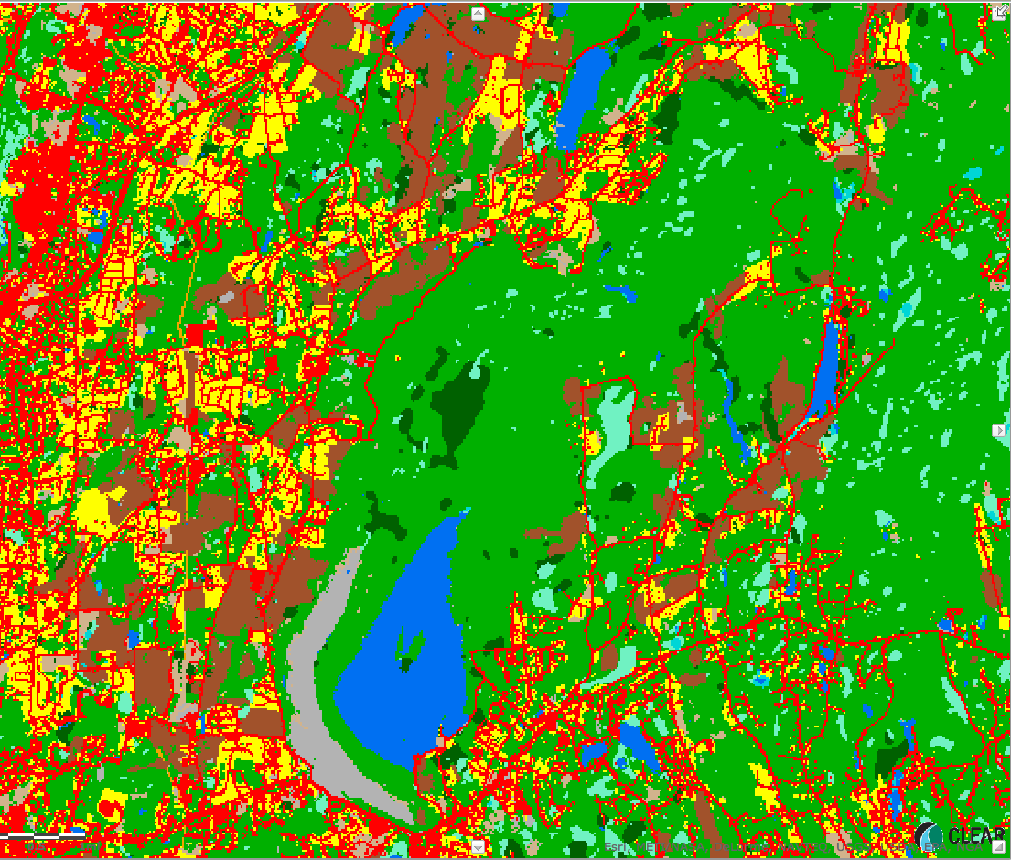
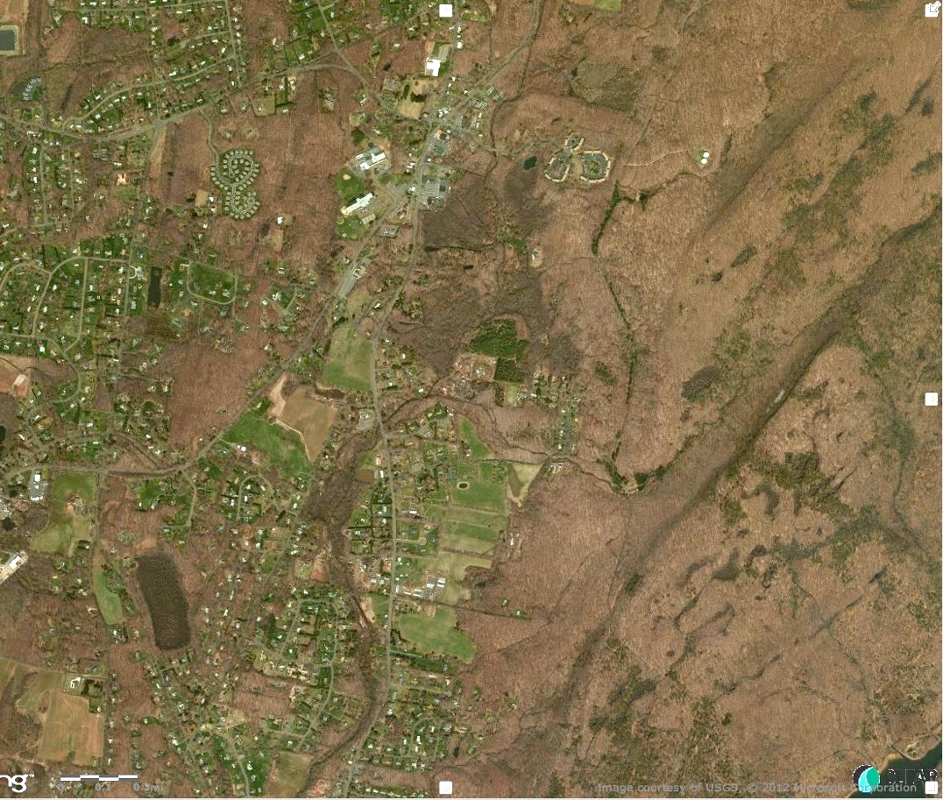
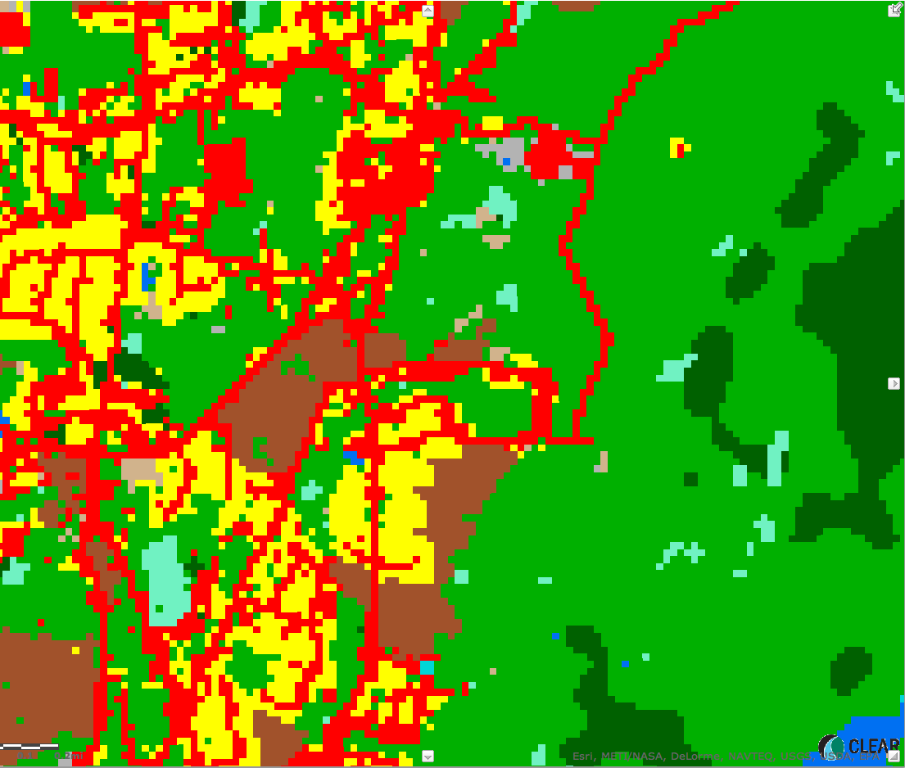
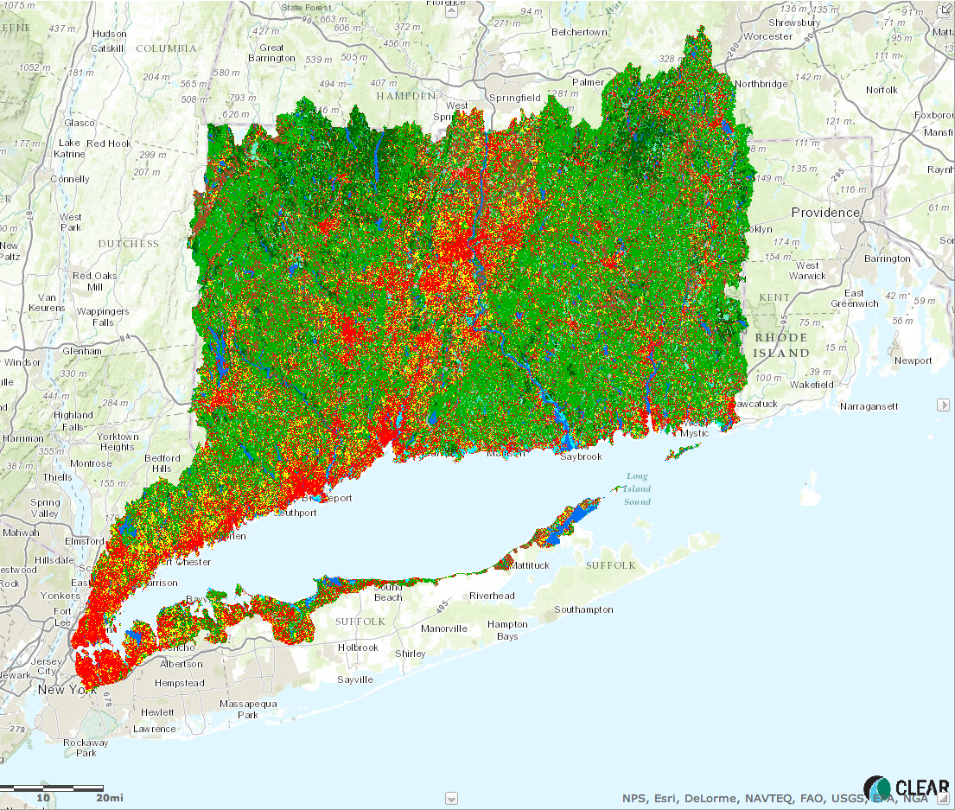
What it looks like

Slide 20
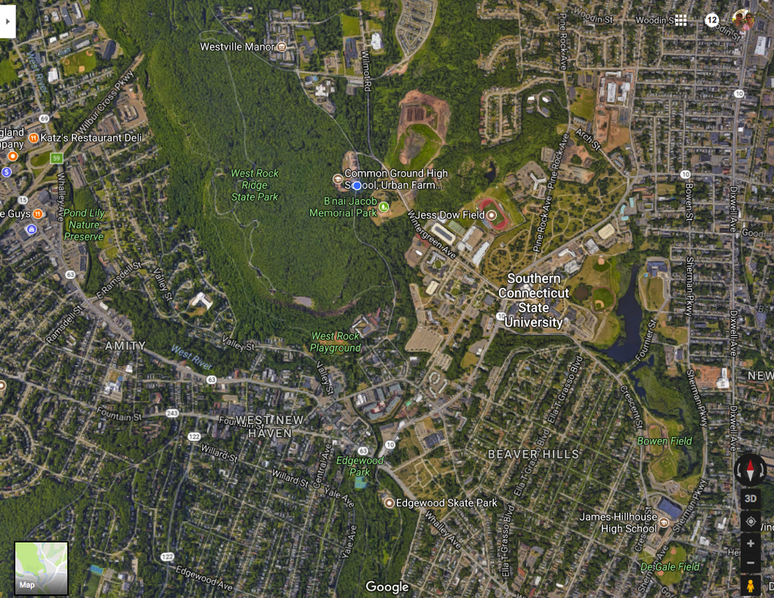
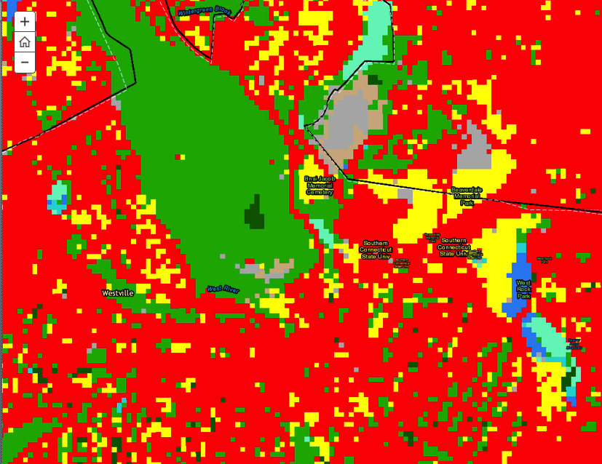
Why create land cover?
61% developed
19% forest
15% turf/grass

Slide 21
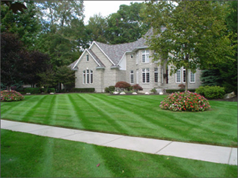
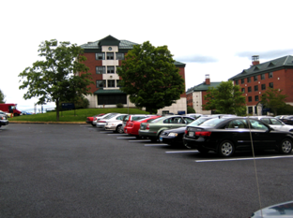
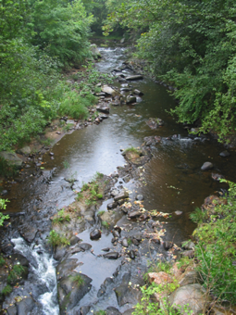
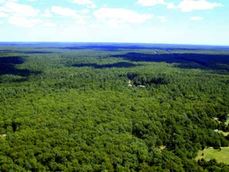
Why create land cover?
It allows us to quantify landcape change
We can cover large areas and long periods of time
It provides a unique view of the landscape for decision makers
It relates to environmental health

Slide 22
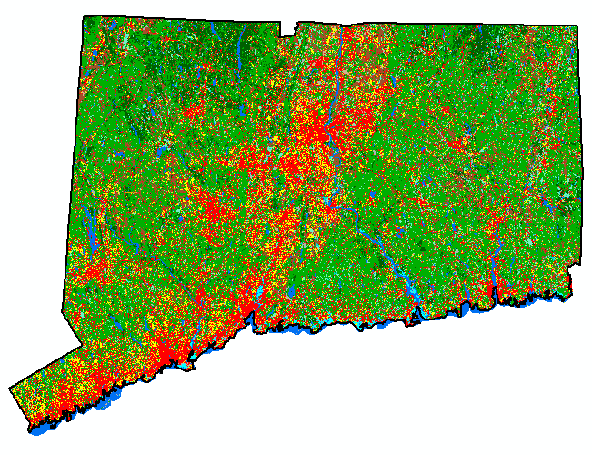
The information, part 1: STATUS

Slide 23
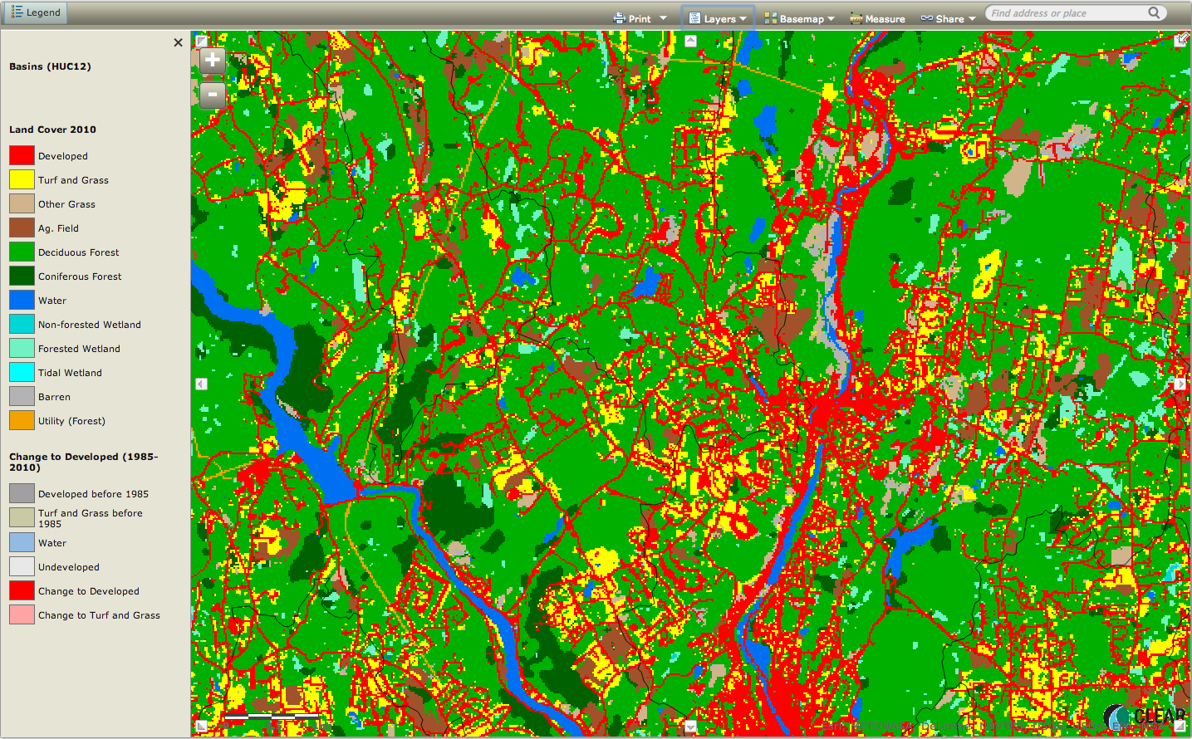

Slide 24
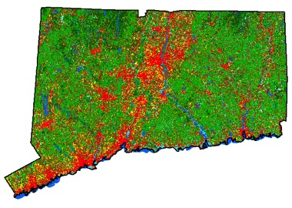
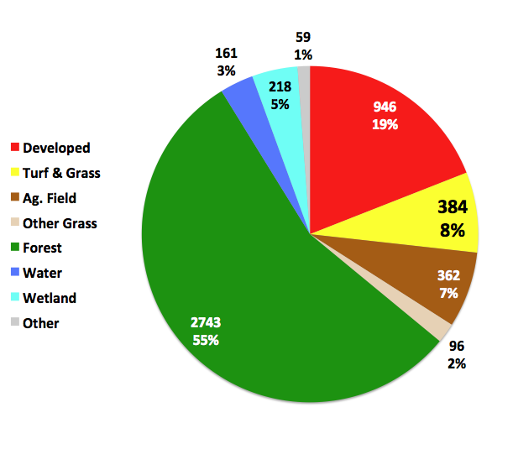
Land Cover Status: 2015

Slide 25
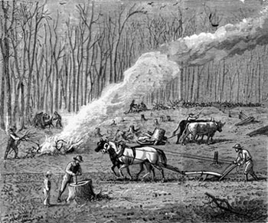
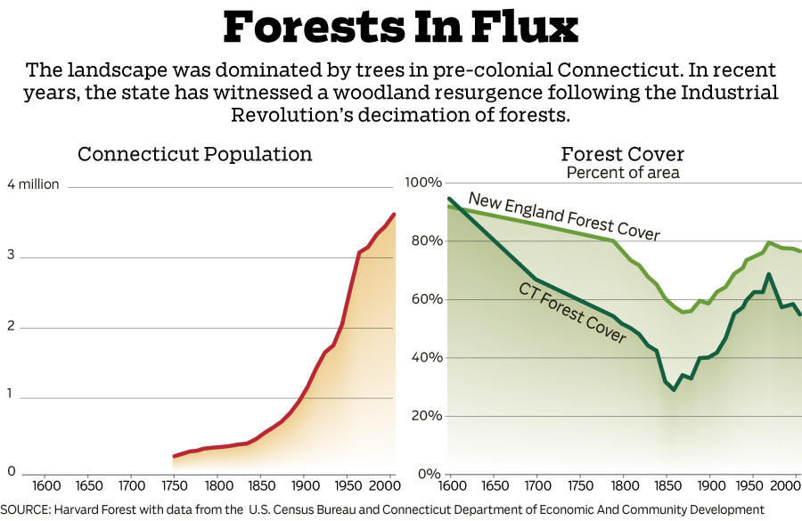
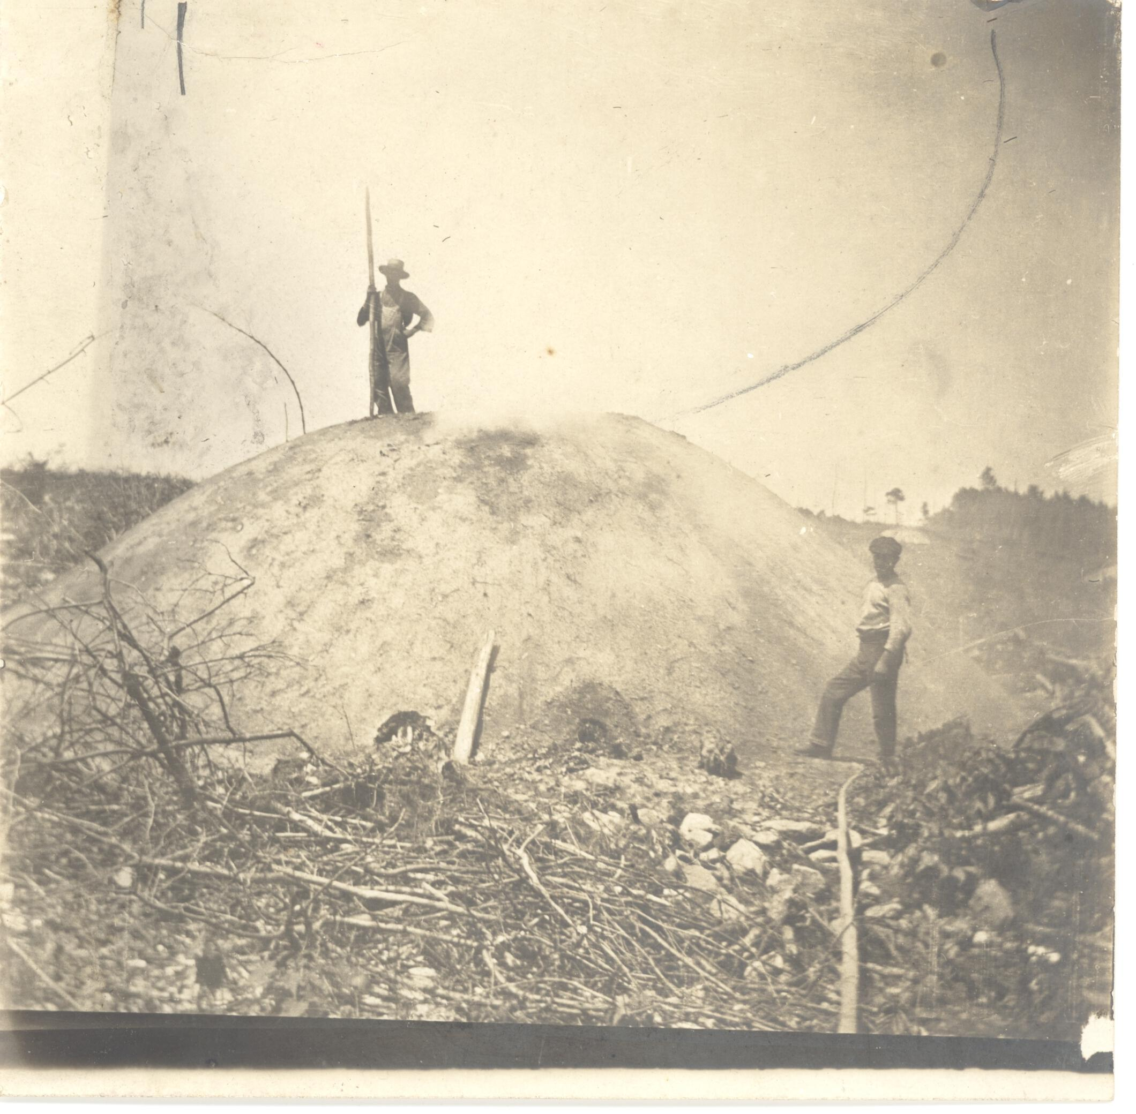
Round 1: agriculture
Henry Sheldon Museum
WNPR
Round 2: charcoal

Slide 26
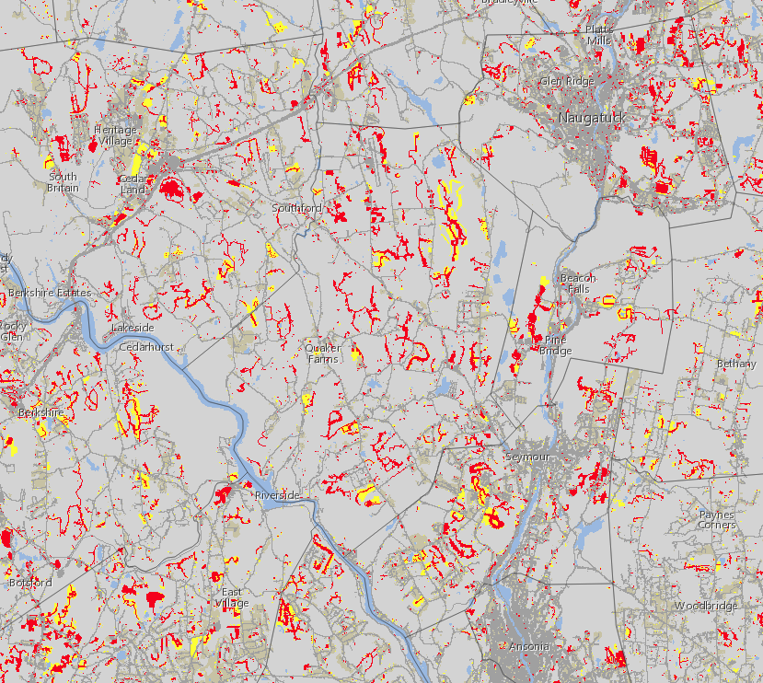
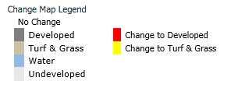
The information, part 2: CHANGE

Slide 27
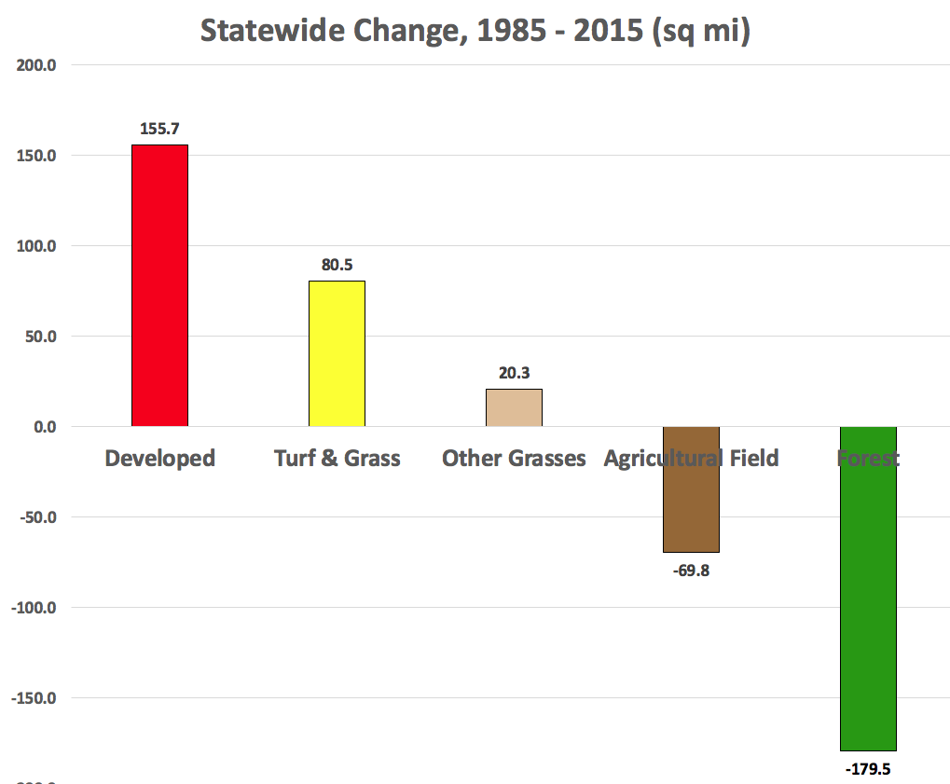

Slide 28
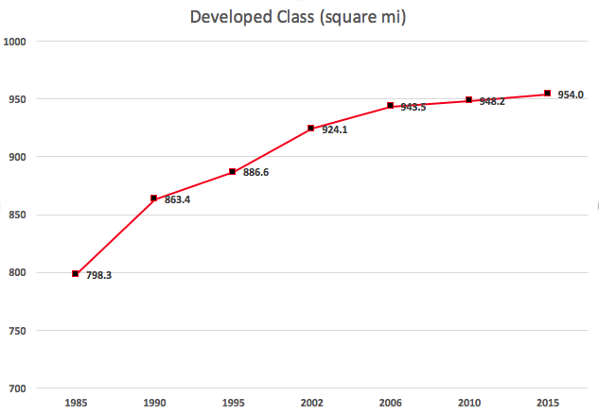
the expansion of development
Area, square miles

Slide 29
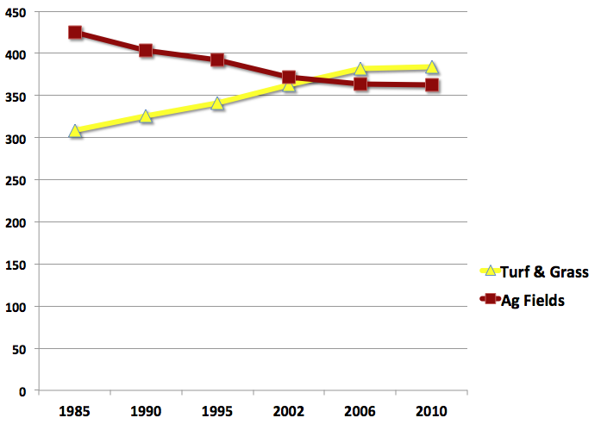
Turf/Grass vs Ag Field classes
Area, square miles

Slide 30
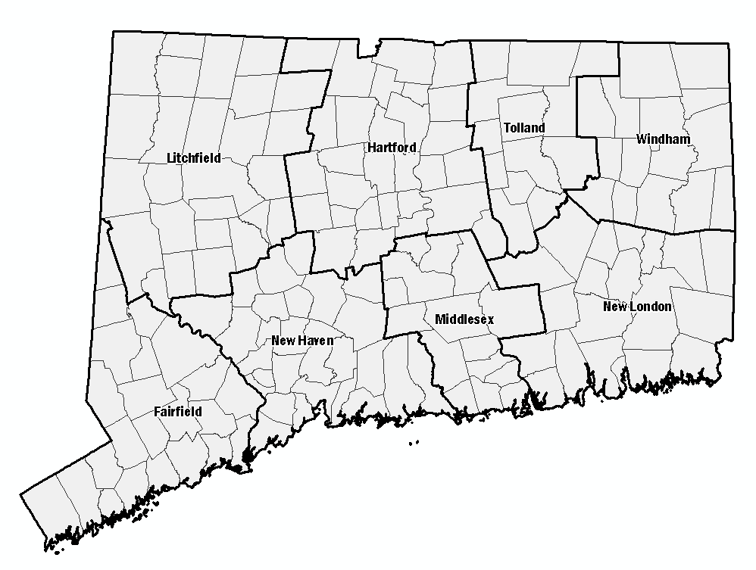
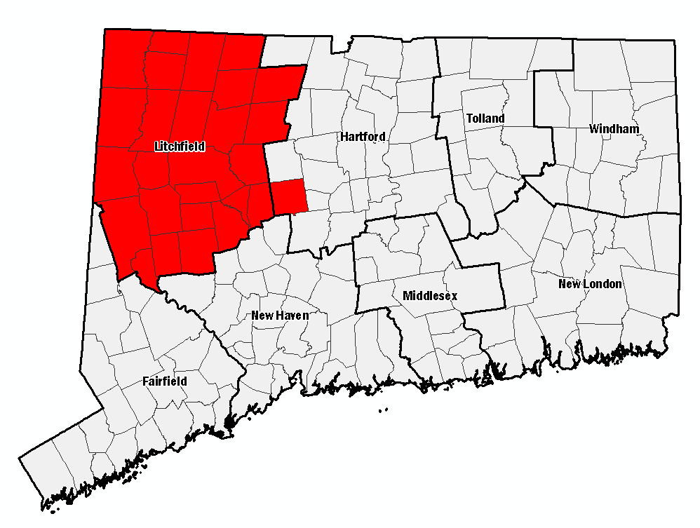
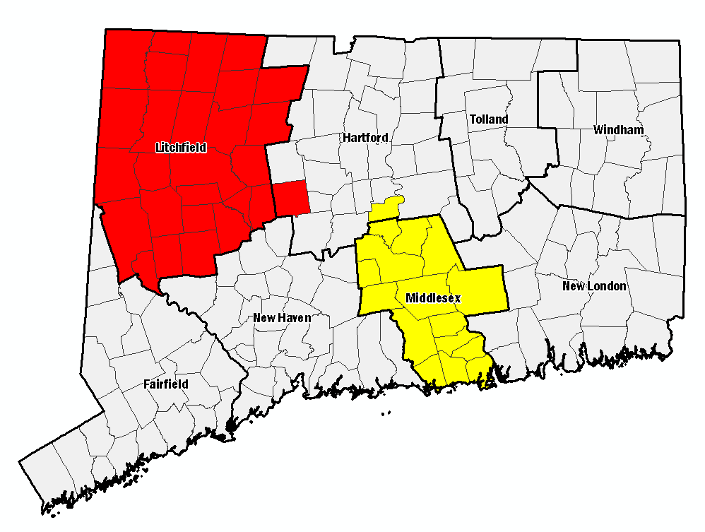
The “development footprint”(2010)
Developed = 946 mi²
Turf = 384 mi²

Slide 31
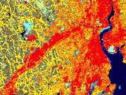
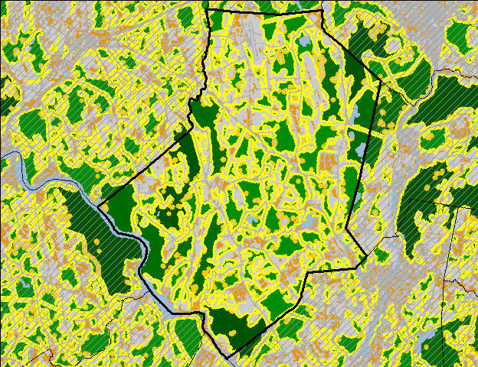
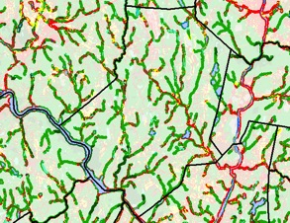
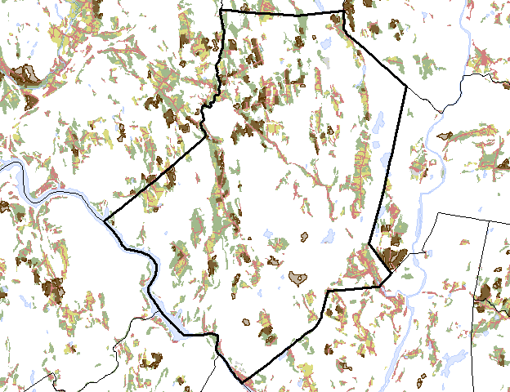
Beyond “Basic” Land Cover
Impervious Cover
Forest Fragmentation
Riparian Corridors
Agricultural Lands

Slide 32
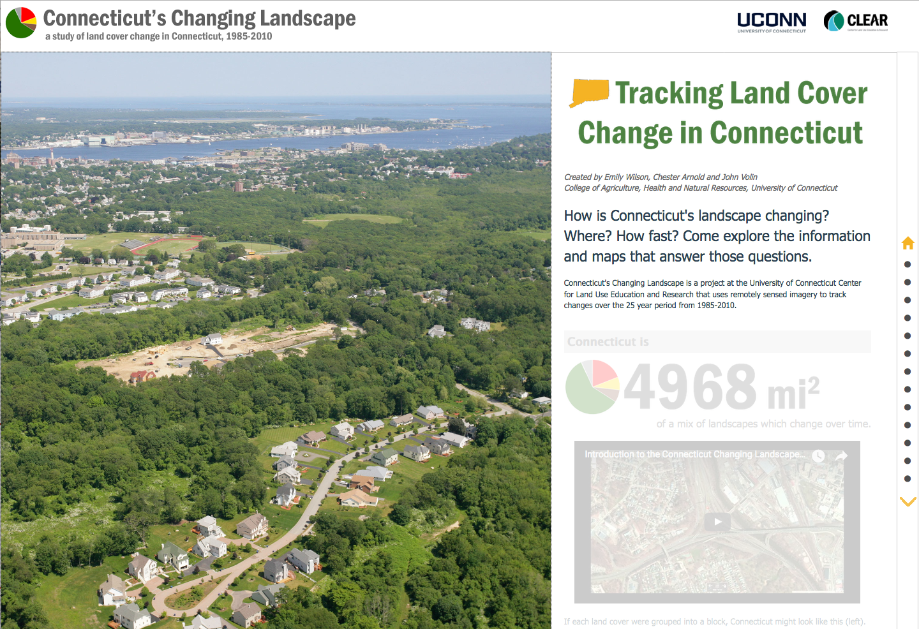

Slide 33
LAND & WATER
our field results
water
land
water & land

Slide 34
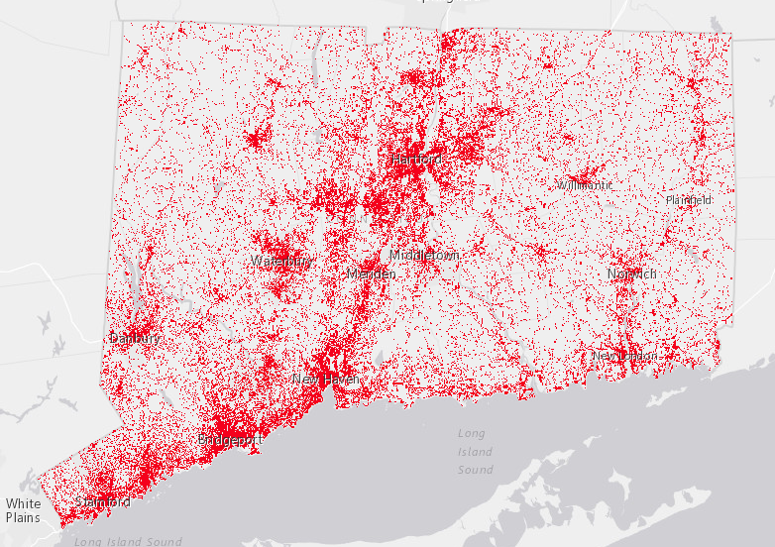

Slide 35





Impervious Surfaces
Man-made hard surfaces that prevent percolation of rainfall into the ground.

Slide 36

Impervious Surfaces

Slide 37


High resolution (1 ft) impervious cover

Slide 38

The famous (in certain circles) Impervious Cover Model

Slide 39

(EPA, 2003)

Slide 40






Hydrologic Impacts of Development
More Runoff
Arriving Faster

Slide 41

Water Quality Impacts
Stormwater is the #1 source of water pollution in the U.S.
US EPA

Slide 42




NUTRIENTS
PATHOGENS
TOXIC CONTAMINANTS
SEDIMENT

Slide 43

A few recent examples from the news

Slide 44





Slide 45


Slide 46



Slide 47

Water Quantity Impacts

Slide 48

Tropical Storm Irene (2011)
A not inconsiderable portion of Vermont travels south to Long Island Sound

Slide 49


A partial list of road closings during 2013 Colorado flooding
Photo By Tim Rasmussen/The Denver Post)

Slide 50


Harvey

Slide 51


Slide 52


Slide 53

160,000 ft² of impervious area
1 inch of rain = 99,738 gallons
Annual (48”) = 4,787,424 gallons
> 7 Olympic pools

Slide 54


Slide 55

And now, to pile on: climate change…
More rain
from the National Climate Assessment
National Climate Assessment

Slide 56

From the National Climate Assessment
And now, to pile on: climate change…
heavier storms
from the National Climate Assessment

Slide 57

More of this in our future
August 13, 2014

Slide 58

Infrastructure Meltdown
April 30, 2014
Google this!

Slide 59





Infrastructure meltdown of the geyser kind

Slide 60



All is not lost!
(But you have to wait until tomorrow…

Slide 61

this presentation
links to Anthropocene and CCL Story Maps
publications on CT’s Changing Landscape and polluted runoff
video on polluted runoff in LIS

Slide 63

Combined Sewer Overflows

Slide 64

Cities with Combined Sewers

Slide 65

May 1, 2014
“Early Thursday morning the plant experienced the highest level of water flow ever recorded…”

