Slide 1


A (brief) Introduction to Geospatial Science & CT ECO
“The location of anything
is becoming everything.”
-Geospatial Revolution Project
http://geospatialrevolution.psu.edu/
Notes:
All quotes are from the Geospatial Revolution Project out of Penn State University http://geospatialrevolution.psu.edu/

Slide 2
“We simply could not know how the earth works without geospatial technology telling us where things are, how they’re related, how it is put together to tell us the story of what’s really happening.”

Slide 3

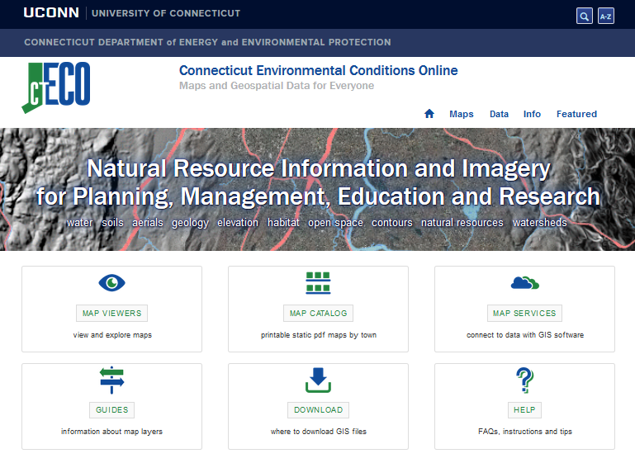


Connecticut Environmental Conditions Online (CT ECO)
http://cteco.uconn.edu
“Maps and geospatial data for everyone”
PDF maps
Interactive map viewers
Data Guides
Map services & data download

Slide 4
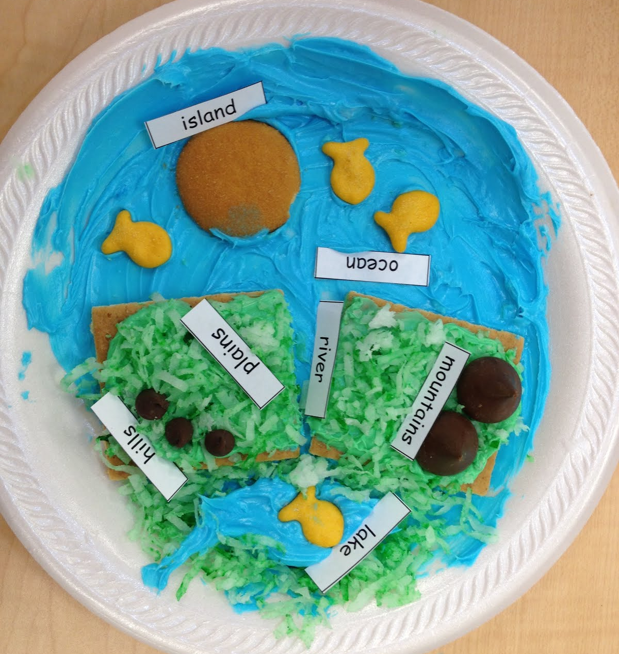
Geospatial Science
Geographic Information Systems (GIS)
Remote Sensing (RS)
Global Positioning System (GPS)
Online mapping
accurate representations of the earth
Notes:
Models of natural features (mountains, rivers, terrain models) and anthropogenic, human built features (road networks, buildings, communication towers, dams).
Model image: teachjunkie.com

Slide 5
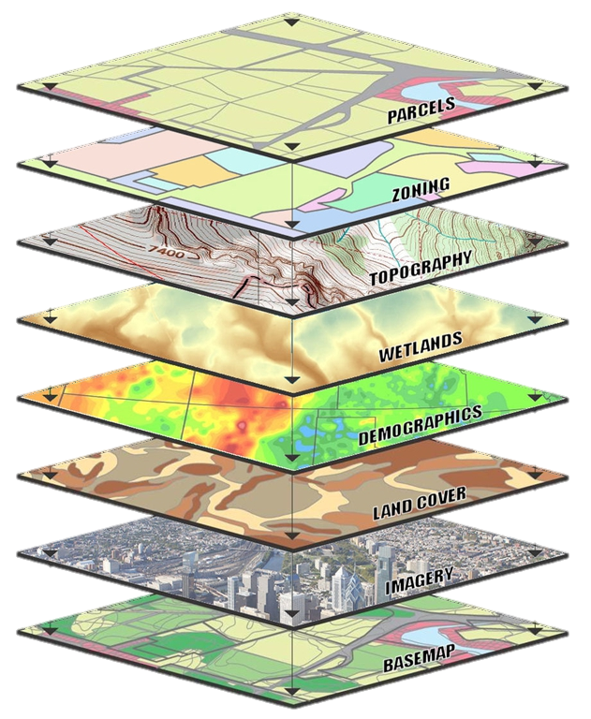
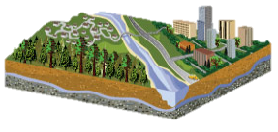
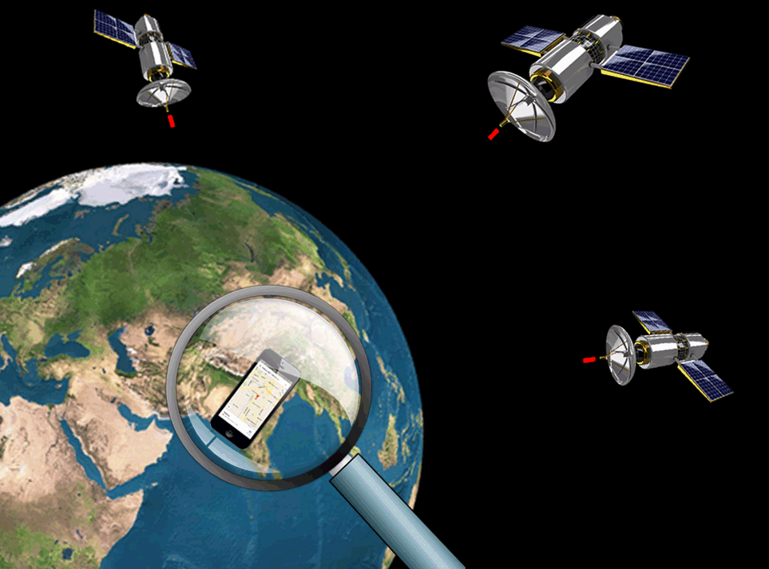
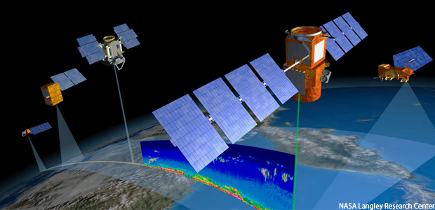
GIS
Remote Sensing
GPS

Slide 6
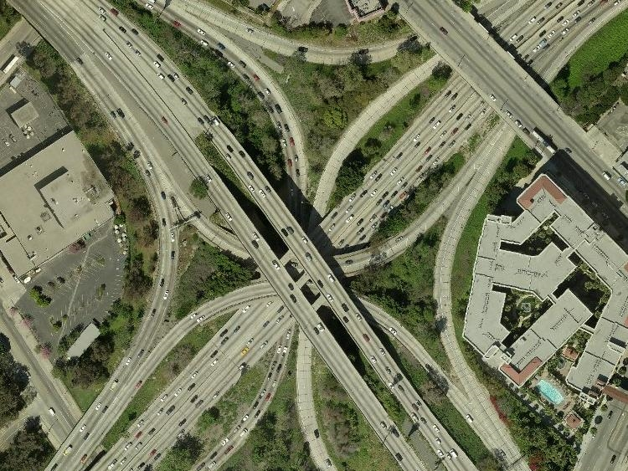
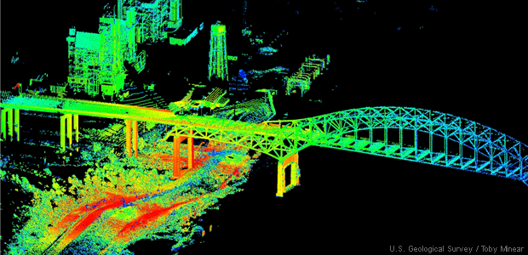
Remote Sensing (RS)
3-inch aerial imagery
3D surface model
Notes:
Sensors (like our eyes) mounted on satellites, aircrafts, even drones, collect information about our world.
High resolution imagery
3D representations of the earth’s surface
Images: NASA (top), USGS (bottom left and right)

Slide 7
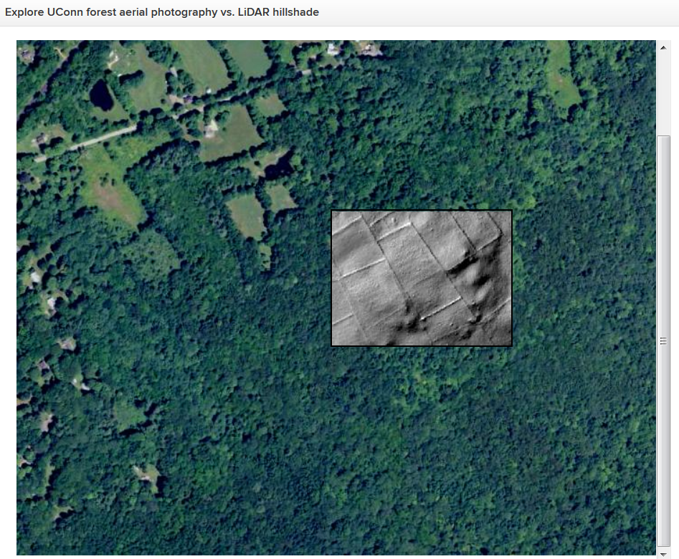
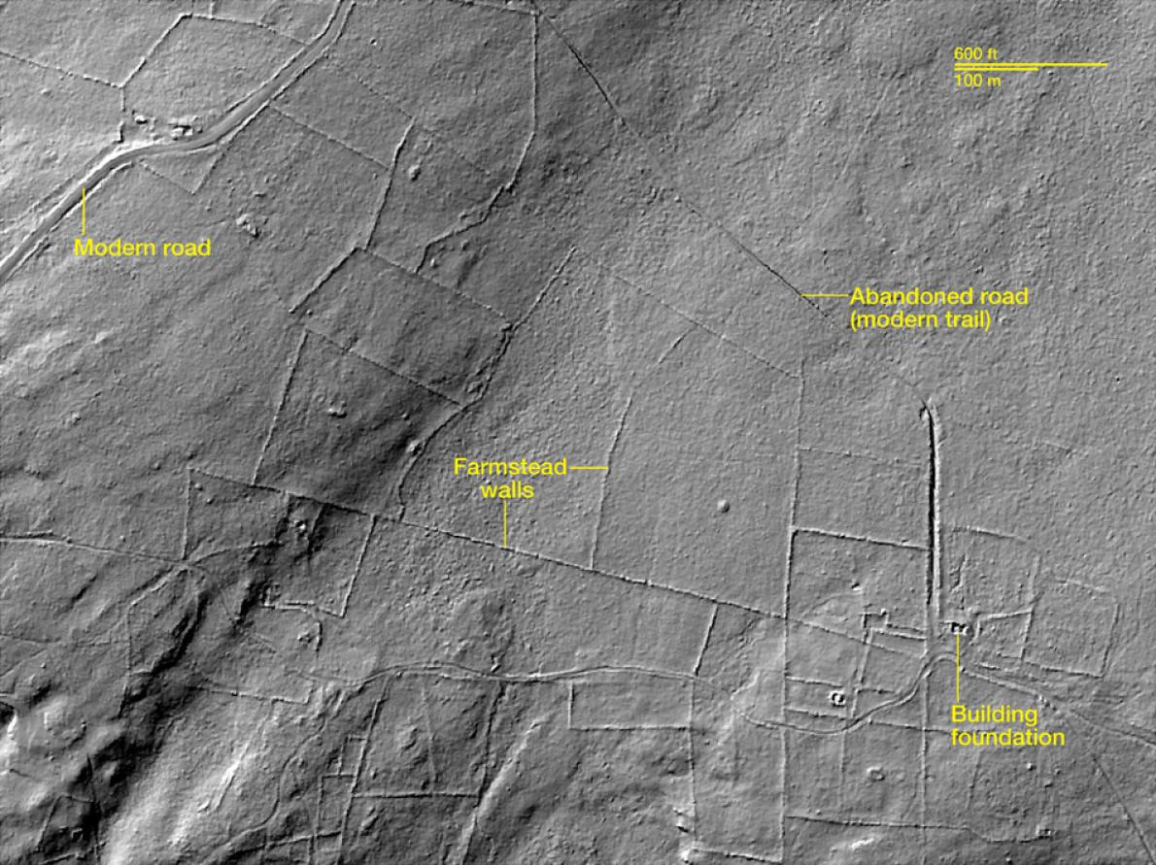
http://geomorphology.uconn.edu/
Notes:
Will Ouimet, Assistant Professor, Dept of Geography, UConn
Using Lidar to search for clues about southern new England’s historical landscape
Identifying cultural landscape features including stone walls and charcoal mounds remains to better understand the human impact on the landscape’s history and development pattern.
Link: http://geomorphology.uconn.edu/

Slide 8
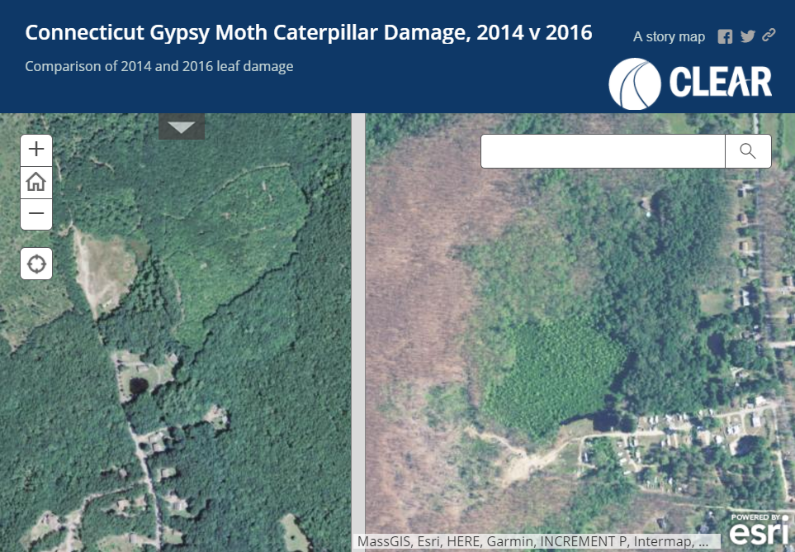
http://s.uconn.edu/caterpillars
Summer 2014
Summer 2016
Notes:
Comparison of high resolution aerial imagery – summer, leaf on – same time of year, two years apart. Can visualize the tree damage from gypsy moth caterpillars using remote sensing imagery.
Link: http://s.uconn.edu/caterpillars

Slide 9
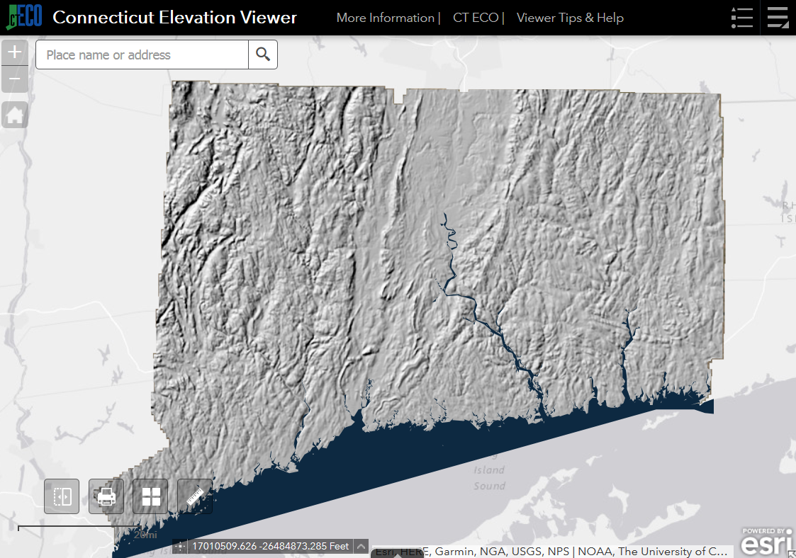

DEMO: CT ECO Imagery & Elevation Viewers
http://cteco.uconn.edu

Slide 10
Global Positioning System
“GPS is a miracle of science and technology”

Slide 11
Notes:
Source Unknown

Slide 12
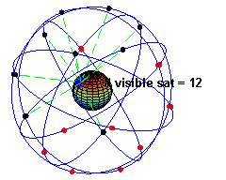
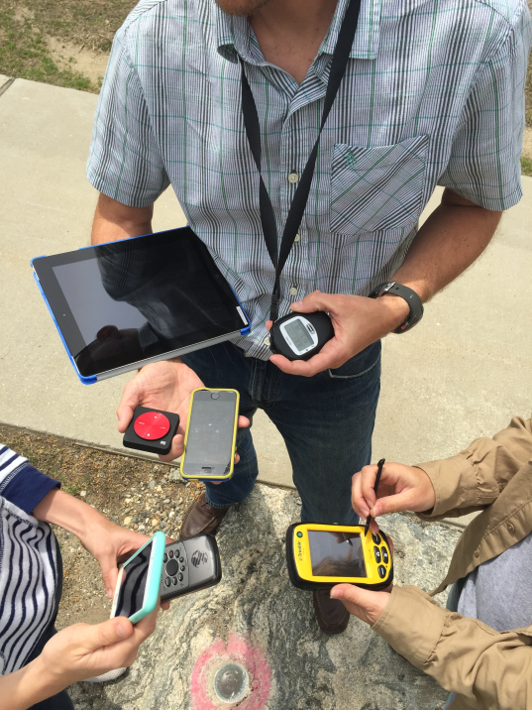
D = T x 186,000 mi/sec
24+ GPS satellites
Six orbital planes
4+ satellites per orbit
Altitude ~ 12,600 miles
Each makes two orbits per day
The distance to a satellite is determined by measuring how long it takes the radio signal to travel from the satellite to the GPS receiver.
Notes:
Photo: UConn CLEAR
Animation: wikipedia

Slide 13
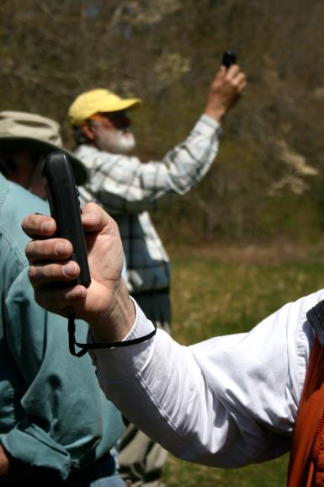
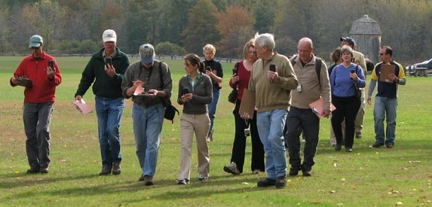
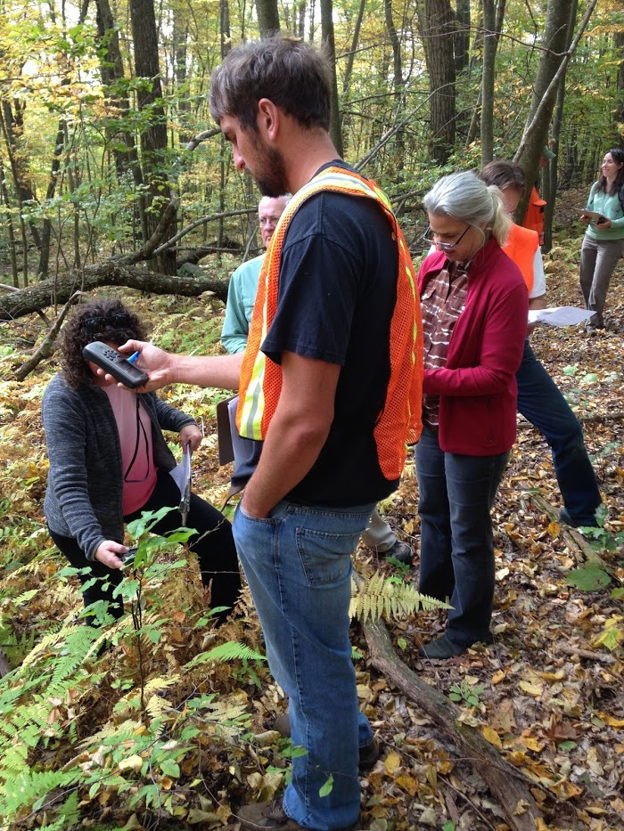
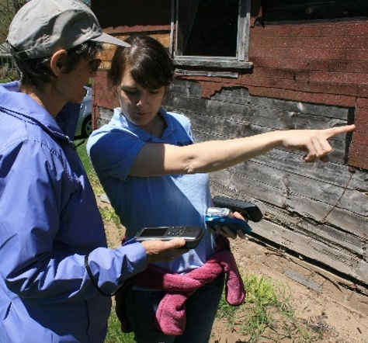
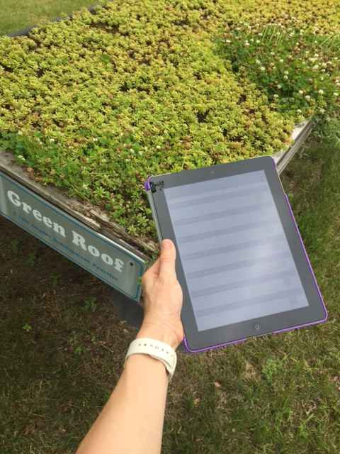

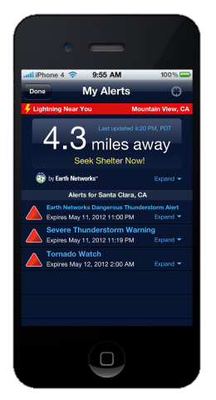
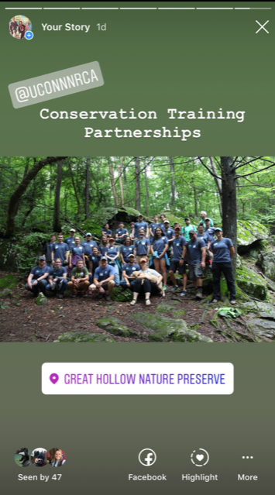
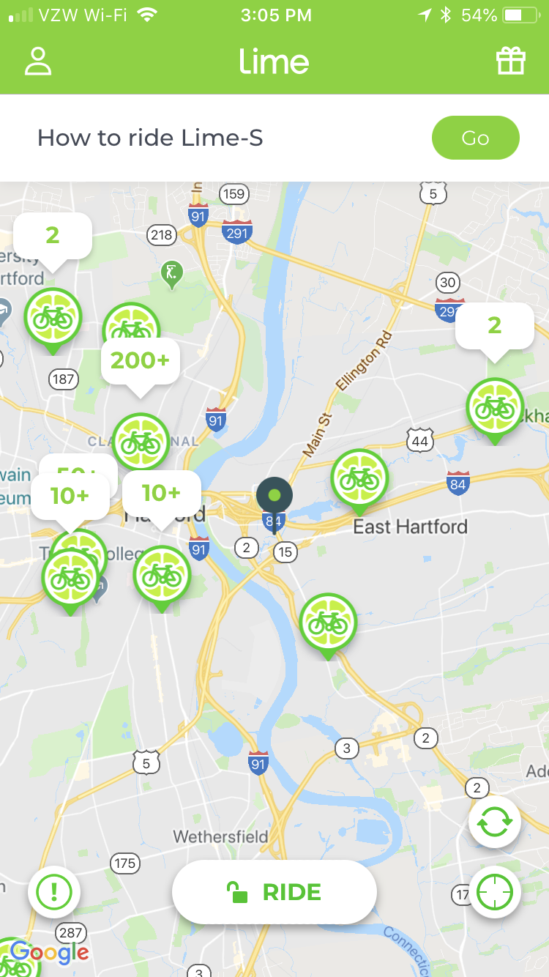

Notes:
Images (top): UConn CLEAR
Image (bottom): Sygic – Family Locator App http://www.sygic.com/family-locator/features

Slide 14
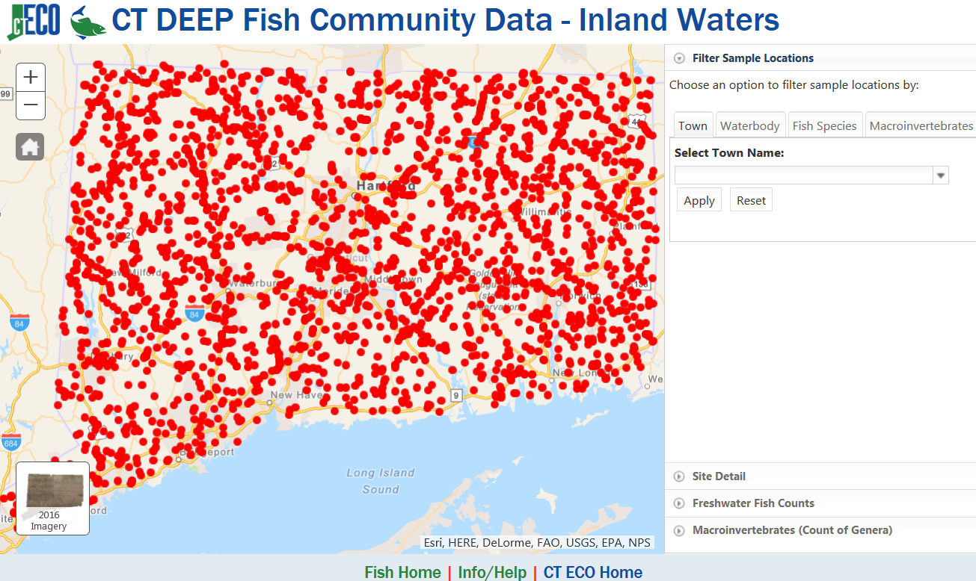
DEMO: CT ECO Fish Viewer
http://cteco.uconn.edu

Slide 15
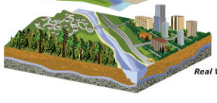
Geographic Information System (GIS)
The Real World
Notes:
Power of maps is in the amount of information they are able to convey. In a GIS, data layers are drawing on top of each other in a common coordinate system. By doing this, we can start to understand spatial relationships – how one thing relates to another. Trends emerge and knowledge is gained. We can also use this information as input into data models to predict future conditions.

Slide 16
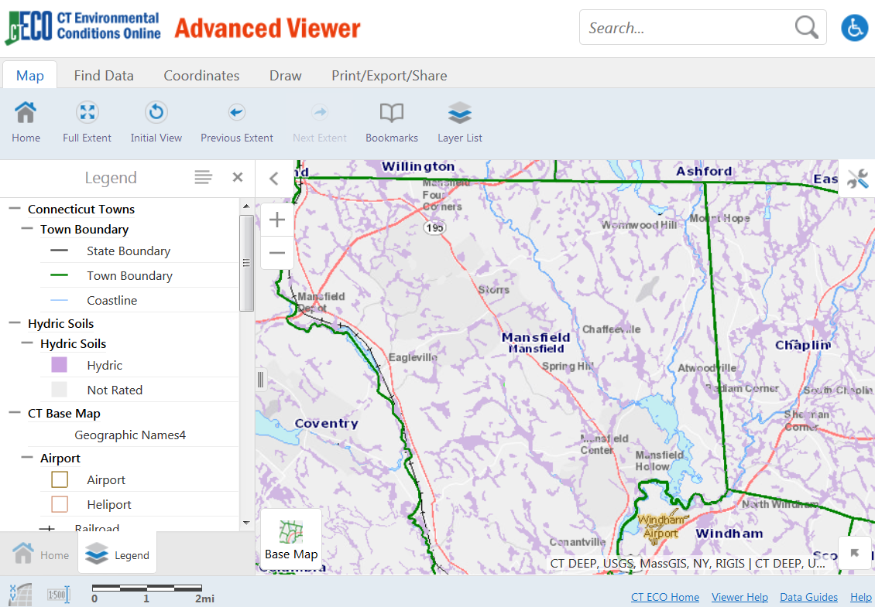
DEMO: CT ECO Map Catalog & Viewers
http://cteco.uconn.edu
Notes:
cteco.uconn.edu

Slide 17
“We now live in an information ecosystem. It’s amazing. It’s cutting edge. It’s changing the world.”

Slide 18
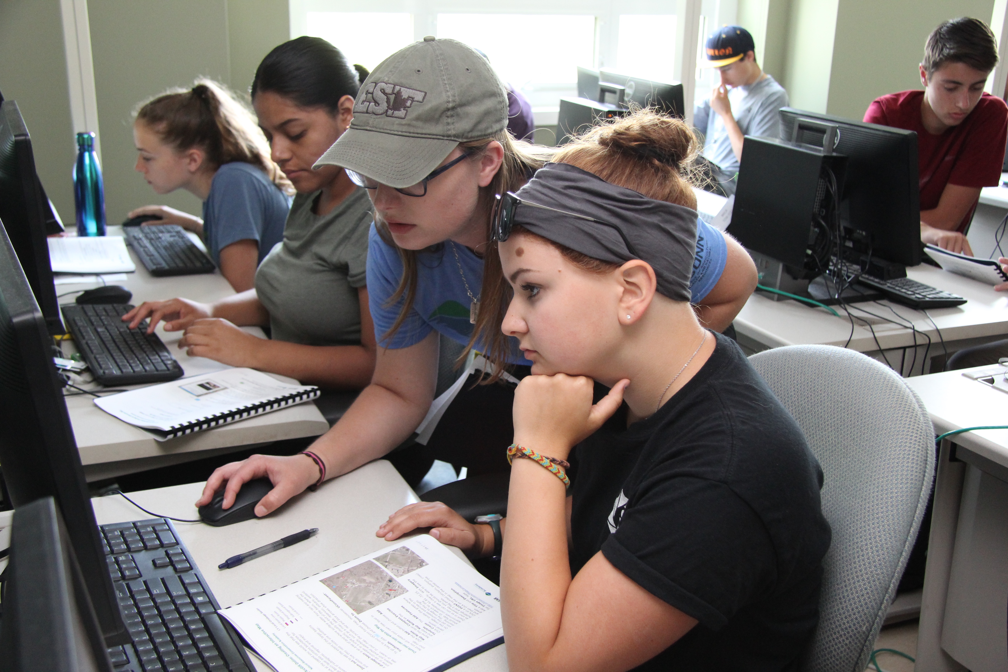

Geospatial Science in Your Classroom
“The application of GIS is limited only by the imagination of those who use it”.
– Jack Dangermond, Esri
Notes:
Photos: UConn CLEAR

Slide 19


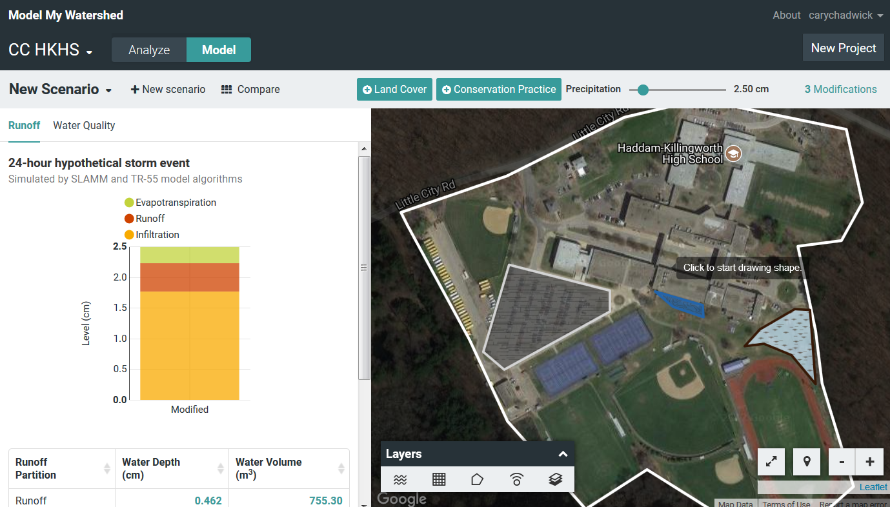

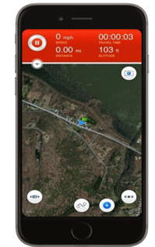
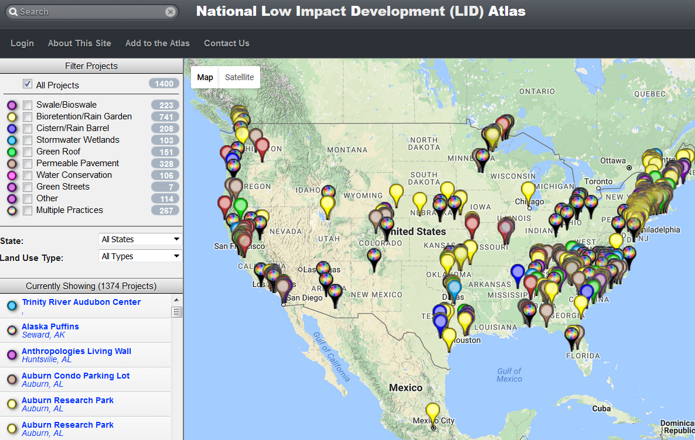

Your TPL Toolbox
Wikiwatersheds
CCL Story Map
CT ECO
Low Impact Development Atlas
Smartphone Apps
Notes:
Images: UConn CLEAR

Slide 20
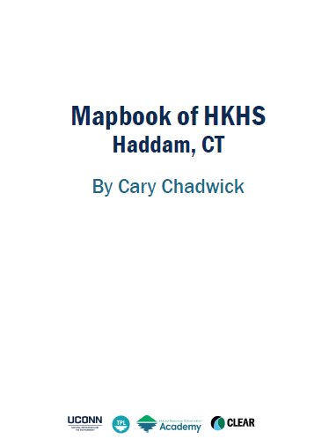
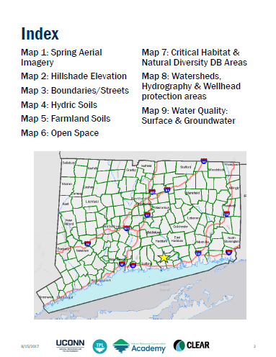
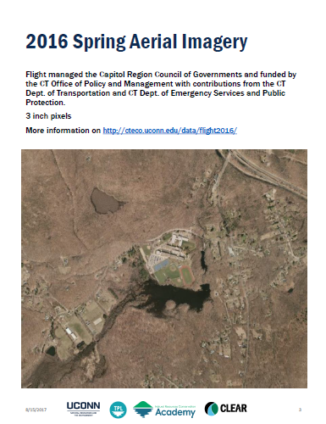
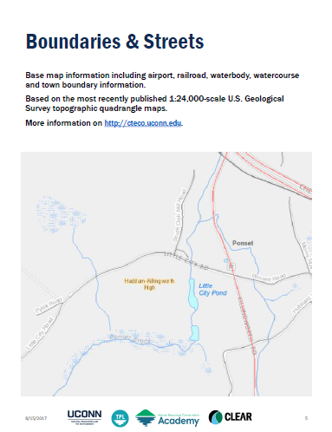
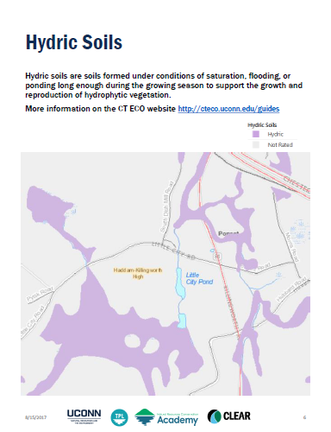
Hands-on Activity: CT ECO Mapbook
Create your own map book (PPT) to showcase your school or town
Use CT ECO maps and viewers
Screenshots of water resource layers
Template available on TPL website
Notes:
UConn CLEAR

