Slide 1
Animation for Environmental Storytelling
Eco-Digital Storytellers Workshop
Led by Anna Lindemann
Notes:
Welcome to the Animation Station!
My name is Anna - I am a professor in the Digital Media and Design Department here at UConn where I teach animation classes and I am so excited to be with all of you today!
In this station we are going to be thinking about the power of animation for environmental storytelling and then diving into an animation demo related to mirror lake, which you explored during the last workshop!

Slide 2
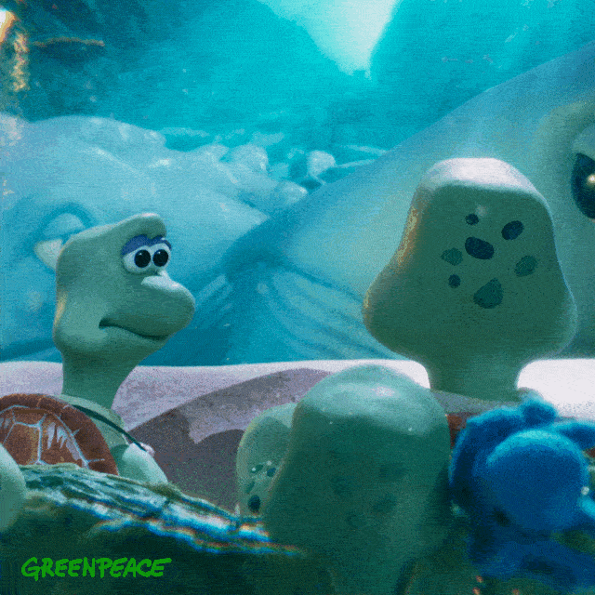
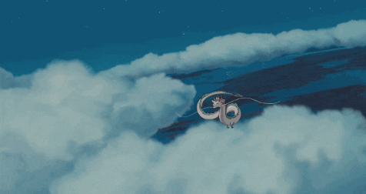
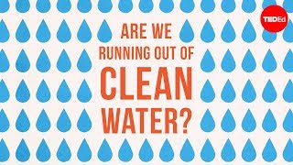
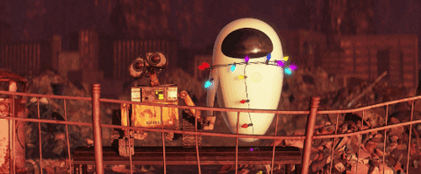
Animation for Environmental Storytelling
a diversity of animation techniques
stop motion
cel animation
2D animation
3D animation
Turtle Journey (2020) by Aardman Animation
Spirited Away (2001) by Studio Ghibli
Are We Running Out of Clean Water? (2019) by Kozmonot Animation Studio
WALL-E (2008) by Pixar Animation Studios
Notes:
Animation can be a really powerful tool for environmental storytelling.
Animation includes many different kinds of techniques including stop motion, cel animation, 2D digital animation and 3D animation

Slide 3
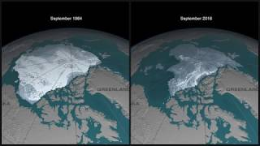
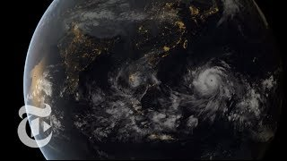
Animation for Environmental Storytelling
a diversity of contexts
advertising
research
education
journalism
arts + entertainment
Turtle Journey (2020) by Aardman Animation
Disappearing Arctic Sea Ice (2018) by NASA
Are We Running Out of Clean Water? (2019) by Kozmonot Animation Studio
How Do Hurricanes Happen? (2013) by The New York Times
WALL-E (2008) by Pixar Animation Studios
Notes:
and we can see animation for environmental storytelling being used in a diversity of contexts

Slide 4
What is the Power of Animation?
Notes:
Animation Today uses a diversity of techniques?

Slide 5
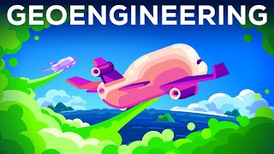
Animation Can Make the Invisible Visible
we can visualize things that are too big or too small to see
Geoengineering: A Horrible Idea We Might Have to Do (2021)
by Kurzgesagt In a Nutshell (9min)
Notes:
Animation can make the invisible visible!
I want to give three examples of how this is achieved.
Using animation, we can visualize things that are too big or too small to see with our own eyes
We are going to watch an animation clip that explains how the sulphur dioxide produced by volcanoes might inspire human-designed solutions to climate change.
After we watch the clip I want to hear some examples of things that are visualized in the animation that we can’t see with our own eyes.
Stratosphere
Atoms - volcanoes
Animation is even used to make connections between these two in an approachable way.

Slide 6
Animation Can Make the Invisible Visible
we can visualize complex and abstract processes
How Do Hurricanes Happen? (2013)
by The New York Times
Notes:
This animation uses simple design to explain how a hurricane forms

Slide 7
Animation Can Make the Invisible Visible
we can even visualize the future
WALL-E (2008)
by Pixar Animation Studios
Notes:
WALL-E takes place on an uninhabitable future earth in the year 2805

Slide 8
How do you create an animation?
Material by Ally Hopper and Alex Gutting
Notes:
I’m going to turn it over to Alex and Ally to show you a little behind the scenes of the animation they have been developing

Slide 9
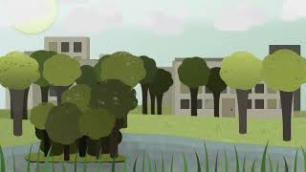
Introduction
Envisioning The Future: Microplastics in Mirror Lake
Notes:
Ally: Hello! I’m Ally and this is [Alex introduce yourself] and we are both Digital Media & Design students concentrating in animation.
Alex:
This is a 2D animation video that Ally and I have been working on recently. The overall purpose of this video is to help people easily understand about the effects of microplastics and how they impact Mirror Lake, but it is shown in a more fun and entertaining way. However, this video is still in progress as we don’t have all the animations finished yet.
Ally:
Once the animation is finished we hope to use this animation as a way to inspire people about the current environmental issues of plastics and microplastics and how it affects not only us but the living organisms around us.

Slide 10
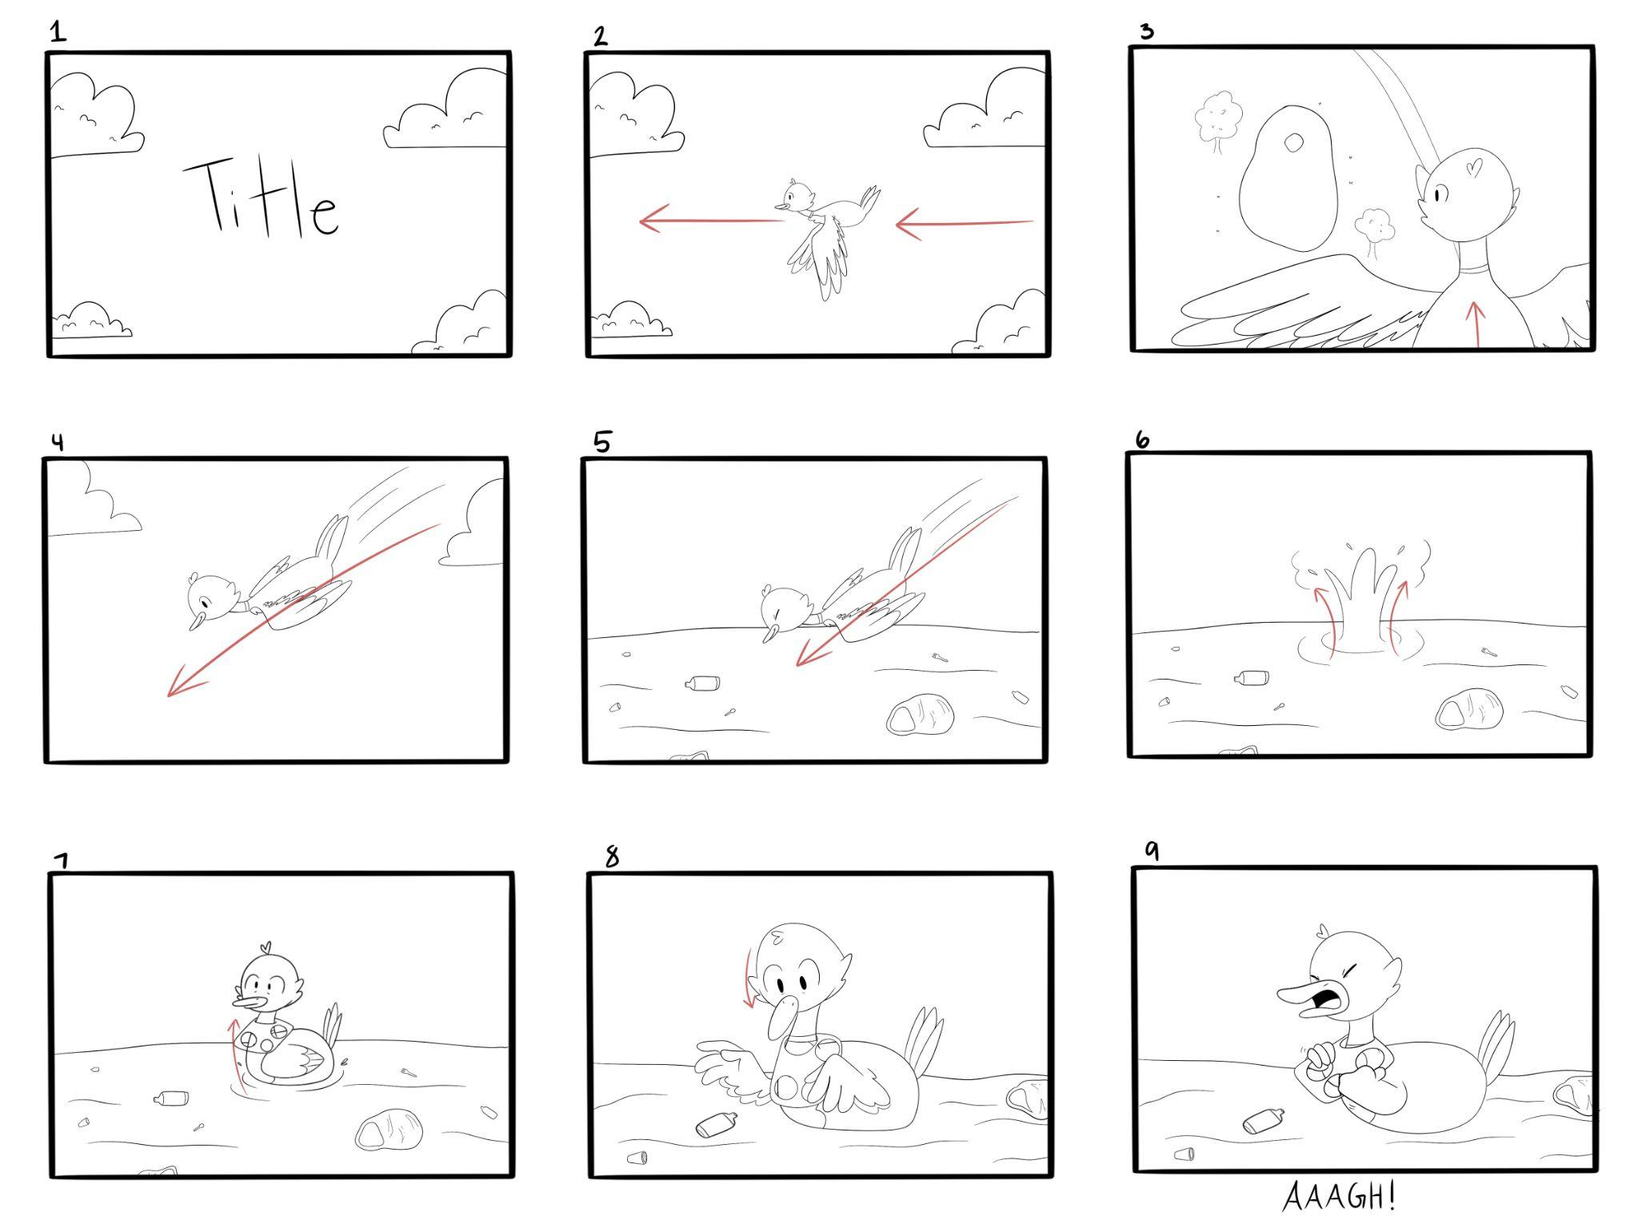
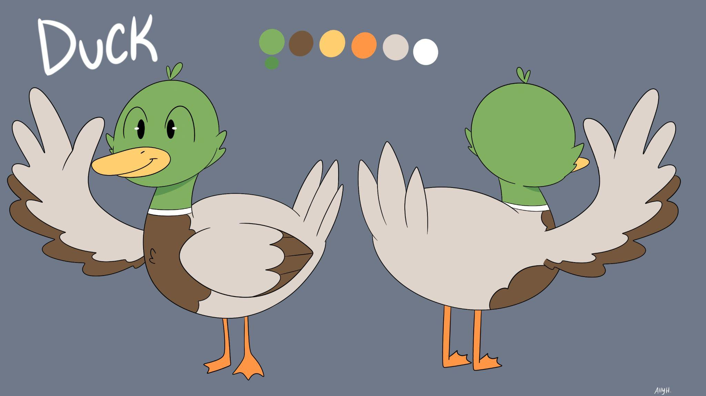
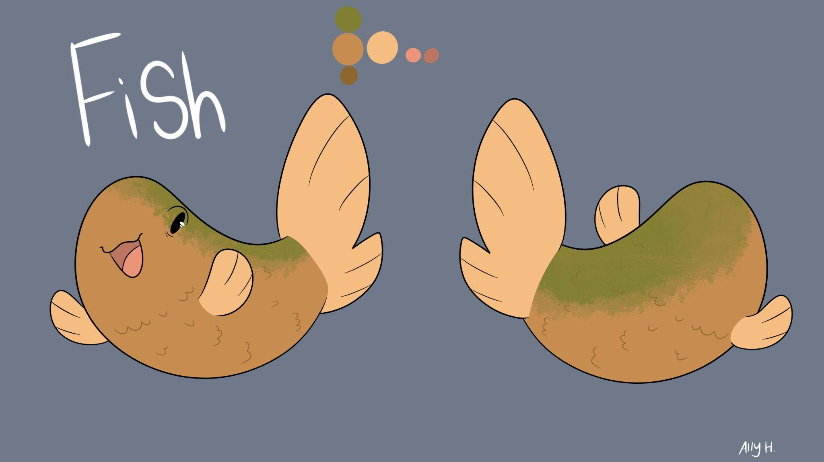
Planning Stages
Storyboard
Animatic
Styleframe
Notes:
Ally: These were our planning stages for the animation you saw previously. Starting off with the storyboard, after we worked on the script I began storyboarding/sketching out what we wanted our animation to look like. Storyboarding is the most important part when it comes to planning out an animation. I wrote down the parts of the script into the storyboard so I would know what dialogue would play with what animation. (probably info dump without a script)
Alex: For the animatic, we took our individual storyboard frames and used voiceovers and sounds to tell the general story. Finally, for the styleframe, we developed some basic ideas for what we wanted the characters to be like and what they would look like. We also decided on using a nice spring-like color palette to go with the mood of the video.

Slide 11
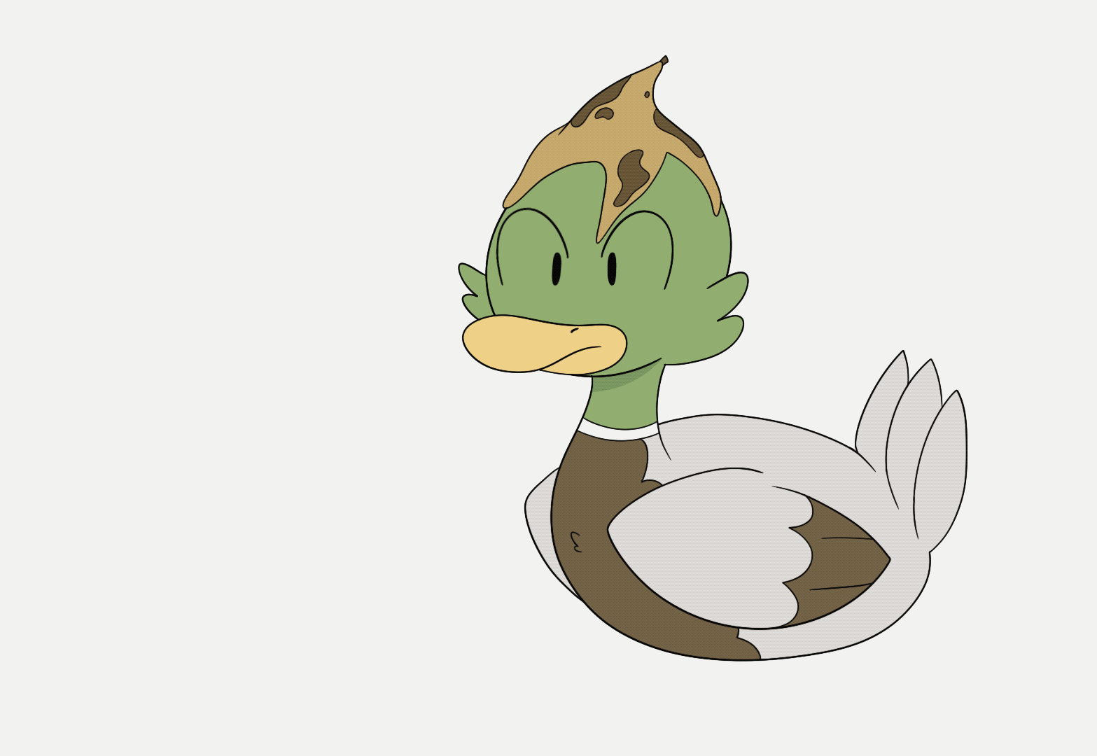
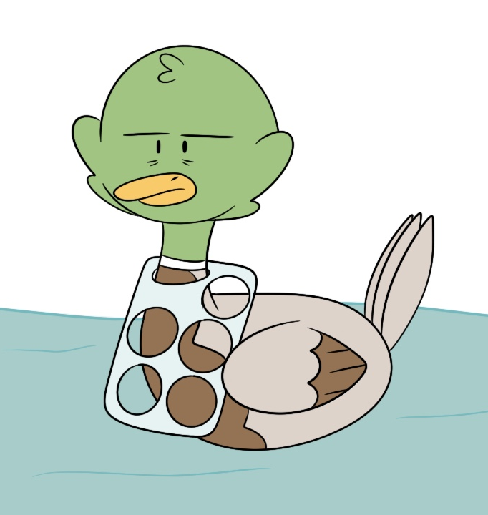
Feedback/Adjustments
One adjustment we did for our animation was the removal of the banana peel and replacing it with a six-pack rings plastic around the duck’s neck
Notes:
Ally: When it came to feedback and the adjustments we made for our project, one change we made was going from having a banana peel on the duck’s head to a plastic six-pack ring around the duck’s neck. We did this because for our final project, we changed our main focus from just general trash to specifically plastics. We wanted to further show how plastic trash left behind in the environment can affect wildlife. By making this change, it made the message a lot more clear.

Slide 12
Animation Demo

Slide 13
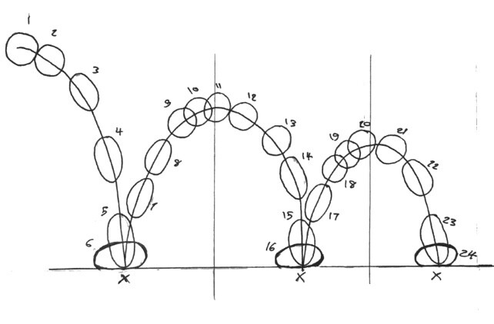
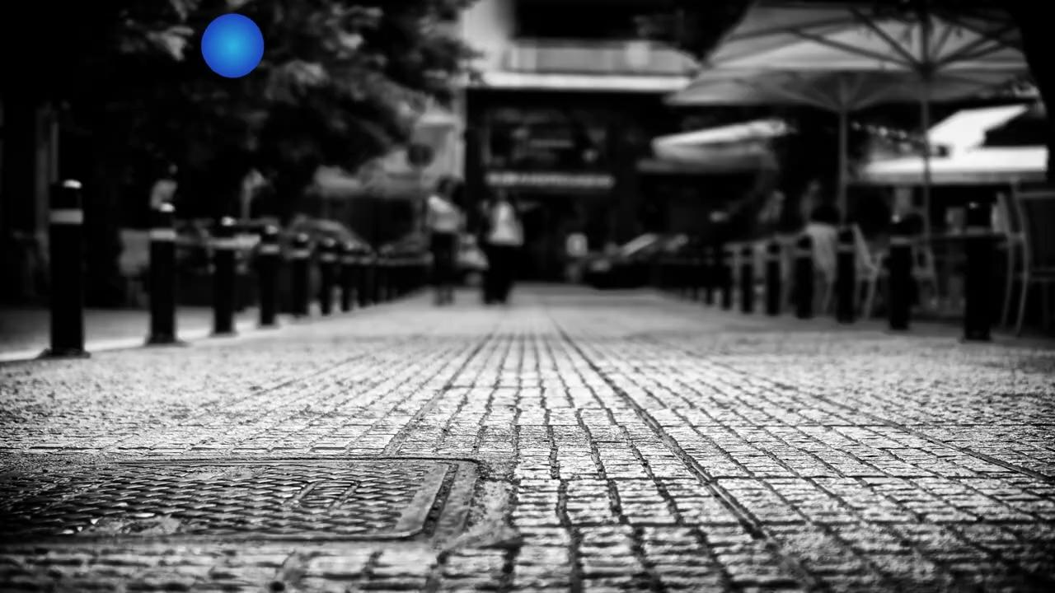
Keyframe Animation
frame-by-frame animation
keyframe animation in After Effects
By Frank Thomas & Ollie Johnston
(1912-2004) (1912-2008)

Slide 14
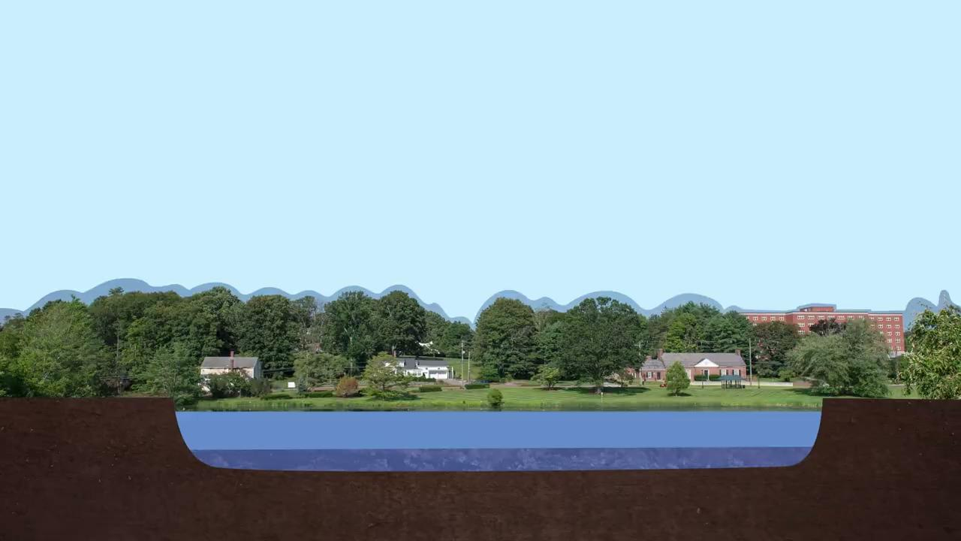
The Impact of Development on Mirror Lake
using the power of animation to make the invisible visible
Notes:
With our animation demo we are going to be working with this scene that shows some of the different ways that development of the built environment can negatively impact waterbodies like Mirror Lake.
“Here we see that one of the consequences of development is that runoff increases. This is because while rainwater can be absorbed by natural groundcover like trees and grasses, rainwater cannot be absorbed by impervious surfaces like buildings, streets, and other paved surfaces. Runoff also increases with increased population density and water usage. More runoff then leads to increased erosion, increased water level, sediment build up, and increased pollutants such as oil from roadways, nutrients from fertilizers, and bacteria from pet waste.”
What are some ways that we are using the power of animation to make the invisible visible?
(1) We are collapsing processes that happen over long time frames (like buildings popping up and leading to increase in runoff) to visualizing cause and effect
(2) We are seeing the lake from a new perspective: from a cross section view, which allows us to show changes in water level and sediment
(3) We are making things we can’t see with our own eyes like pollutants visible
Let’s take a look at how this animation was made

