Slide 1
Photo/Video Station!
Eco-Digital Storytellers Workshop
Laurel & Heather

Slide 2
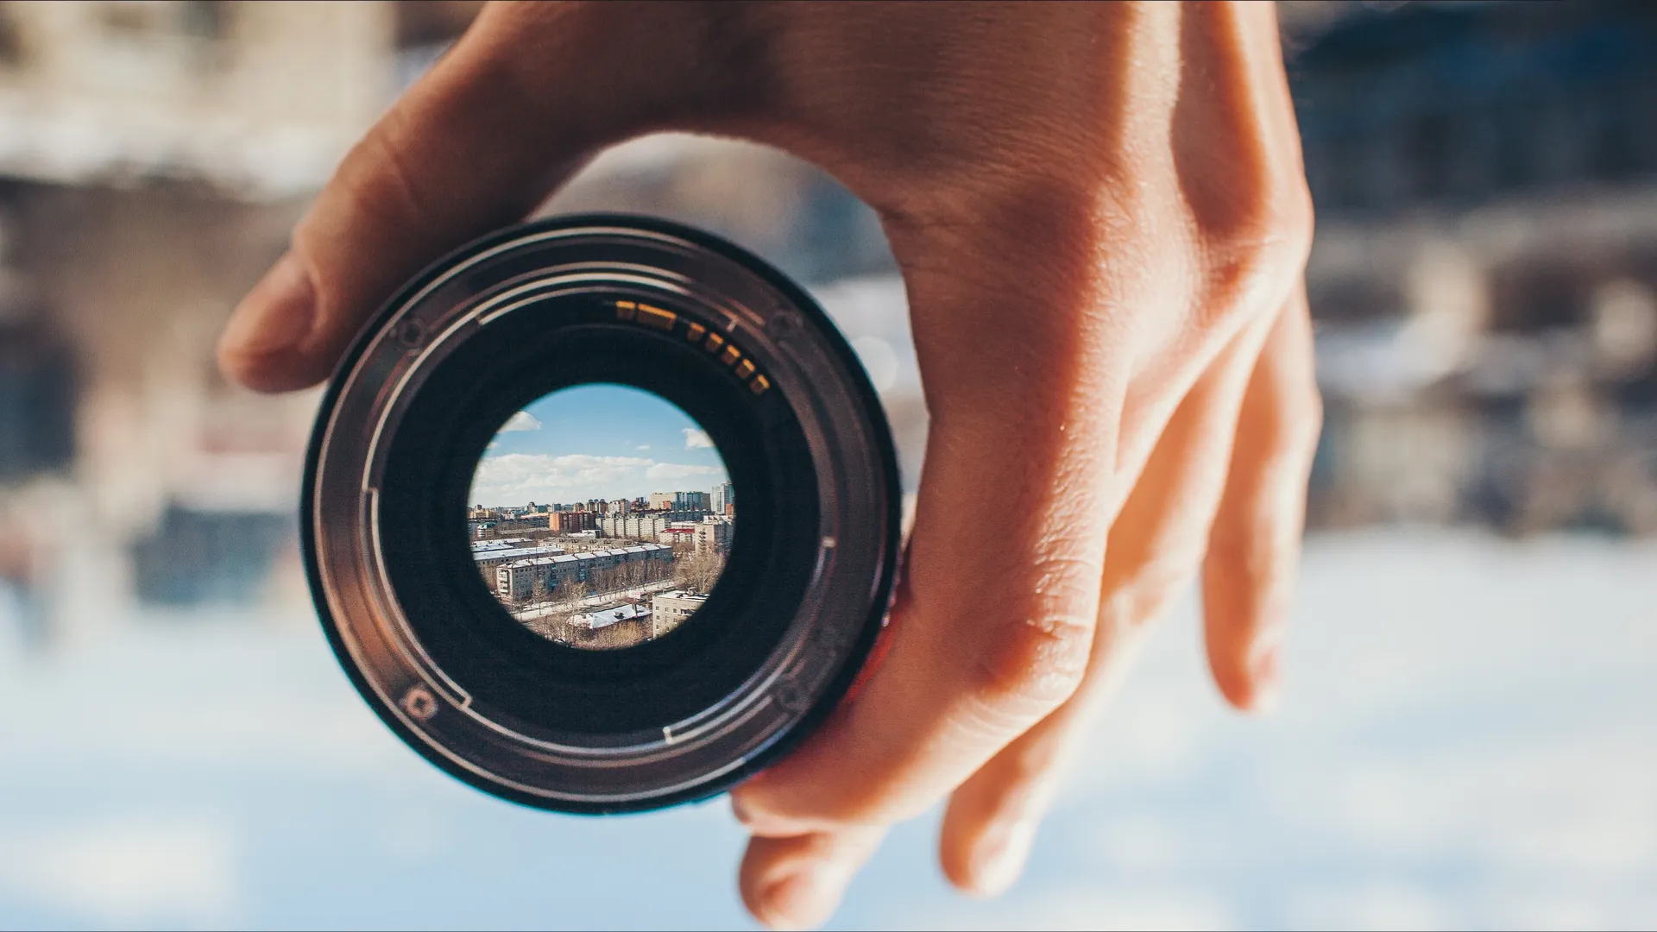
The DSLR Camera
Have you used one?
Notes:
How many of you have used a DSLR camera before?

Slide 3
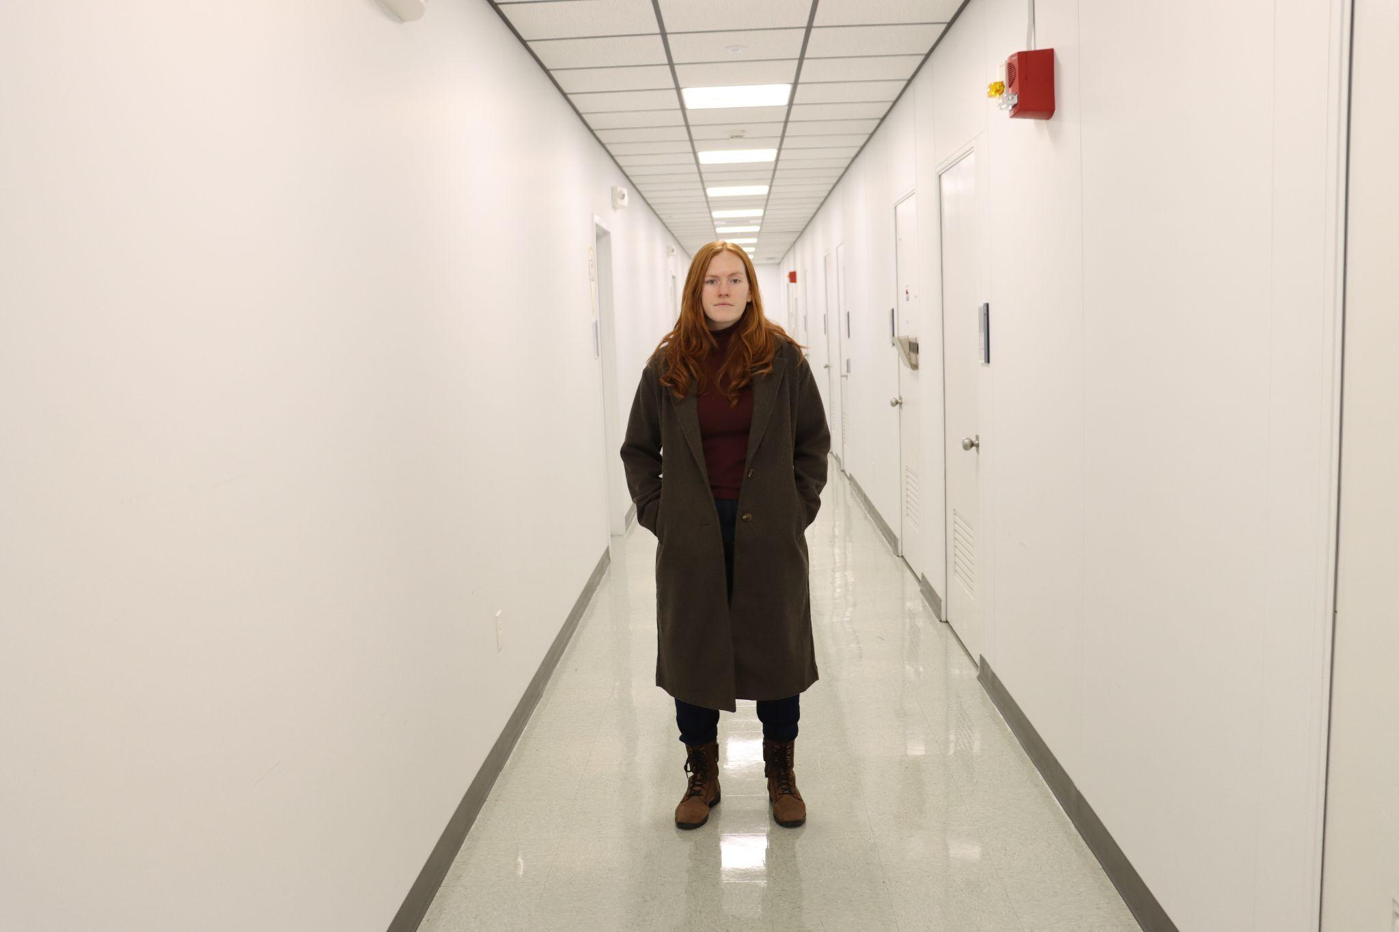
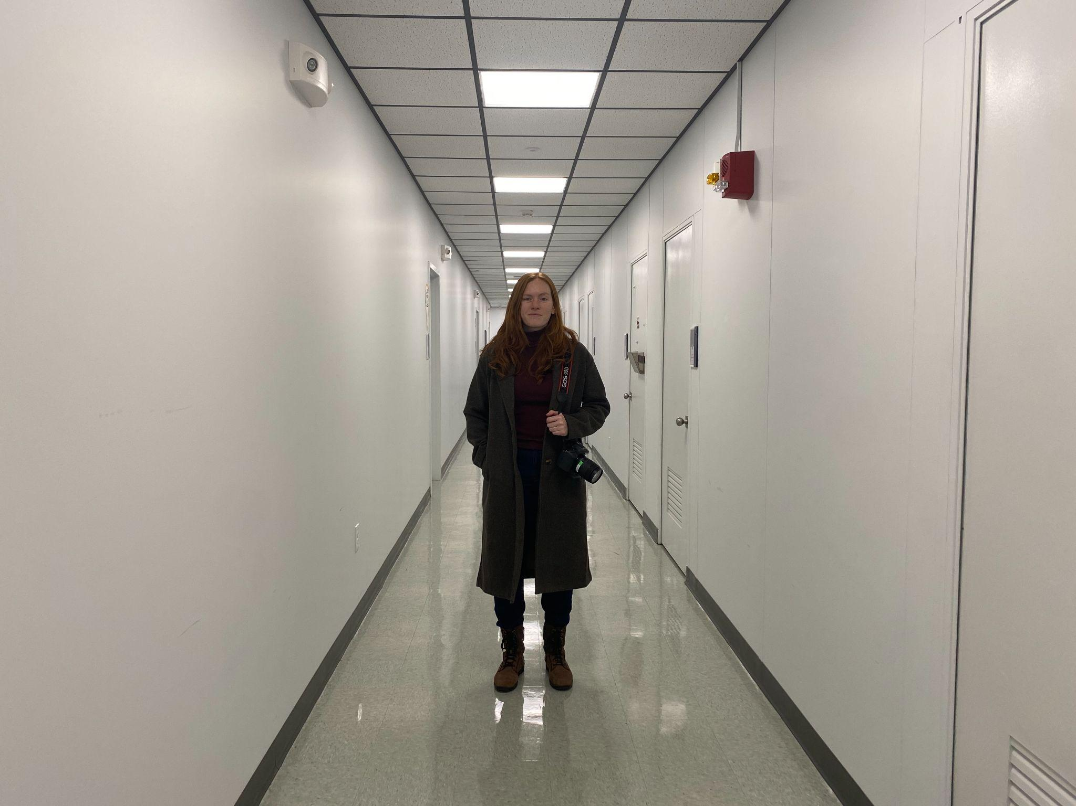
Shoot Off - 90D vs. iPhone 11

Slide 4
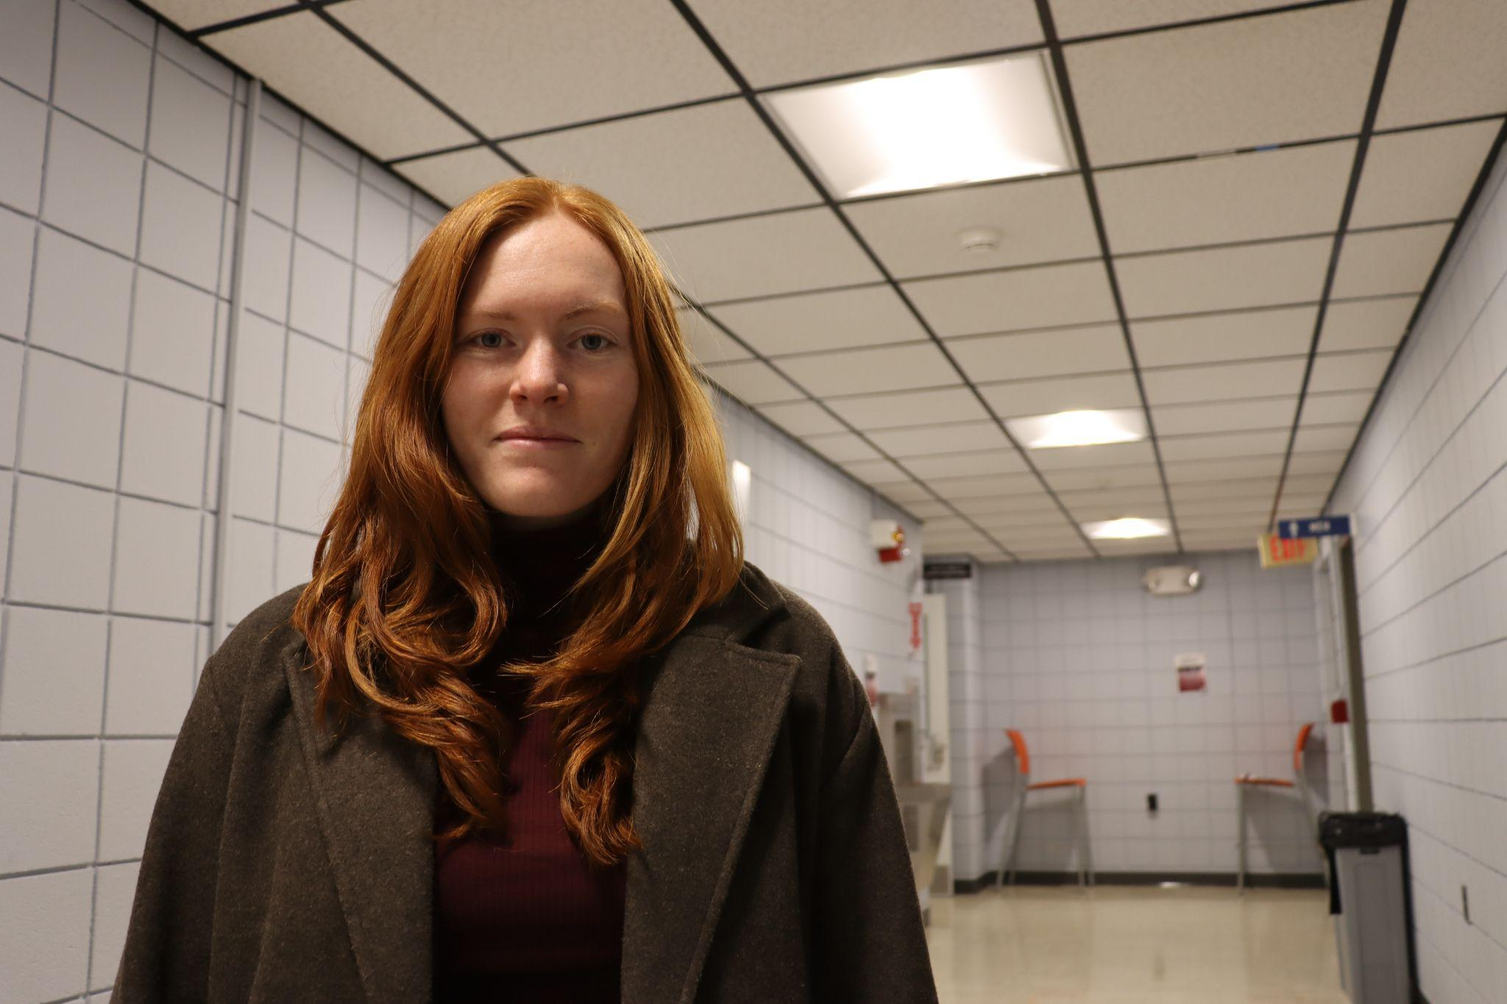
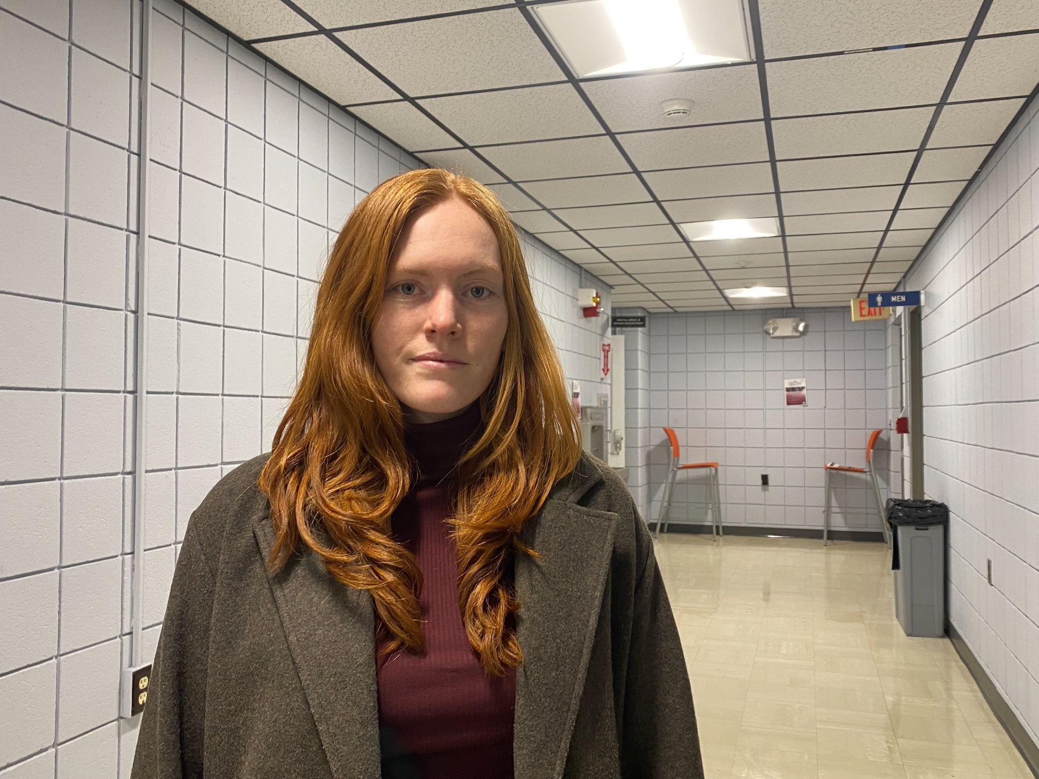
Shoot Off - 90D vs. iPhone 11

Slide 5
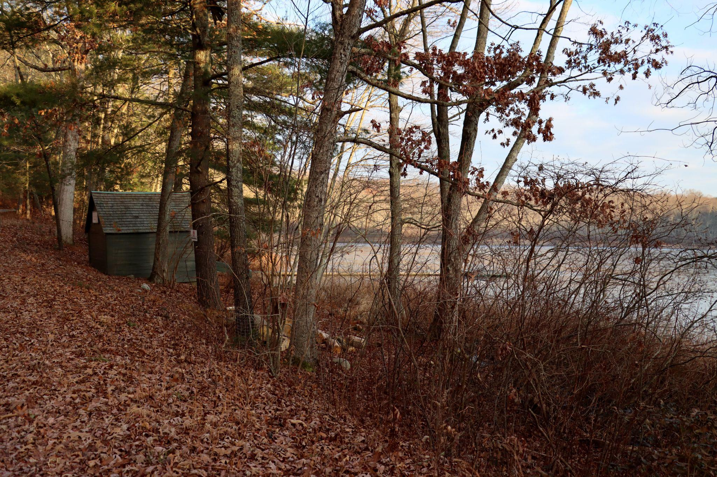
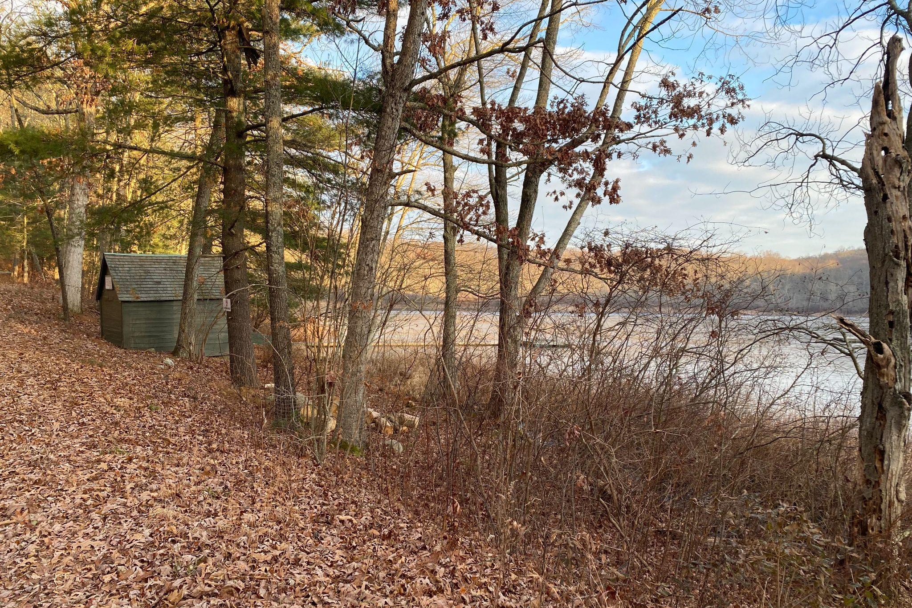
Shoot Off - 90D vs. iPhone 11

Slide 6
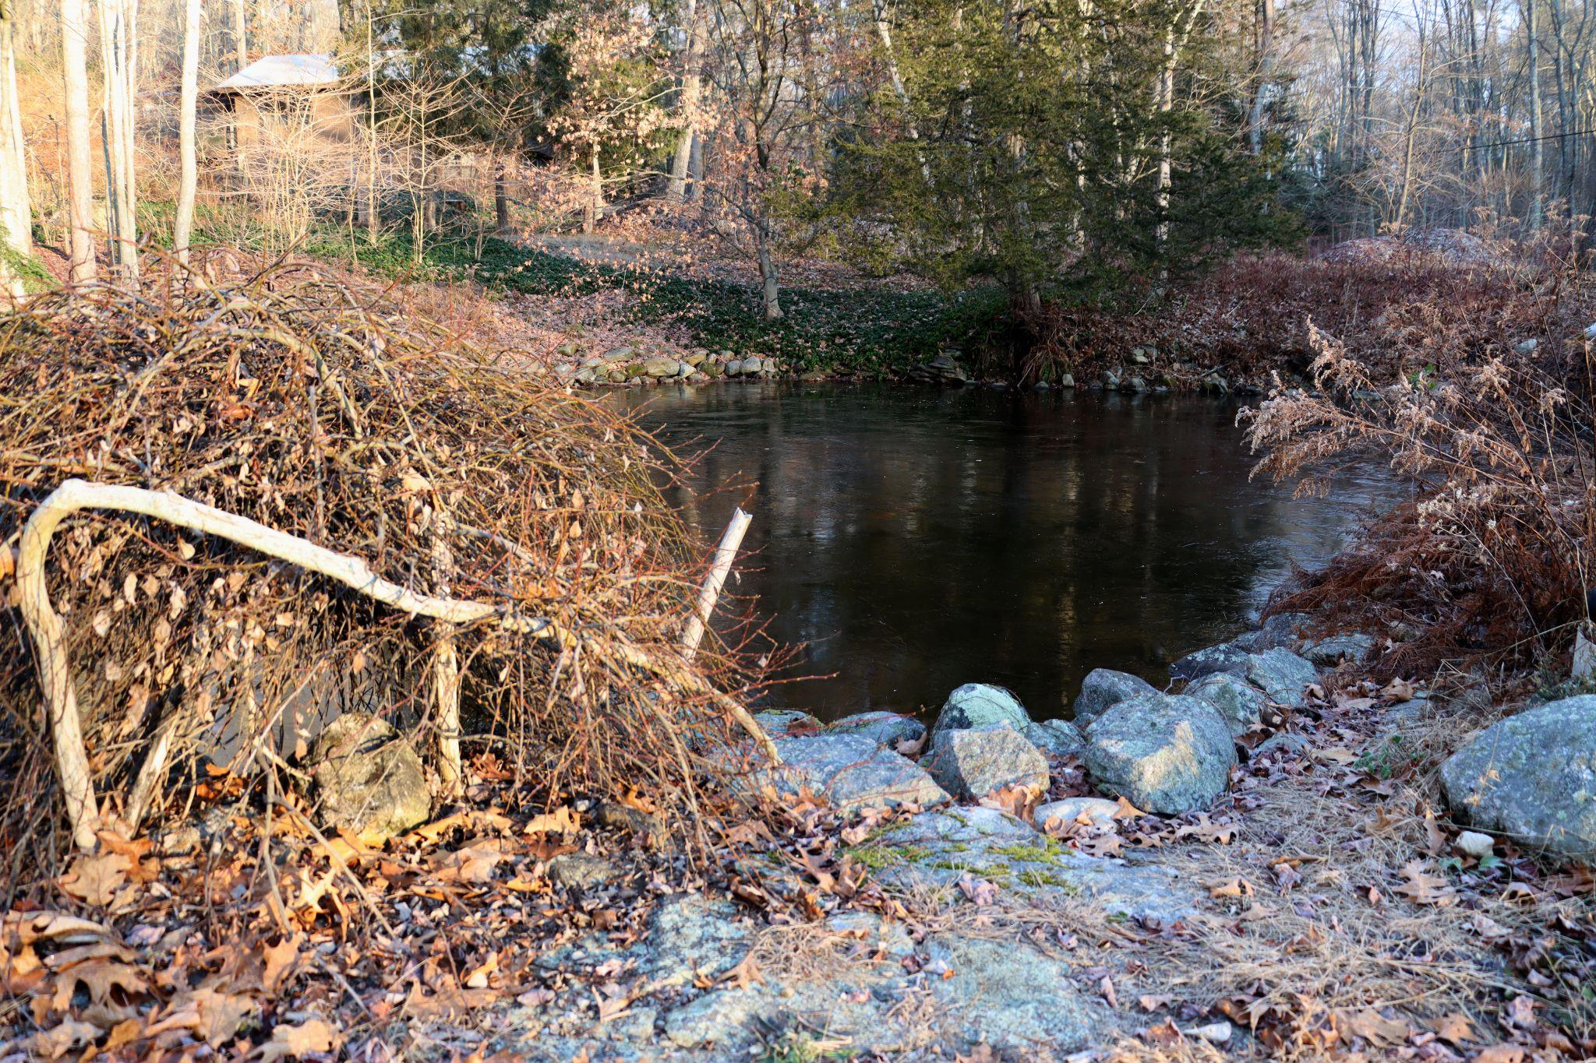
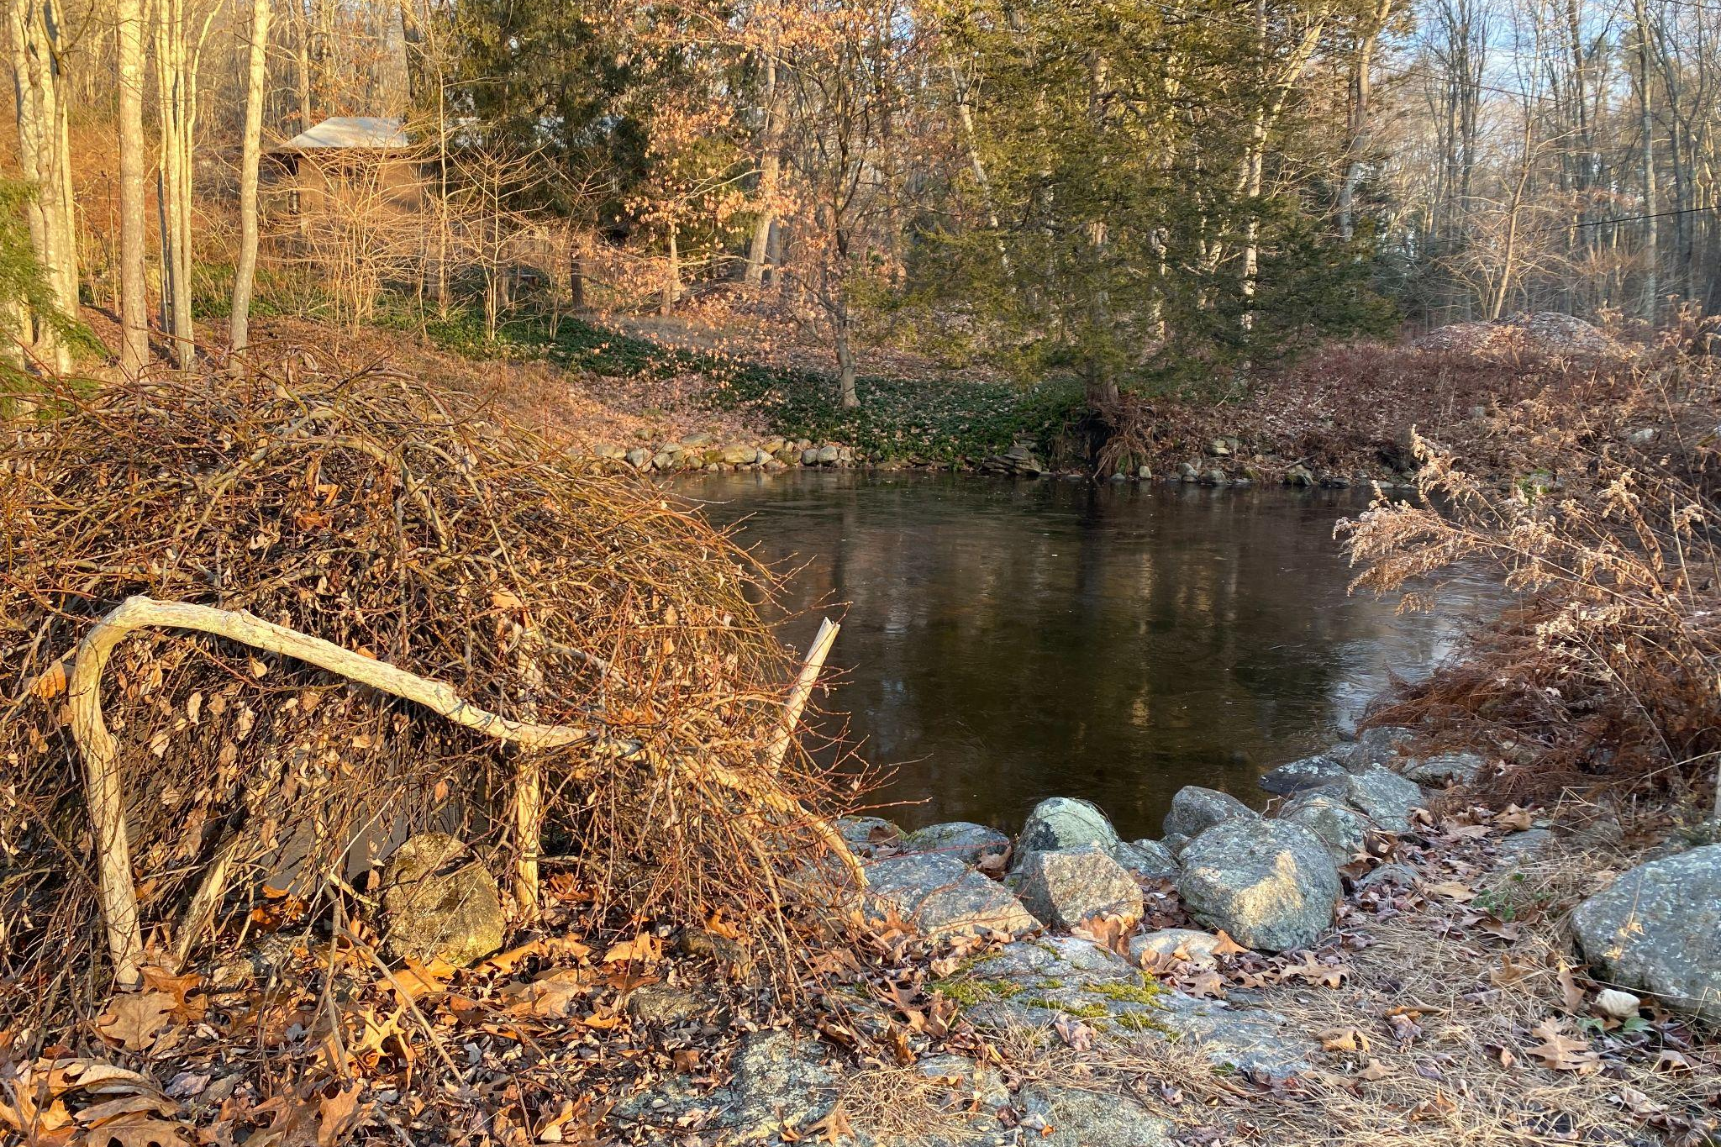
Shoot Off - 90D vs. iPhone 11

Slide 7
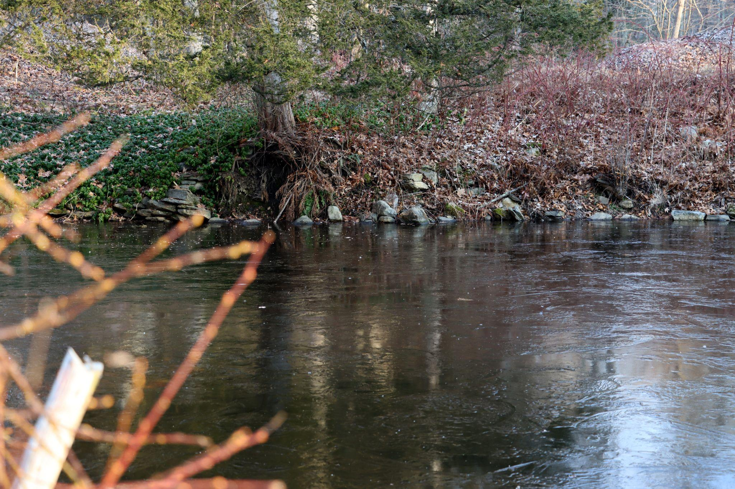
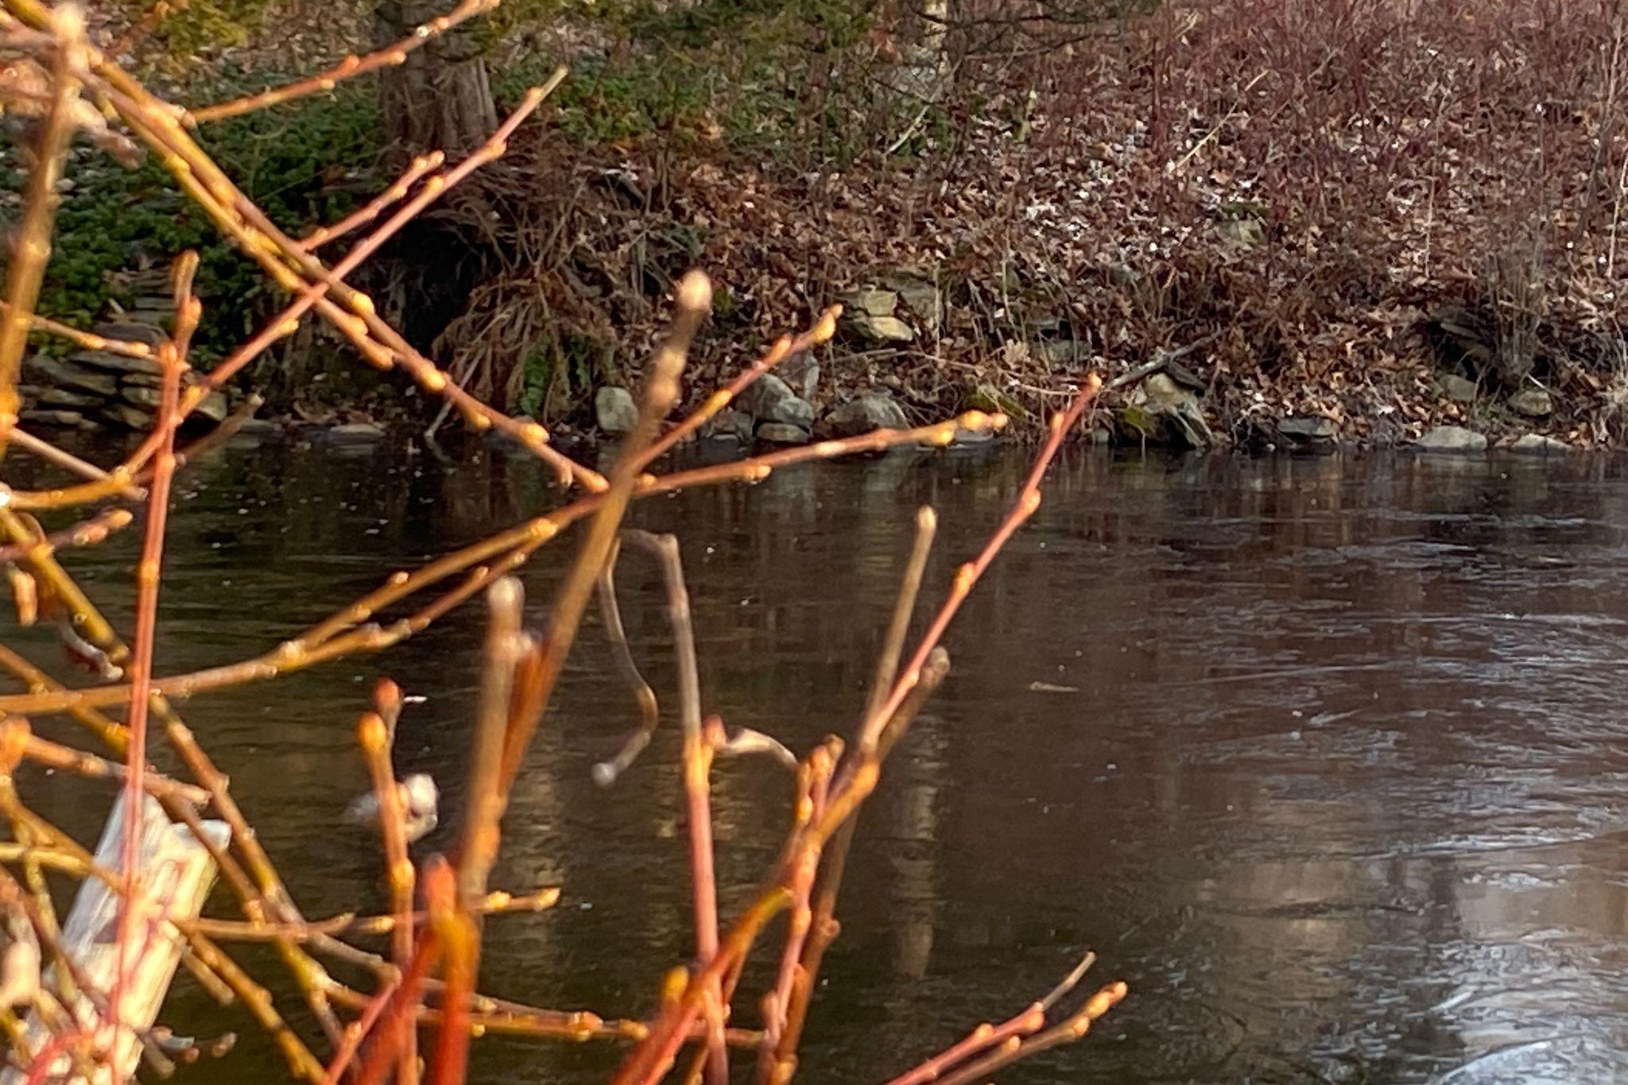
Shoot Off - 90D vs. iPhone 11

Slide 8
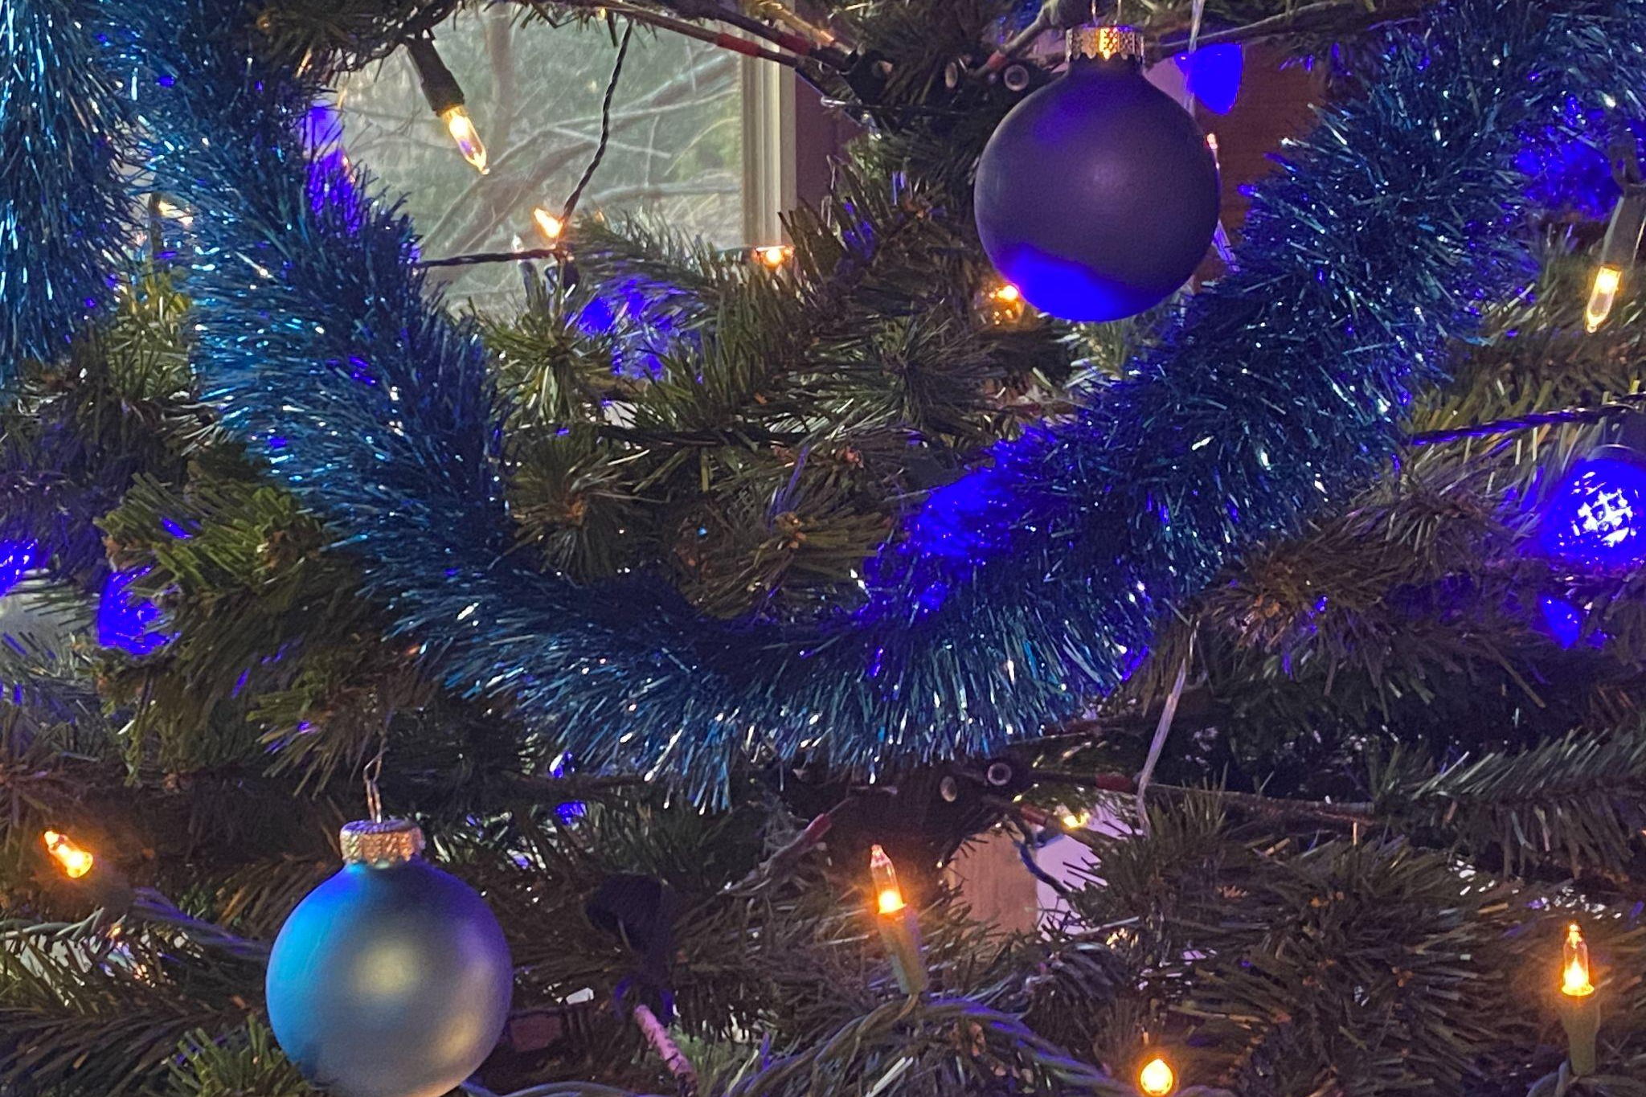
Shoot Off - 90D vs. iPhone 11

Slide 9
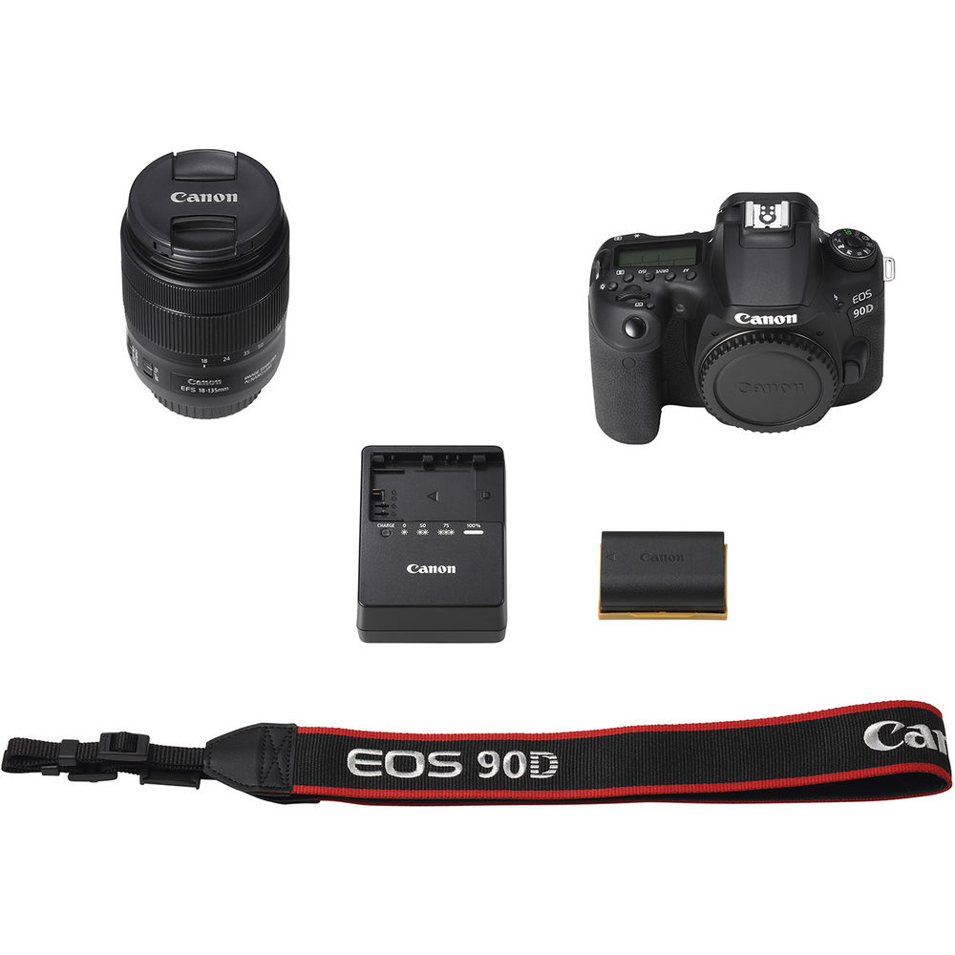
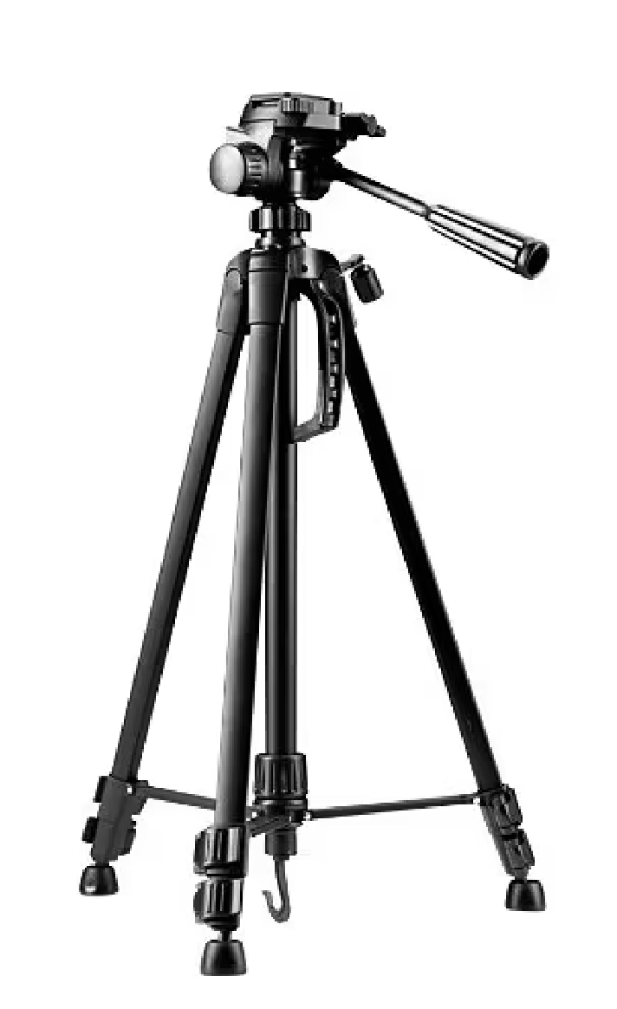
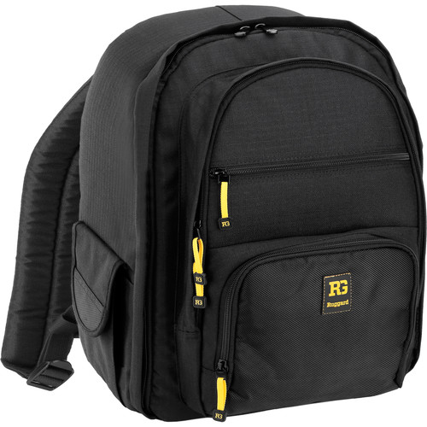
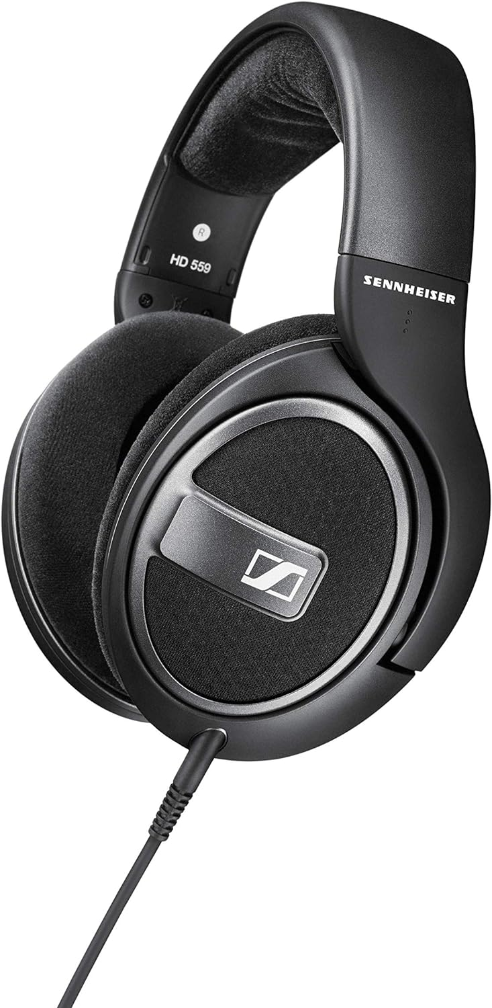
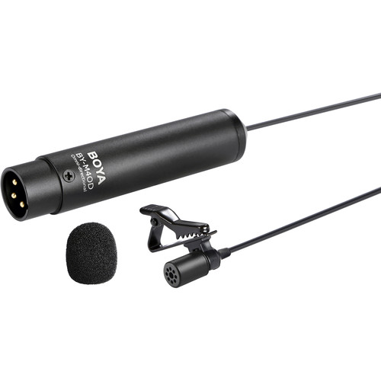
What’s in The Kit?
Camera, lens
lens strap, lens cap, battery, battery charger
Lavalier microphone, headphones
SD card, card reader, SSD hard drive
Tripod
Backpack bag

Slide 10
Tripods
Our EDS gear kit includes a basic PHOTOGRAPHY tripod. You should always utilize a tripod when recording video, otherwise your footage will be too shaky to use.
Each school will also have a fluid head VIDEO tripod.

Slide 11
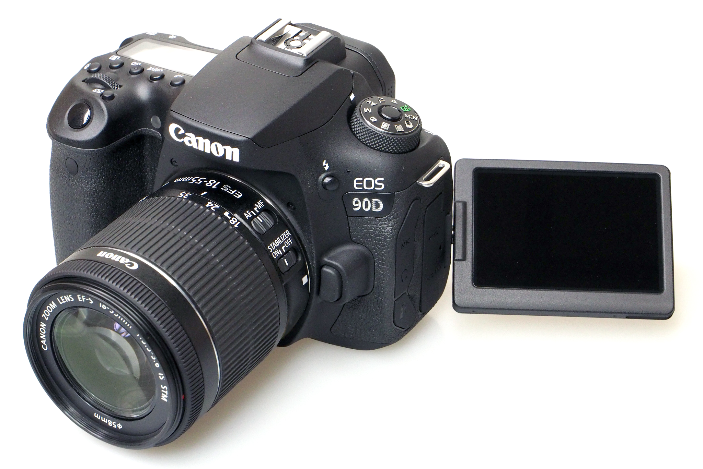
Canon 90D camera w/ 18-135mm lens
We are using a DSLR camera, the Canon 90D.
High Image Quality with 32.5 Megapixel CMOS Sensor.
Photo: High-Speed Continuous Shooting of up to 10 fps with no Time Lag
Video: up to 4K (UHD) 30fps / FHD 120fps
Notes:
10 photos/sec burst mode
auto focus

Slide 12
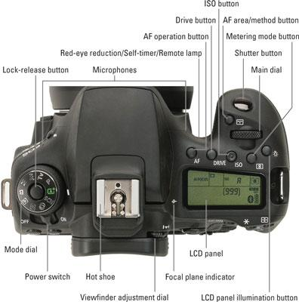
Canon 90D camera w/ 18-135mm lens
We are using a DSLR camera, the Canon 90D.
We will use the P (Program) mode for ease of use.
Notes:
10 photos/sec burst mode
auto focus

Slide 13
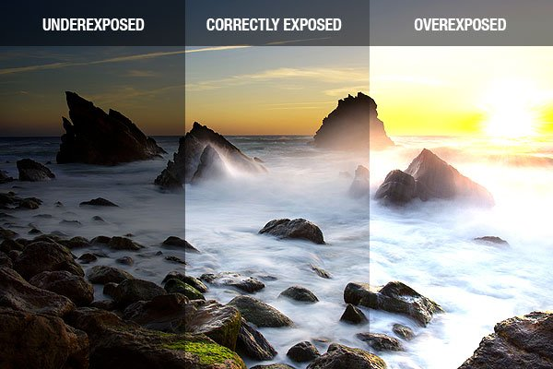
Exposure
Exposure settings control the amount of light recorded on the camera sensor. Incorrect settings can cause the image to be too bright or too dark (over / under exposed). We want an exposure that shows details in both the bright and dark areas of the image.

Slide 14
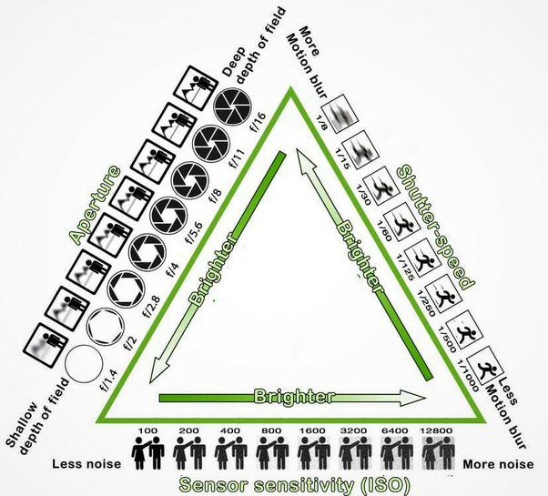
Exposure
Aperture, shutter speed, and ISO are the 3 setting that we can control when using manual exposure mode. These settings dictate the exposure while also creating secondary impacts: depth of field, motion blur, and noise.
For beginners, you can use automatic exposure settings. Students with prior photo experience can utilize manual exposure.

Slide 15
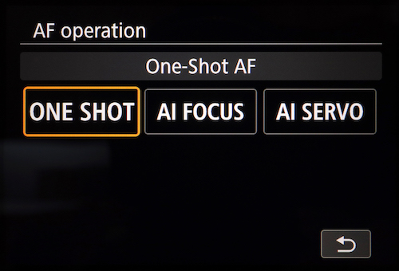
Focus
If you want to use Auto focus settings, check to make sure this is turned on in TWO PLACES:
On the switch on the barrel of the lens and
The touch screen settings on the camera screen
There are two focus modes: One-Shot AF, which works well for still subjects, and Servo AF for moving subjects.

Slide 16
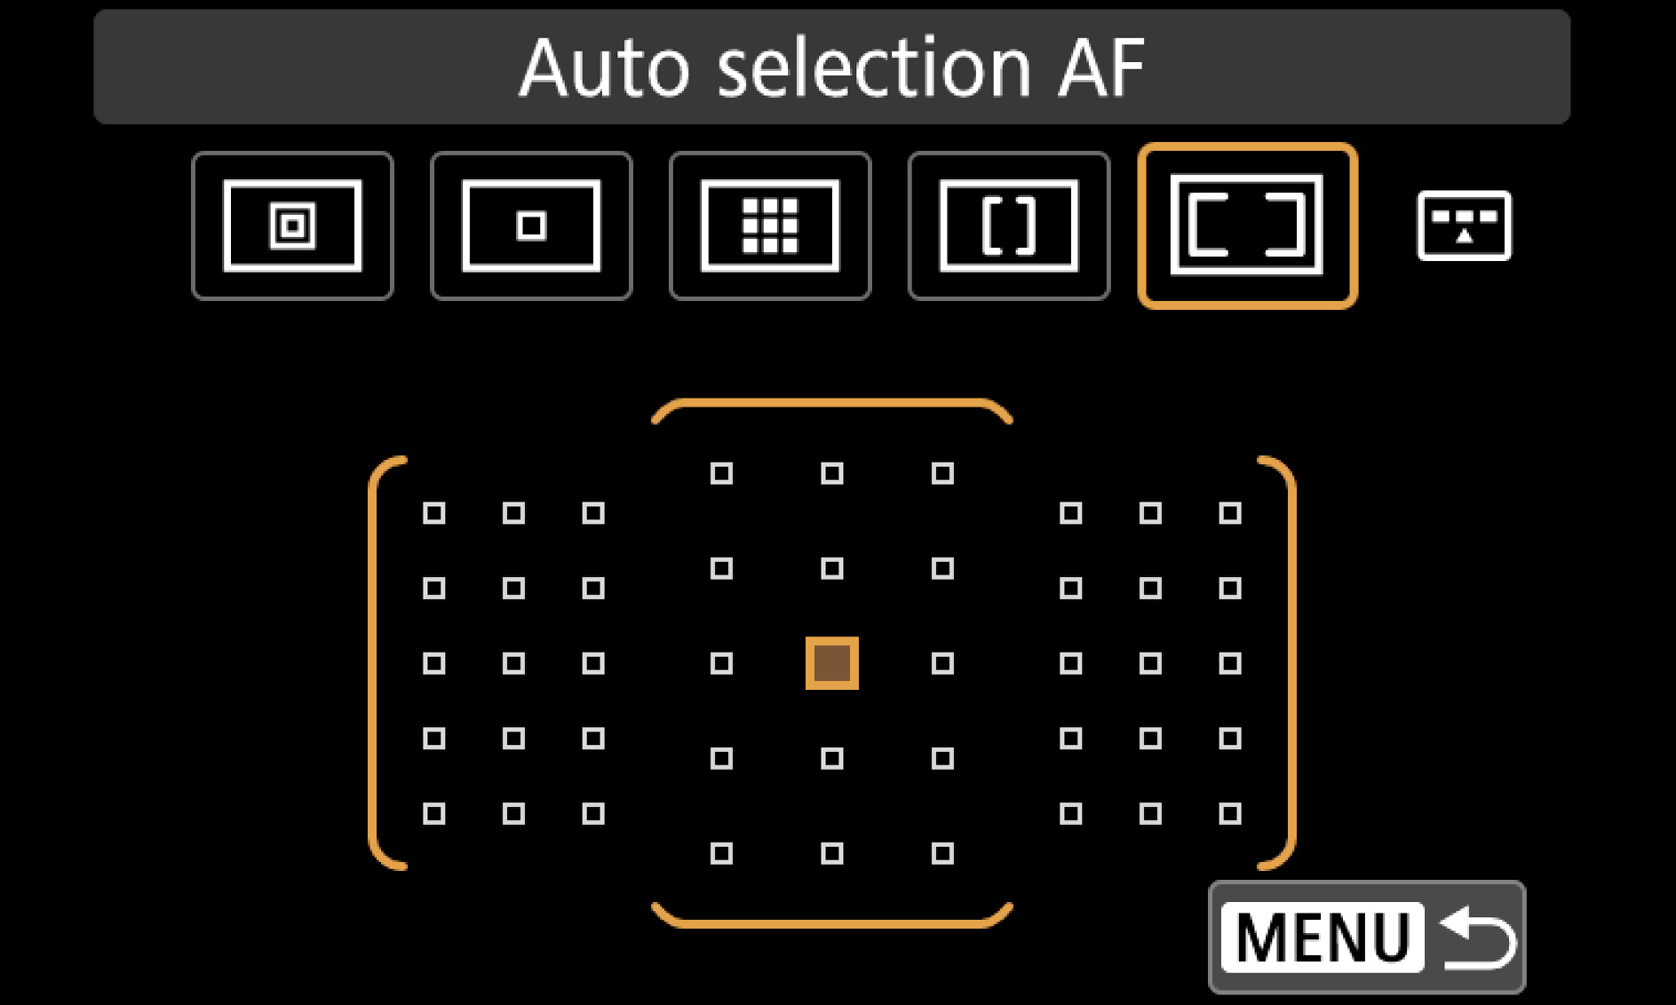
Focus
You can also set different focus point zones. In Viewfinder mode:
Spot
1-point
Zone
Large Zone
Auto Selection area
In Live View mode:
Face Tracking
Spot
1-point
Zone

Slide 17
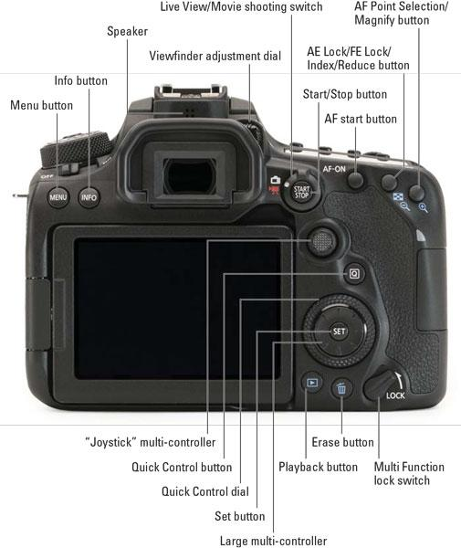
Focus
After capturing a photo or video, review it instantly using the Playback Button. Use the Magnify Button to ensure that your photo is in focus. Crisp focus is essential to creating a compelling image!
Always check your focus!!

Slide 18
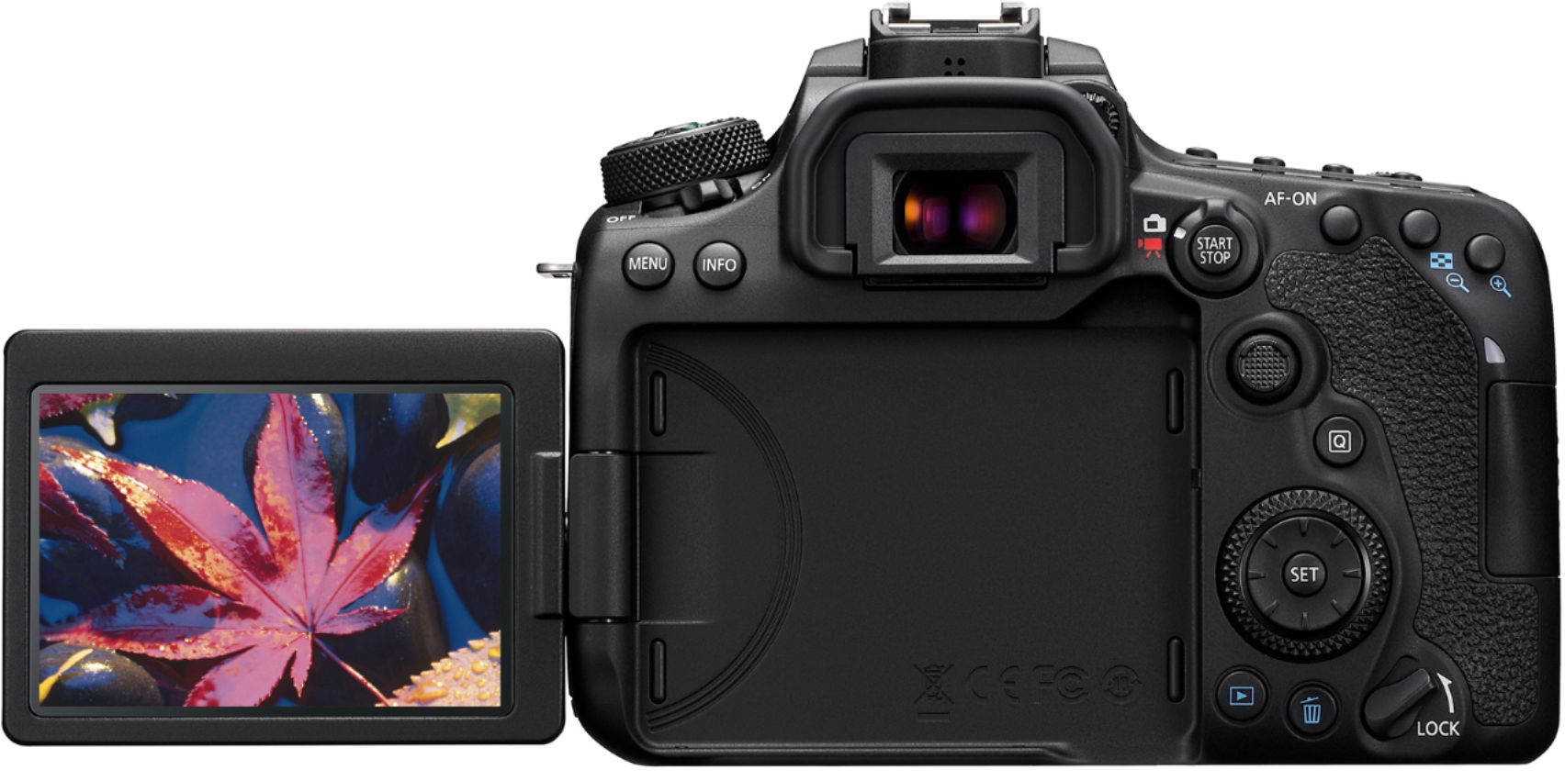
Photo vs. Video Mode
Toggle between photo and video capture modes.
In video mode you will always be looking at the LCD screen to see your framing and settings.
Set your camera to record FHD (full HD) 1920x1080p at 23.98fps.
**You always want to confirm your settings BEFORE you begin your shoot!!

Slide 19
Gear Care
Check that you have all the parts and that there is no damage when you pick up equipment!
Don’t leave the lens or lens cap off when you don’t need to have it off.
Don’t leave the gear unattended, in your car, or out in public.
Don’t expose the camera to extreme elements - cold, heat, rain, etc.

Slide 20
Sequences - Scenes - Shots
Films are made up of SEQUENCES
Sequences are made of SCENES
Scenes are made of SHOTS
There are 50+ types of shots and angles to explore
Together, these tell the story. You need to understand how these work together.

Slide 21
Types of “Shots” in Visual Storytelling
Filmmaking techniques engage audiences, tell stories, and evoke emotions.
One of the fundamental elements of filmmaking is shot composition.
Creates visually compelling narratives and convey specific messages effectively.
Notes:
Filmmaking is a visual medium that relies on various techniques to engage audiences, tell stories, and evoke emotions. One of the fundamental elements of filmmaking is shot composition. Understanding the different shot types in film is crucial for filmmakers and enthusiasts alike, as it allows them to create visually compelling narratives and convey specific messages effectively. In this article, we will explore the significance of shot types in filmmaking and discuss various shot categories, their purposes, and how they contribute to the overall cinematic experience.
Why Shot Types Matter in Filmmaking
The Role of Shot Types in Visual Storytelling
Shot types play a pivotal role in visual storytelling. By selecting the appropriate shot for a scene, filmmakers can convey information, establish atmosphere, and guide the viewer's attention. Each shot type has its own unique characteristics, framing, and perspective, enabling filmmakers to express their creative vision and communicate with the audience on multiple levels

Slide 22
Types of “Shots” in Visual Storytelling
Types of Camera Shot Sizes
Extreme Wide Shot (ELS)
Long Shot (LS) / Wide Shot (WS)
Full Shot (FS)
Medium Long Shot (MLS) / Medium Wide Shot (MWS)
Cowboy Shot
Medium Shot (MS)
Medium Close Up (MCU)
Close Up (CU)
Extreme Close Up (ECU)
Establishing Shot
Notes:
Filmmaking is a visual medium that relies on various techniques to engage audiences, tell stories, and evoke emotions. One of the fundamental elements of filmmaking is shot composition. Understanding the different shot types in film is crucial for filmmakers and enthusiasts alike, as it allows them to create visually compelling narratives and convey specific messages effectively. In this article, we will explore the significance of shot types in filmmaking and discuss various shot categories, their purposes, and how they contribute to the overall cinematic experience.
Why Shot Types Matter in Filmmaking
The Role of Shot Types in Visual Storytelling
Shot types play a pivotal role in visual storytelling. By selecting the appropriate shot for a scene, filmmakers can convey information, establish atmosphere, and guide the viewer's attention. Each shot type has its own unique characteristics, framing, and perspective, enabling filmmakers to express their creative vision and communicate with the audience on multiple levels

Slide 23
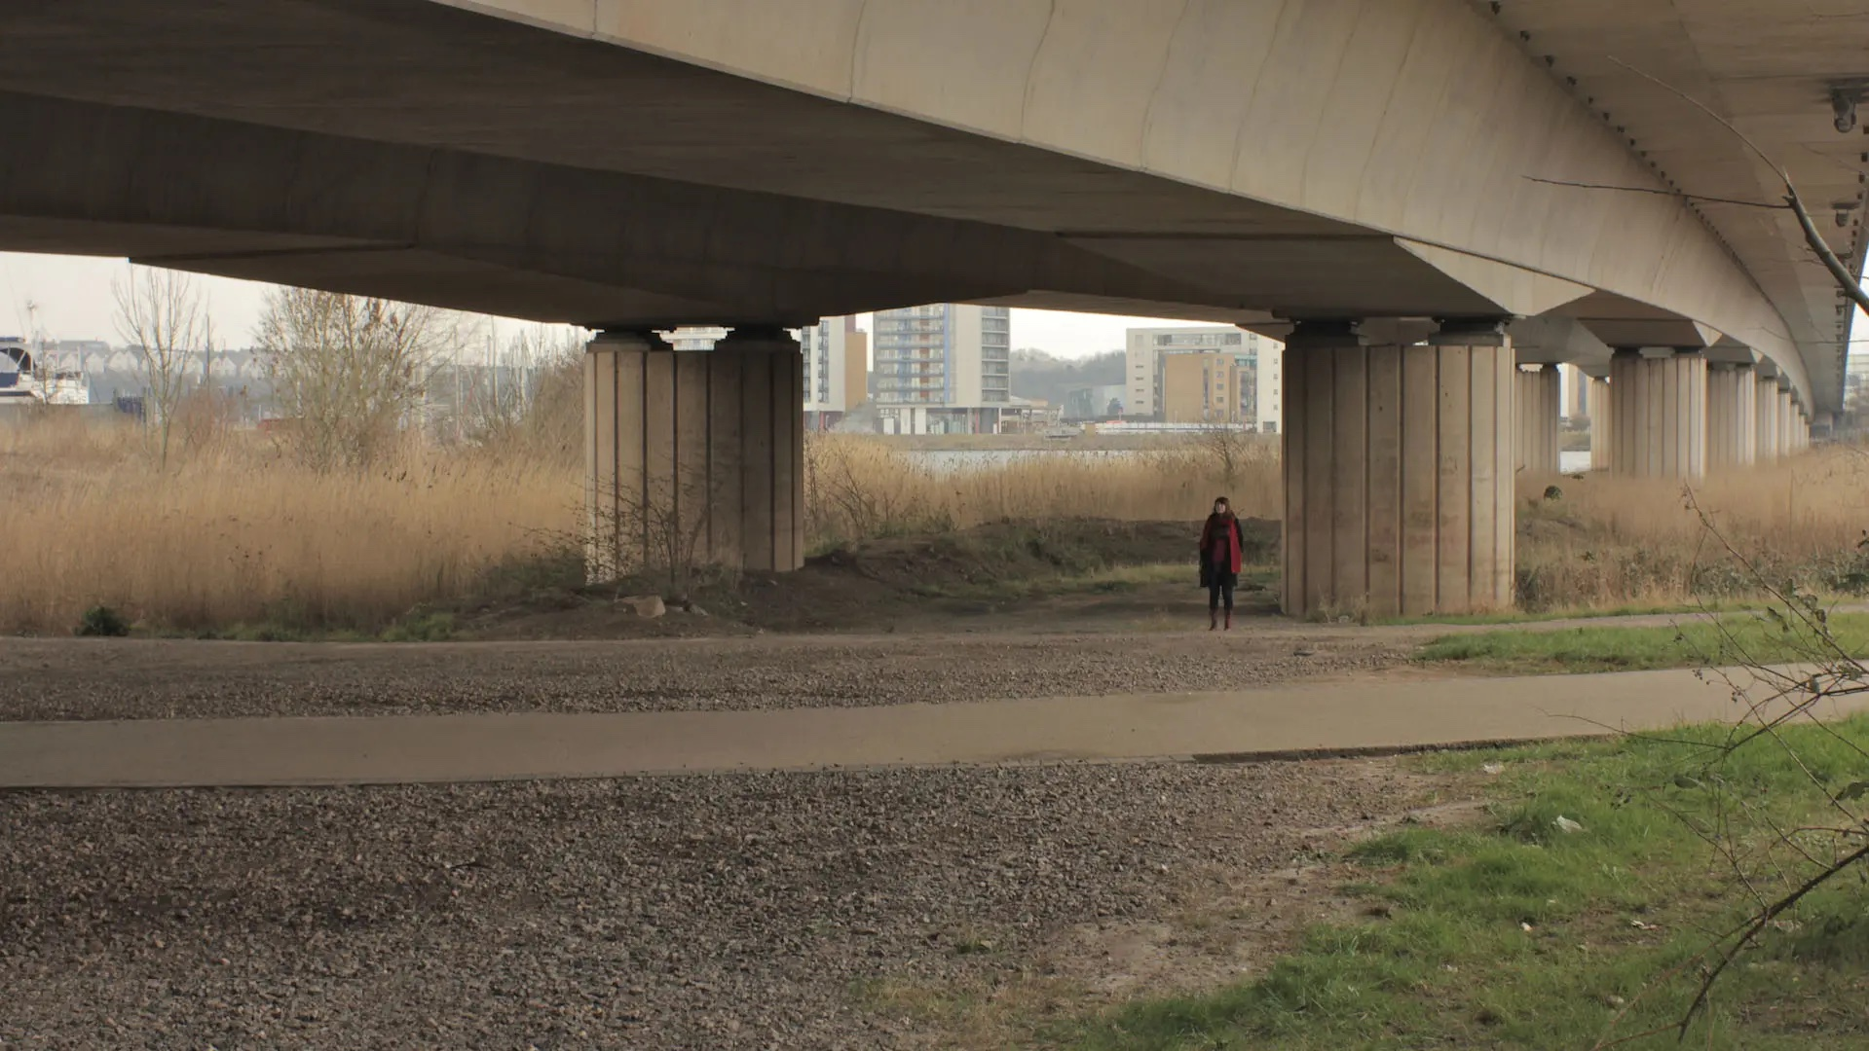
Wide Shot
Extreme long shots or wide shots mainly show the setting: if they include people, they’ll be very small. These are used as establishing shots at the beginning of a film or a sequence to show where the scene is set.
Notes:
Filmmaking is a visual medium that relies on various techniques to engage audiences, tell stories, and evoke emotions. One of the fundamental elements of filmmaking is shot composition. Understanding the different shot types in film is crucial for filmmakers and enthusiasts alike, as it allows them to create visually compelling narratives and convey specific messages effectively. In this article, we will explore the significance of shot types in filmmaking and discuss various shot categories, their purposes, and how they contribute to the overall cinematic experience.
Why Shot Types Matter in Filmmaking
The Role of Shot Types in Visual Storytelling
Shot types play a pivotal role in visual storytelling. By selecting the appropriate shot for a scene, filmmakers can convey information, establish atmosphere, and guide the viewer's attention. Each shot type has its own unique characteristics, framing, and perspective, enabling filmmakers to express their creative vision and communicate with the audience on multiple levels

Slide 24
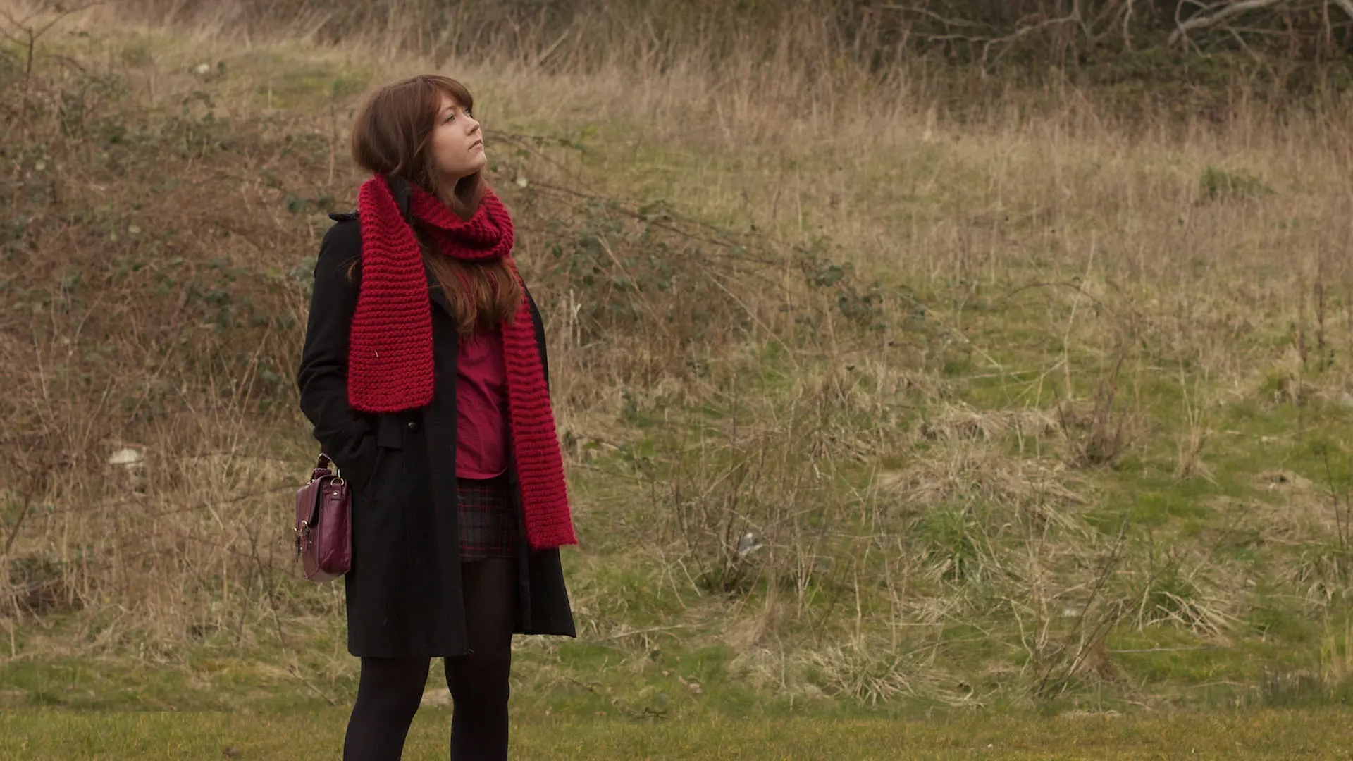
Medium Long Shot
Medium long shots are closer, sometimes called three-quarter shots because that’s how much of the body they show.
Notes:
Introducing people
To show people in the setting, you need to get closer.

Slide 25
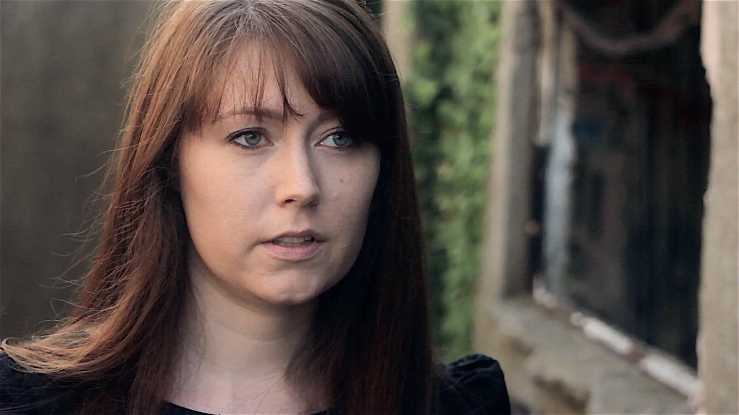
Close Up Shot
A standard closeup shows the head and maybe a bit of the shoulders.
Notes:
Using closeups
Don’t make the mistake of shooting the whole film with just mid or long shots: take the time and trouble to use closeups as well. This will give it more impact and help your viewers to understand the story.

Slide 26
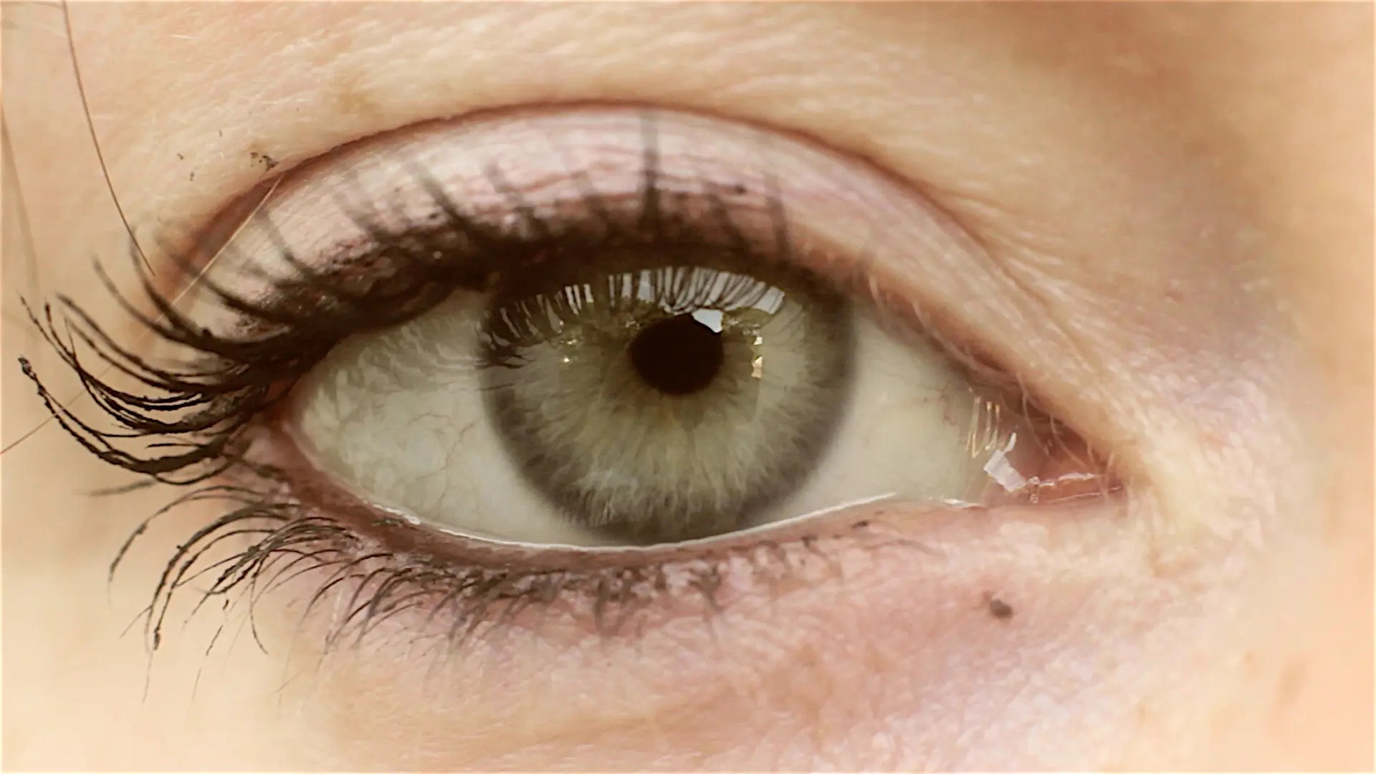
Extreme Close Up Shot
Extreme closeups show part of somebody’s face like the eyes or the mouth
Notes:
You can even use extreme closeups, which just show part of somebody’s face like the eyes or the mouth.
For an emotional scene, try starting with fairly loose framing (maybe mid shots) and then use bigger and bigger closeups to build up the intensity.
You can also use closeups of things, to show patterns and details.

Slide 27
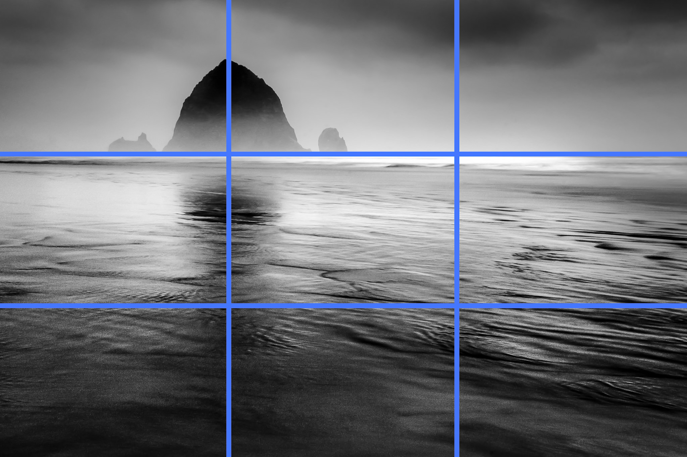
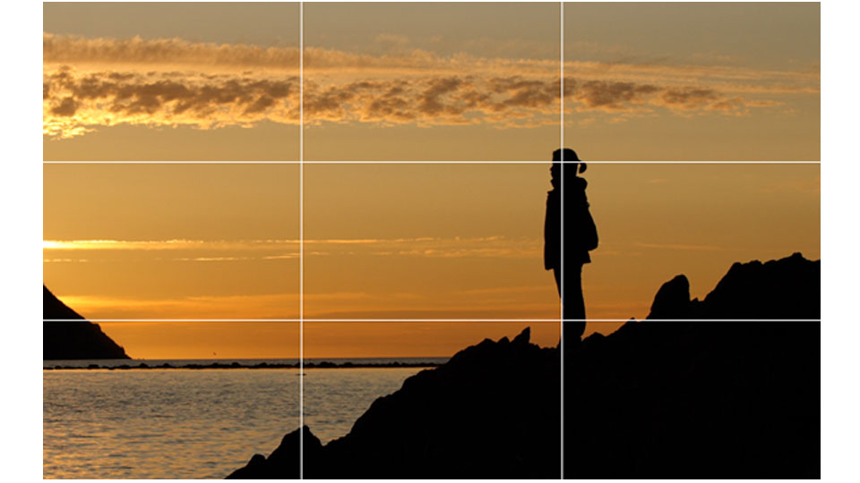
REVIEW: remember the “Rule of Thirds”

Slide 28
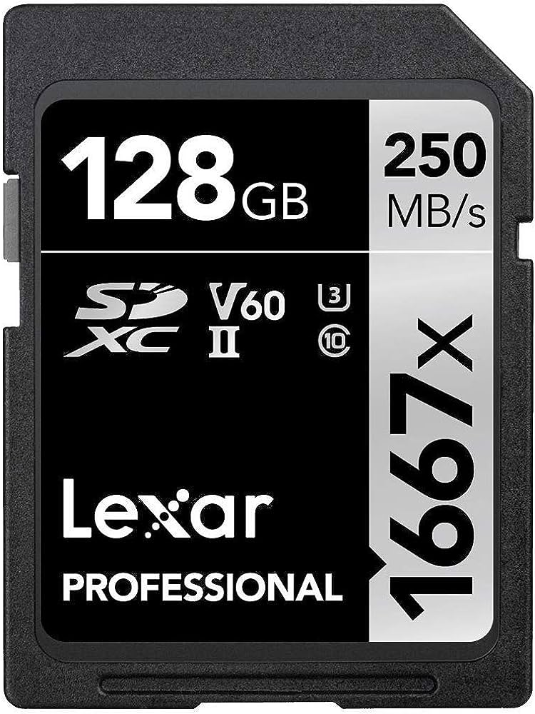
Saving your photos
Your photos are recorded onto the SD Cards. For recording video, you must use a 10-speed or greater SD card (provided).
Eject your SD Card
Insert the SD Card into the Card Reader / laptop.
If you don’t have a Card Reader in your laptop, connect the Card Reader via the USB cable.
The Card will mount as a drive in your finder (MAC) / file explorer (PC)
Create a local folder on your computer.
Copy the images from the SD Card to your local folder.
**REMINDER: always have at least two backups of all digital files!!

